Slide 1
baseline:
2024_nips_LLM-ESR_Large Language Models Enhancement for Long-tailed Sequential Recommendation
相关论文：
2025_NeurIPS_SRA-CL_Semantic Retrieval Augmented Contrastive Learning for Sequential Recommendation（盛聪的baseline）
2026_WWW_SAGE: Global Semantic Alignment with LLMs for Long-Tail Sequential Recommendation

Slide 2
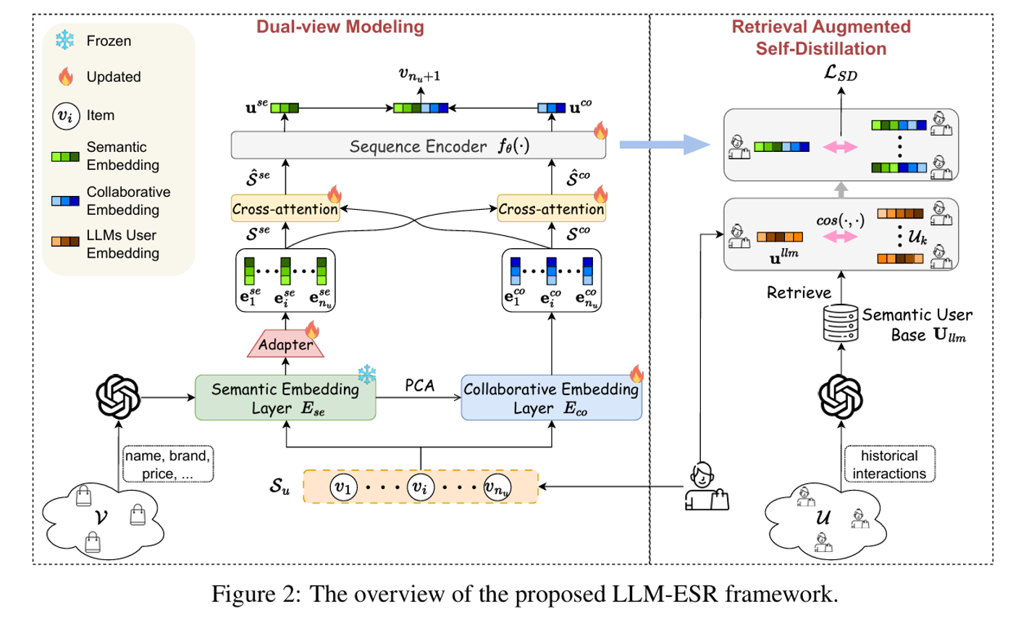
2024_nips_LLM-ESR_Large Language Models Enhancement for Long-tailed Sequential Recommendation

Slide 3
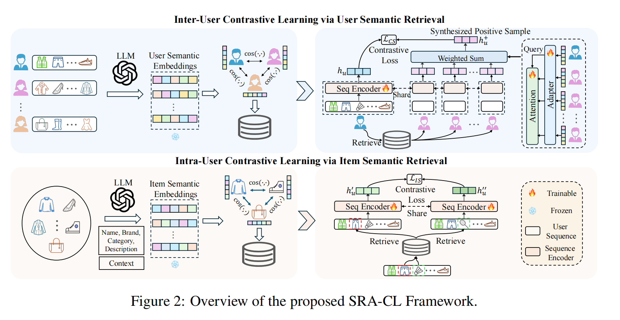
2025_NeurIPS_SRA‑CL_Semantic Retrieval Augmented Contrastive Learning for Sequential Recommendation

Slide 4




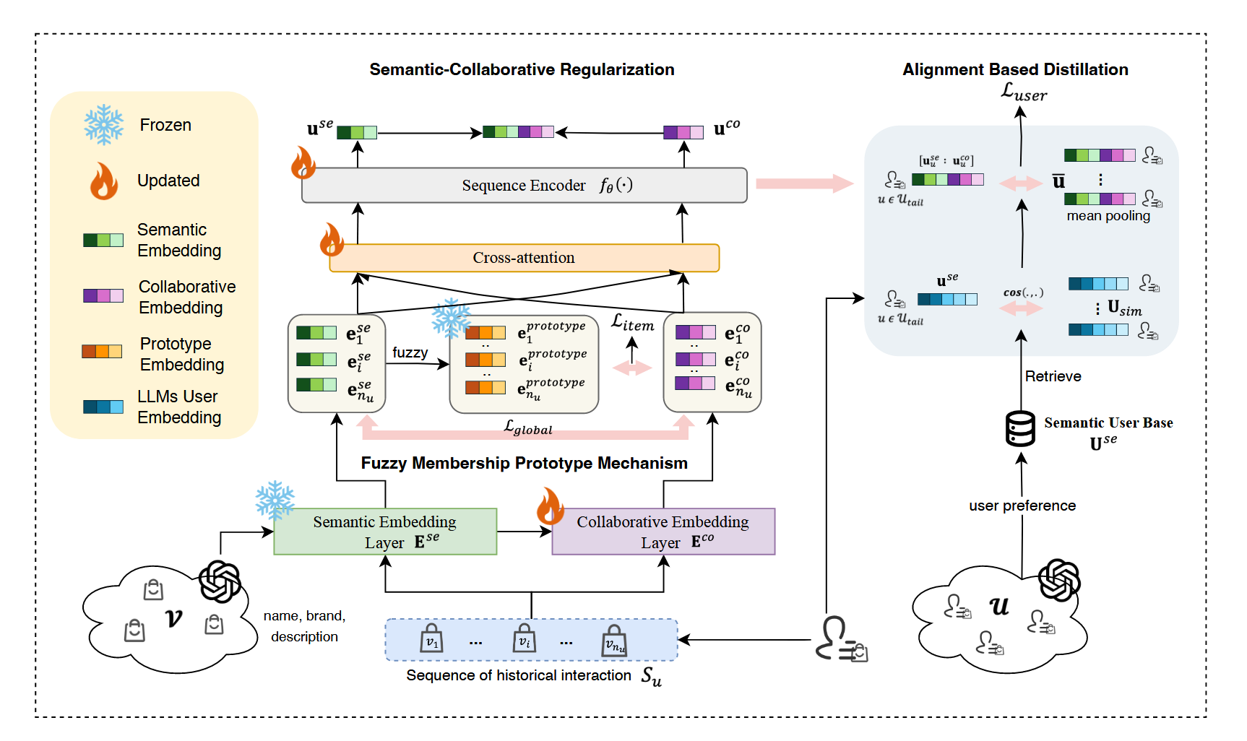
ATAI
Advanced Technique of Artificial Intelligence
ATAI
ChongqingUniversity _{AdvancedTechniqueof}
of Technology Artificial Intelligence
Chongqing University of
Technology
Chongqing University ^{ATAI}
_{of Technology} Advanced Techniqueof
Artificial Intelligence
Chongqing University of Technology
Chongqing University of Technology
2026_WWW_SAGE: Global Semantic Alignment with LLMs for Long-Tail Sequential Recommendation

