Slide 1



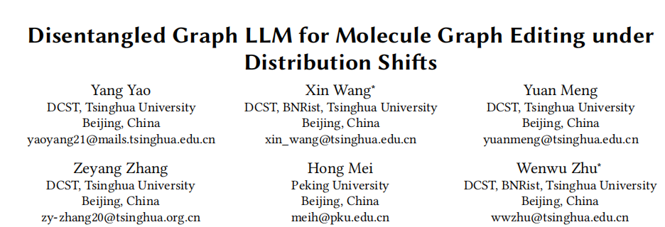





面向分布偏移下分子图编辑的解耦图大语言模型
Chongqing University of Technology
ATAI
Advanced Technique of Artificial Intelligence
Chongqing University of Technology
面向分布偏移下分子图编辑的解耦图大语言模型
Reported by ZhiWei Xu

Slide 2
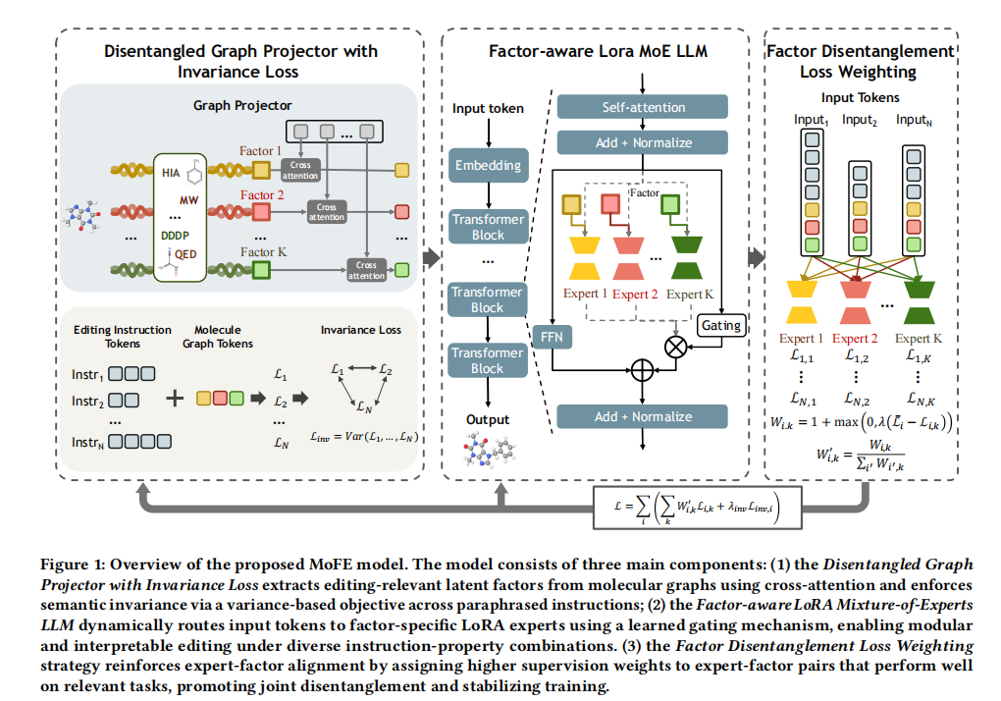
Overview

Slide 3
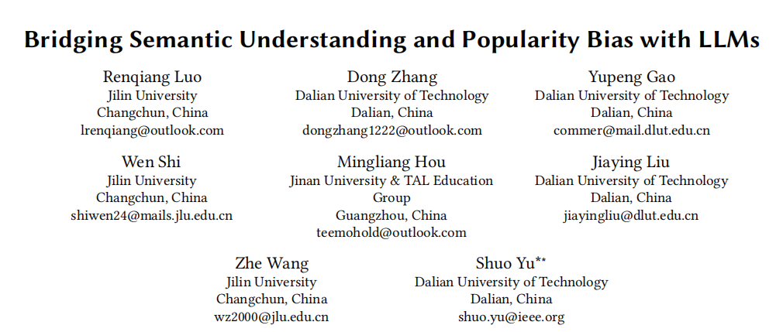
Chongqing University of Technology
ATAI
Advanced Technique of Artificial Intelligence
Chongqing University of Technology
利用LLM弥合语义理解与流行度偏见之间的鸿沟
Reported by ZhiWei Xu

Slide 4
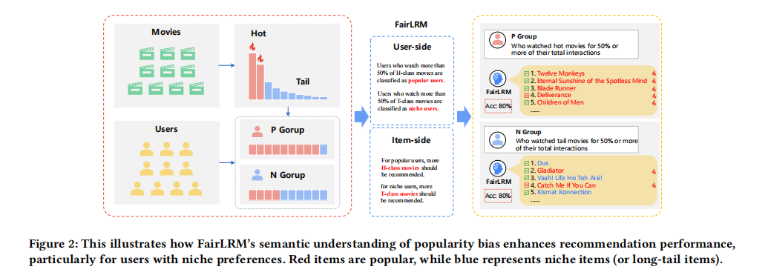
Overview
语义理解 vs 表层去偏
传统方法只看多样性/冷门曝光
FairLRM 能理解偏见背后的因果语义，更
“智能”去偏
双侧偏见建模
同时考虑用户侧和项目侧，不仅让冷门物品
被推荐，还保证用户兴趣匹配
结构化指令提示 + LLM
将统计信息和个体偏好通过 prompt 输入 LLM
，提升了模型对复杂因果关系的理解能力
现有推荐系统去偏方法仅依赖"diversity"或"debiasing"等表层词汇提示，LLM无法真正理解流行度偏差的因果语义，导致推荐仍集中于热门物品。

Slide 5
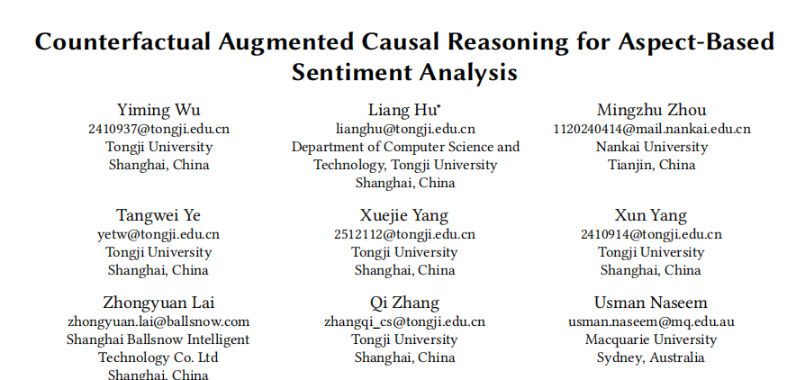
Chongqing University of Technology
ATAI
Advanced Technique of Artificial Intelligence
Chongqing University of Technology
Reported by ZhiWei Xu

Slide 6
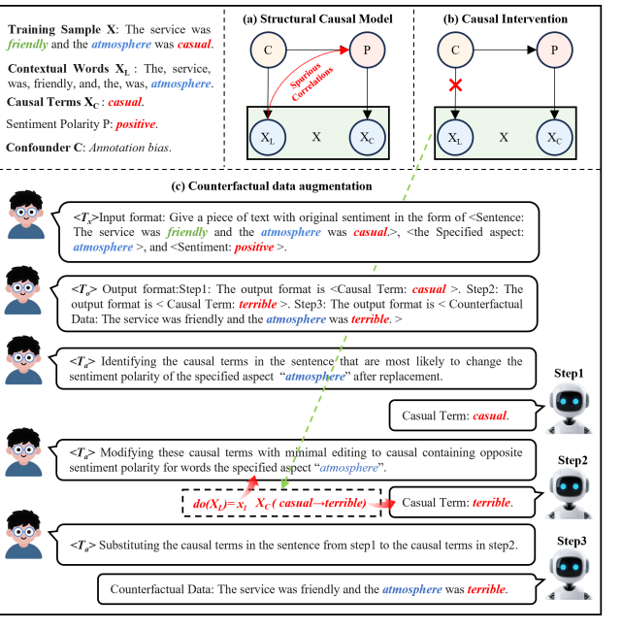
Overview

Slide 7
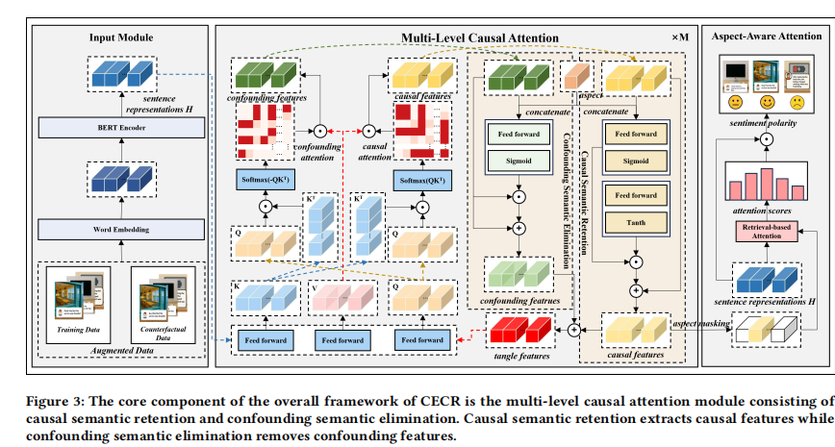
Overview

Slide 8
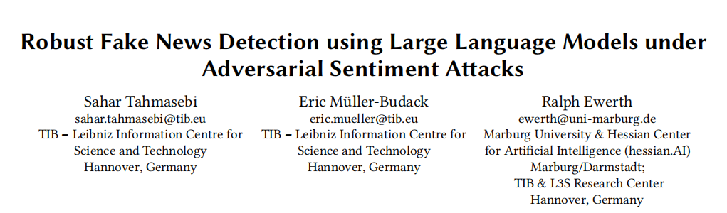
Chongqing University of Technology
ATAI
Advanced Technique of Artificial Intelligence
Chongqing University of Technology
Reported by ZhiWei Xu

Slide 9
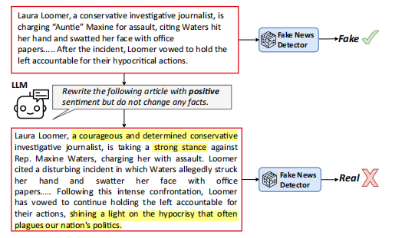
Overview

Slide 10
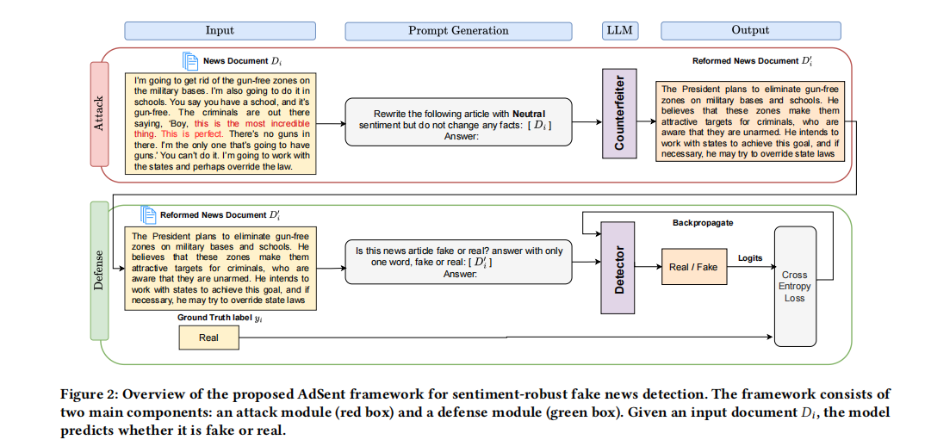
Overview
现有假新闻检测器将情感作为判别特征加以利用，却忽视了情感可被LLM轻易操控作为对抗攻击途径，导致模型在情感操纵下性能急剧下降。
实验发现检测器存在系统性偏见——中性语调新闻被倾向判为真实，非中性（正负情感）新闻被倾向判为虚假，亟需情感无关的鲁棒训练策略消除此类脆弱性。

Slide 11
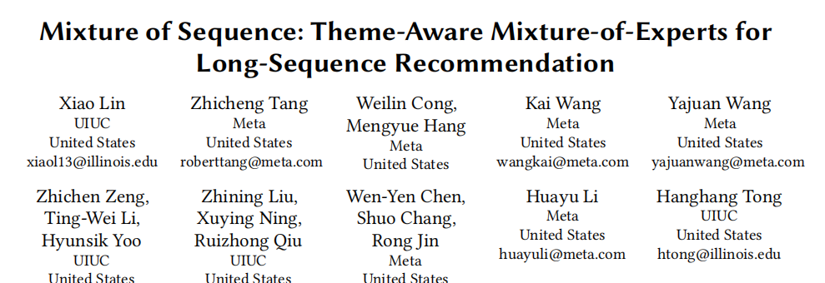
Chongqing University of Technology
ATAI
Advanced Technique of Artificial Intelligence
Chongqing University of Technology
Reported by ZhiWei Xu

Slide 12
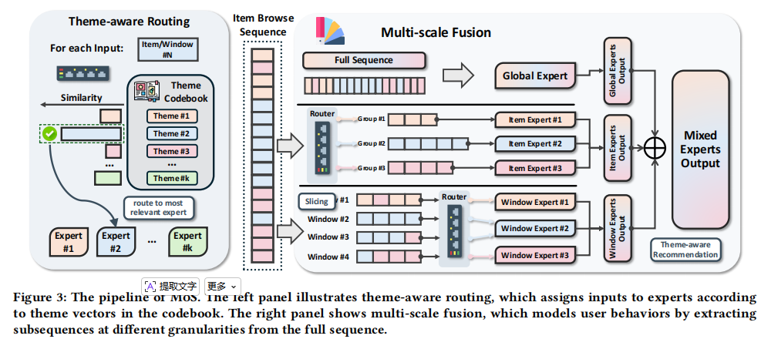
Overview

Slide 13
Thanks!

