Slide 1










ATAI
Advanced Techniqueof Artificial Intelligence
ATAI
ChongqingUniversity _{AdvancedTechniqueof}
of Technology Artificial Intelligence
Chongqing University of
Technology
Chongqing University ^{ATAI}
_{of Technology} Advanced Techniqueof
Artificial Intelligence
Chongqing University of Technology
Chongqing University of Technology
AlphaFree: Recommendation Free from Users, IDs, and GNNs
Code: https://github.com/minseojeonn/AlphaFree.
2026.3.15
—— WWW_2026
Reported by Yang Hu
1

Slide 2

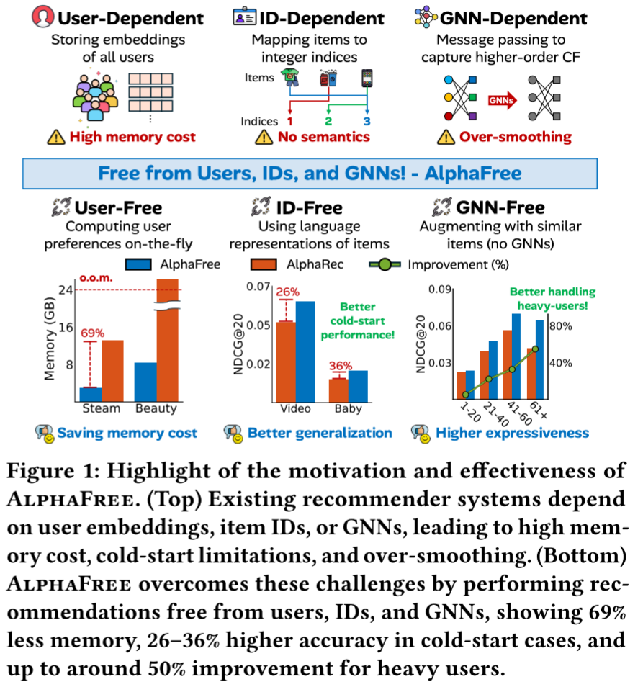
ATAI
AdvancedTechniqueof
Artificial Intelligence
ATAI
ChongqingUniversity _{AdvancedTechniqueof}
of Technology Artificial Intelligence
ChongqingUniversity of Technology
Motivation
(1) user-dependent methods: Although user embeddings encode individual preferences, they become unreliable when interactions are sparse or noisy, and their memory cost scales linearly with the number of users.
(2)ID-dependent methods rely on raw discrete identifiers (IDs) as the initial features of users and items. While simple and effective for seen entities,these representations lack semantic meaning and generalize poorly to unseen users or items.

Slide 3
ATAI
AdvancedTechniqueof
Artificial Intelligence
ATAI
ChongqingUniversity _{AdvancedTechniqueof}
of Technology Artificial Intelligence
ChongqingUniversity of Technology
Motivation
(3)GNN-dependent methods use GNNs to capture high-order collaborative signals from explicit graph structures(e.g., user–item graphs). However, they also need to preserve user embeddings (thus inherently user-dependent) as well as graphs,which leads to high memory usage, and their expressiveness is limited due to over-smoothing .

Slide 4

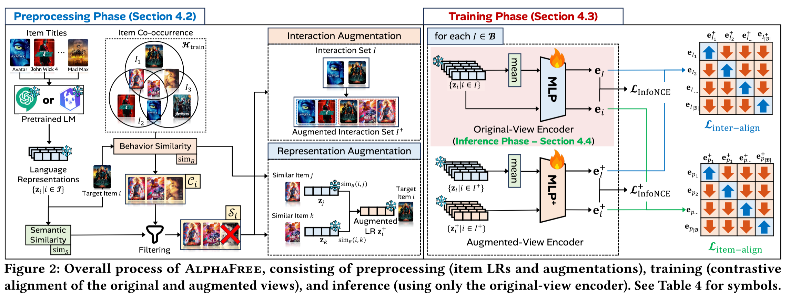
ChongqingUniversity of Technology
ATAI
AdvancedTechniqueof
Artificial Intelligence
ATAI
ChongqingUniversity _{AdvancedTechniqueof}
of Technology Artificial Intelligence
Overview

Slide 5
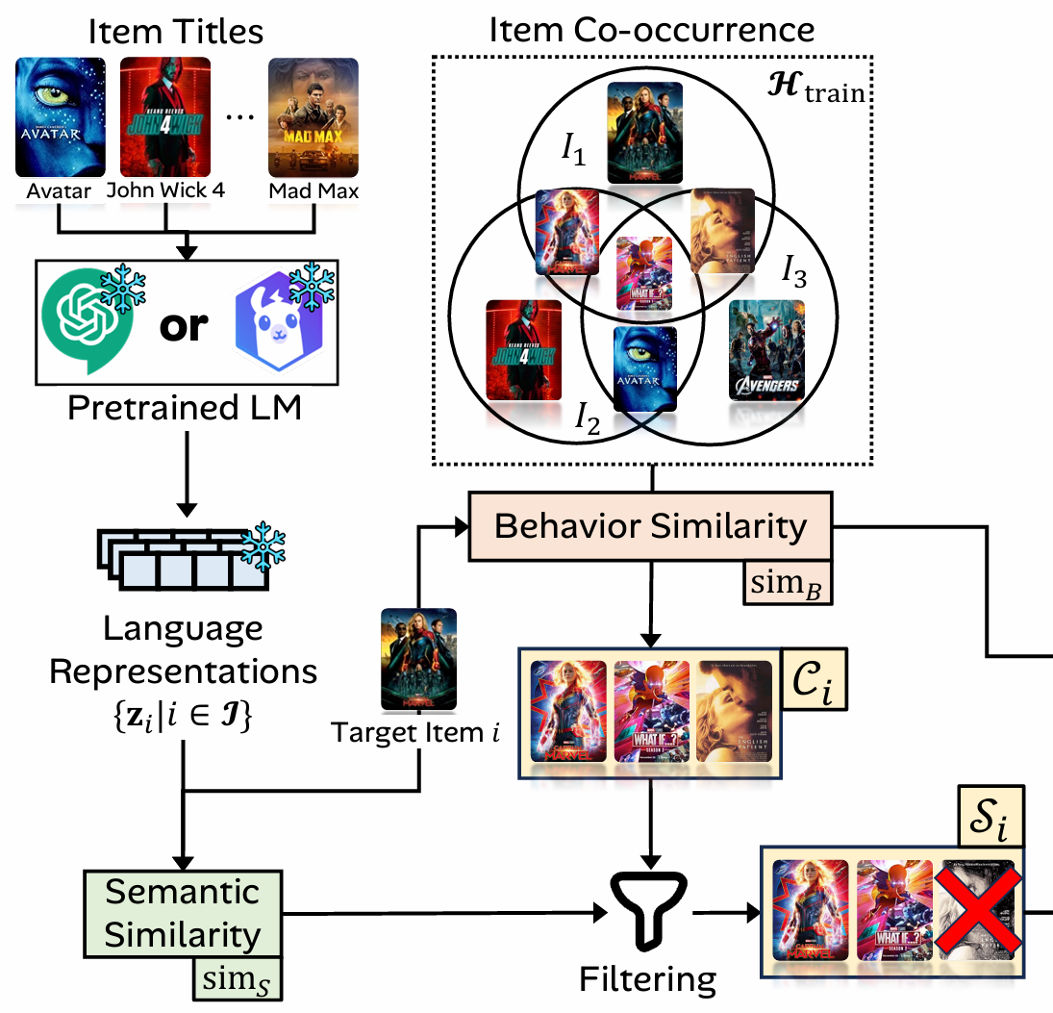
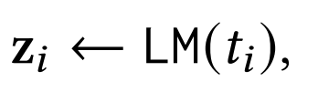
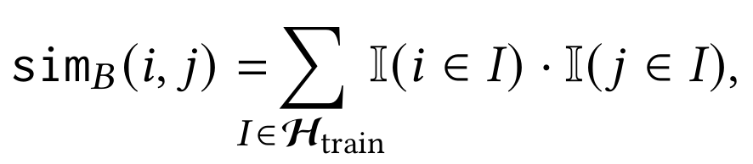
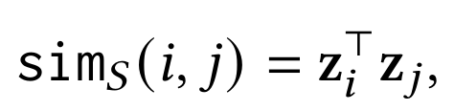
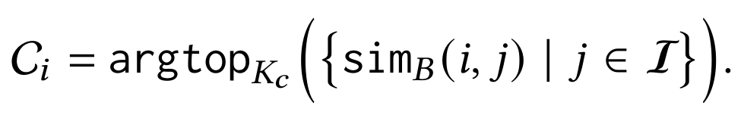
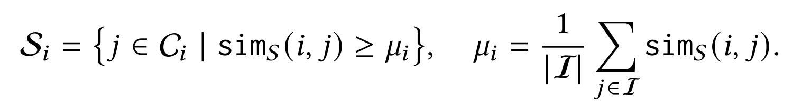
ChongqingUniversity of Technology
ATAI
AdvancedTechniqueof
Artificial Intelligence
ATAI
ChongqingUniversity _{AdvancedTechniqueof}
of Technology Artificial Intelligence
Method
(1)
(2)
(3)
(4)
(5)

Slide 6
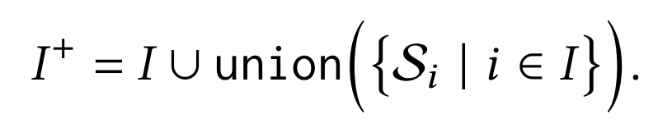
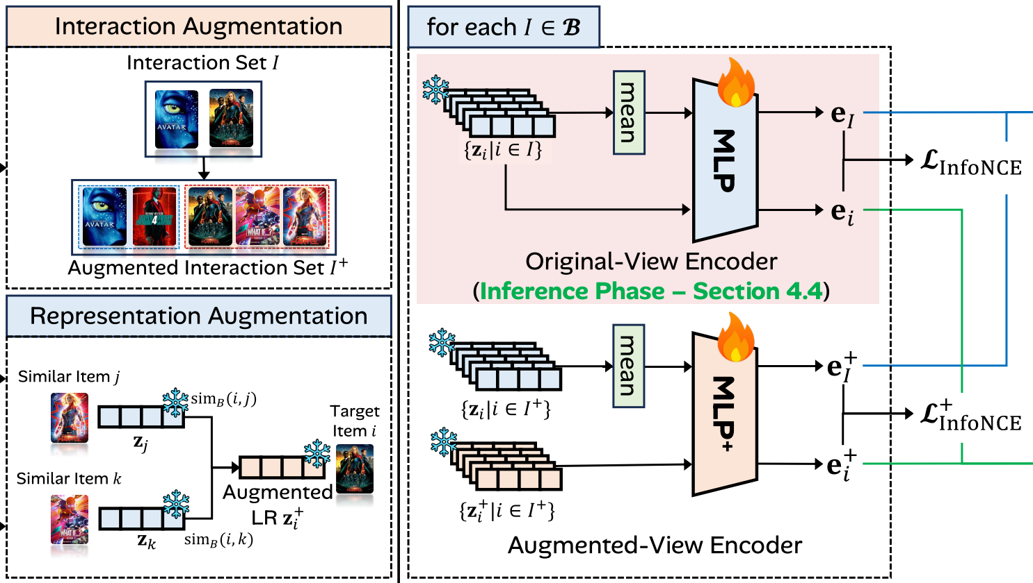
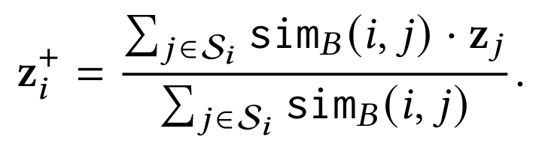
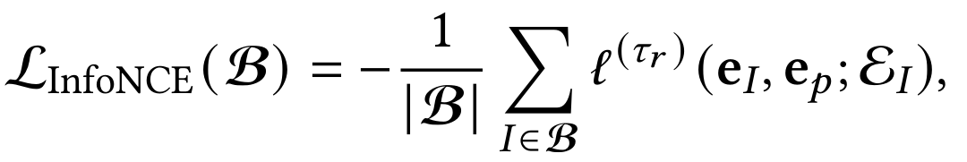
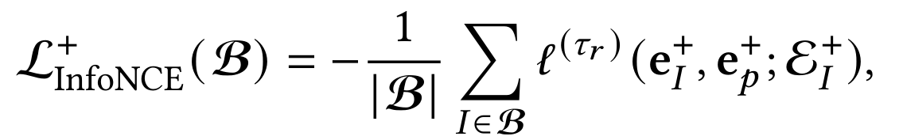
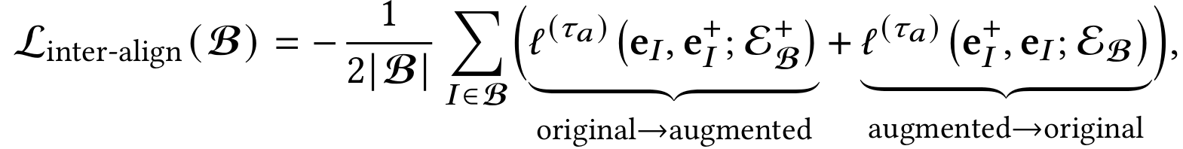
ChongqingUniversity of Technology
ATAI
AdvancedTechniqueof
Artificial Intelligence
ATAI
ChongqingUniversity _{AdvancedTechniqueof}
of Technology Artificial Intelligence
Method
(6)
(7)
(8)
(9)
(10)

Slide 7
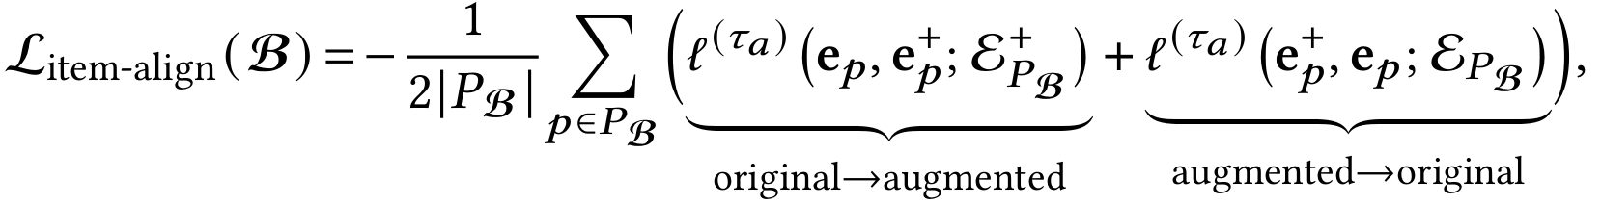
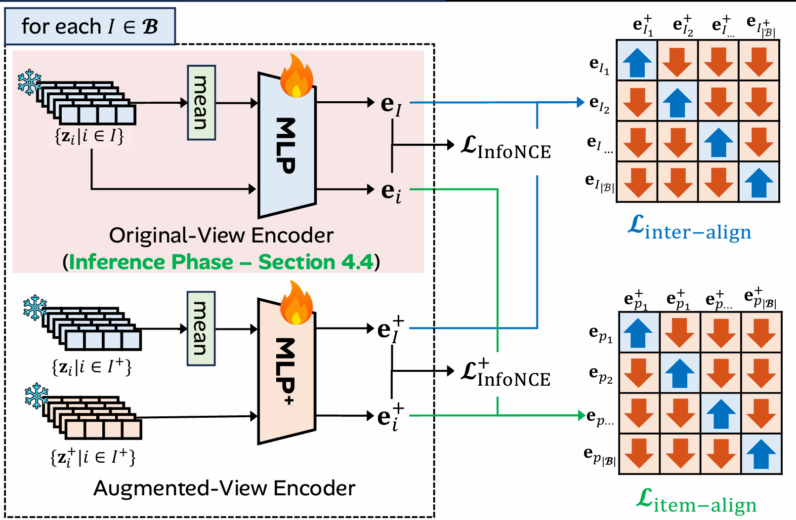
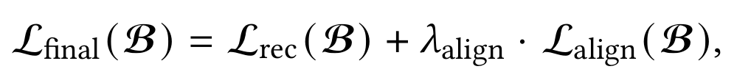
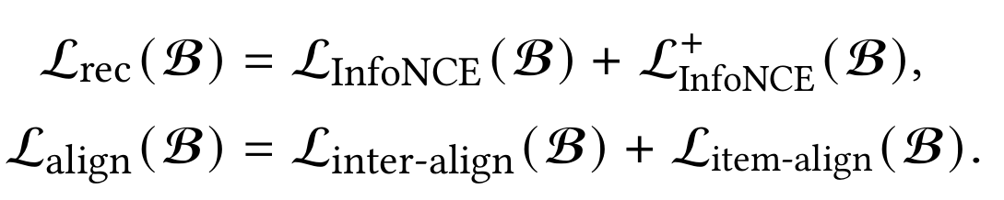
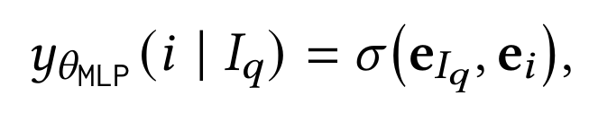
ChongqingUniversity of Technology
ATAI
AdvancedTechniqueof
Artificial Intelligence
ATAI
ChongqingUniversity _{AdvancedTechniqueof}
of Technology Artificial Intelligence
Method
(11)
(12)
(13)

Slide 8

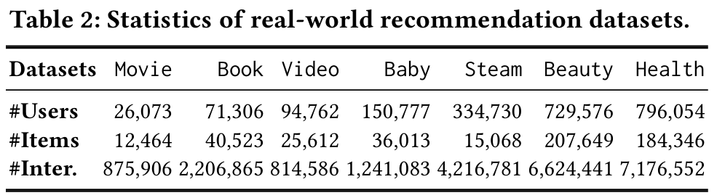
ATAI
AdvancedTechniqueof
Artificial Intelligence
ATAI
ChongqingUniversity _{AdvancedTechniqueof}
of Technology Artificial Intelligence
ChongqingUniversity of Technology
Experiments

Slide 9
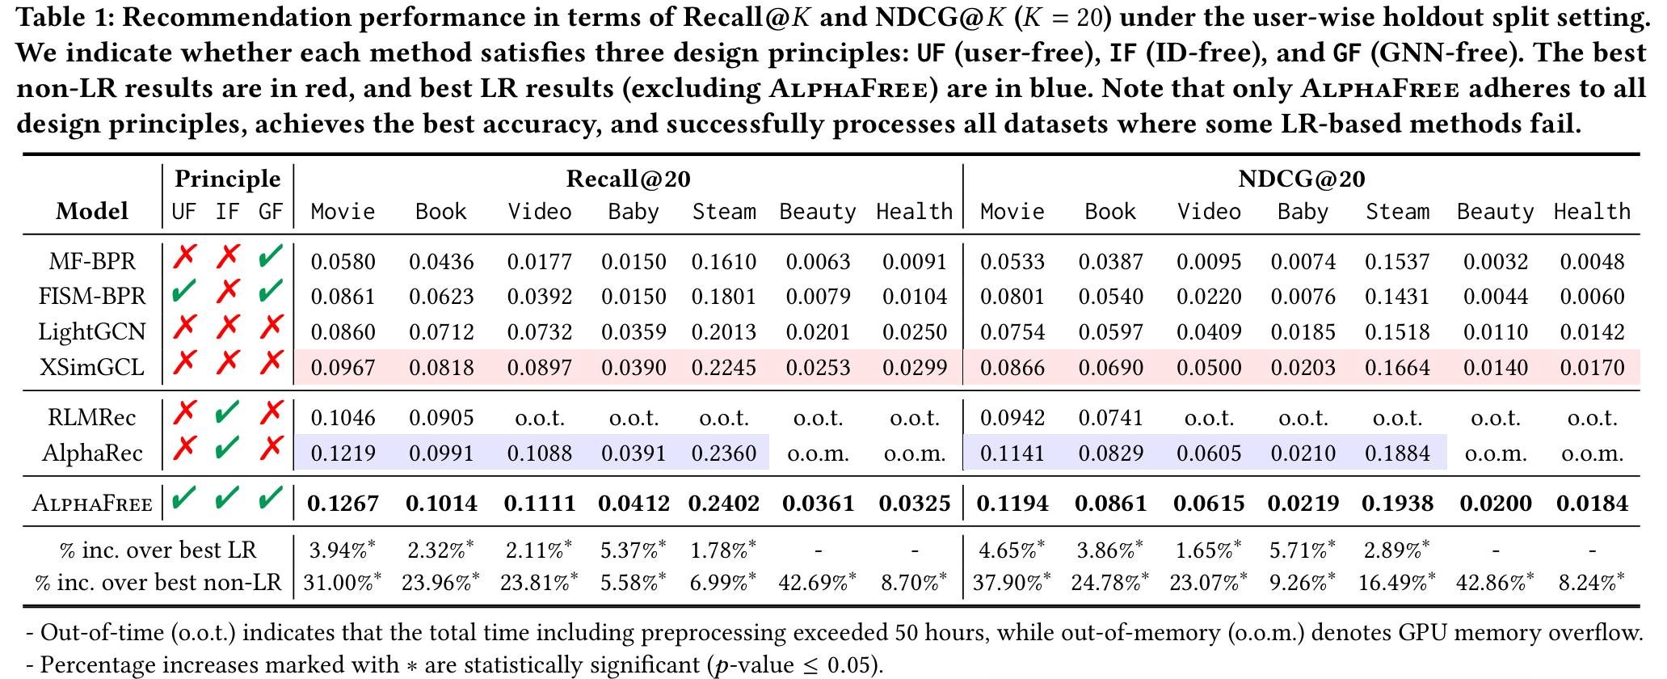
ATAI
AdvancedTechniqueof
Artificial Intelligence
ATAI
ChongqingUniversity _{AdvancedTechniqueof}
of Technology Artificial Intelligence
ChongqingUniversity of Technology
Experiments

Slide 10
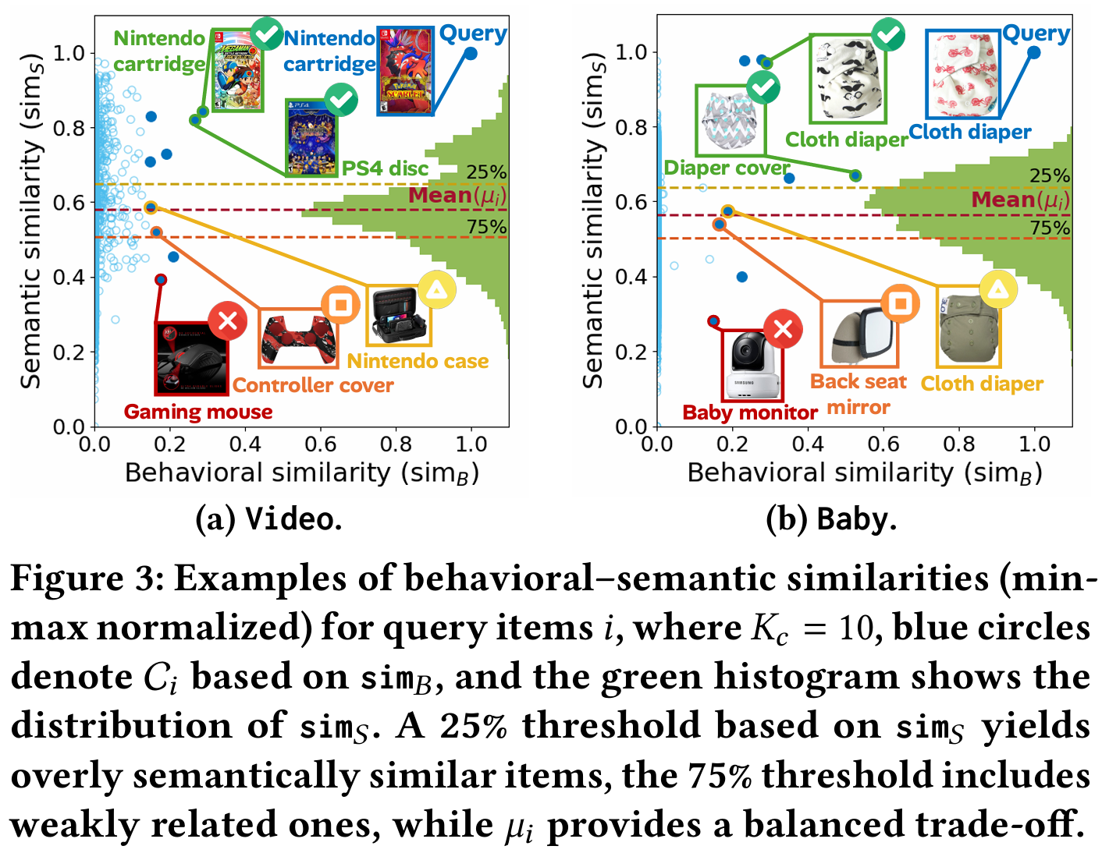
ATAI
AdvancedTechniqueof
Artificial Intelligence
ATAI
ChongqingUniversity _{AdvancedTechniqueof}
of Technology Artificial Intelligence
ChongqingUniversity of Technology
Experiments

Slide 11
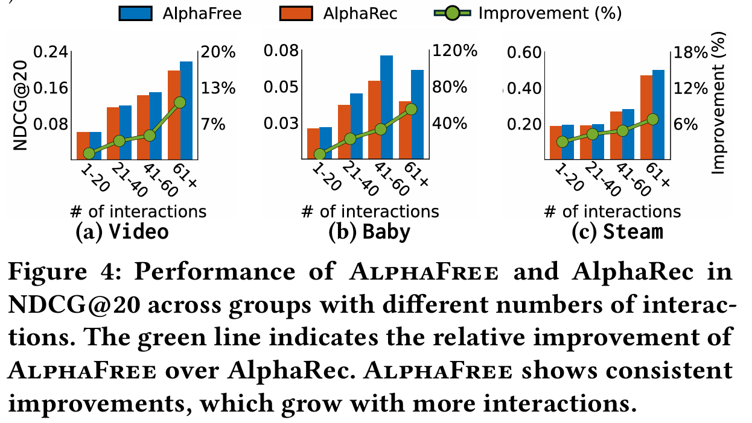
ATAI
AdvancedTechniqueof
Artificial Intelligence
ATAI
ChongqingUniversity _{AdvancedTechniqueof}
of Technology Artificial Intelligence
ChongqingUniversity of Technology
Experiments

Slide 12
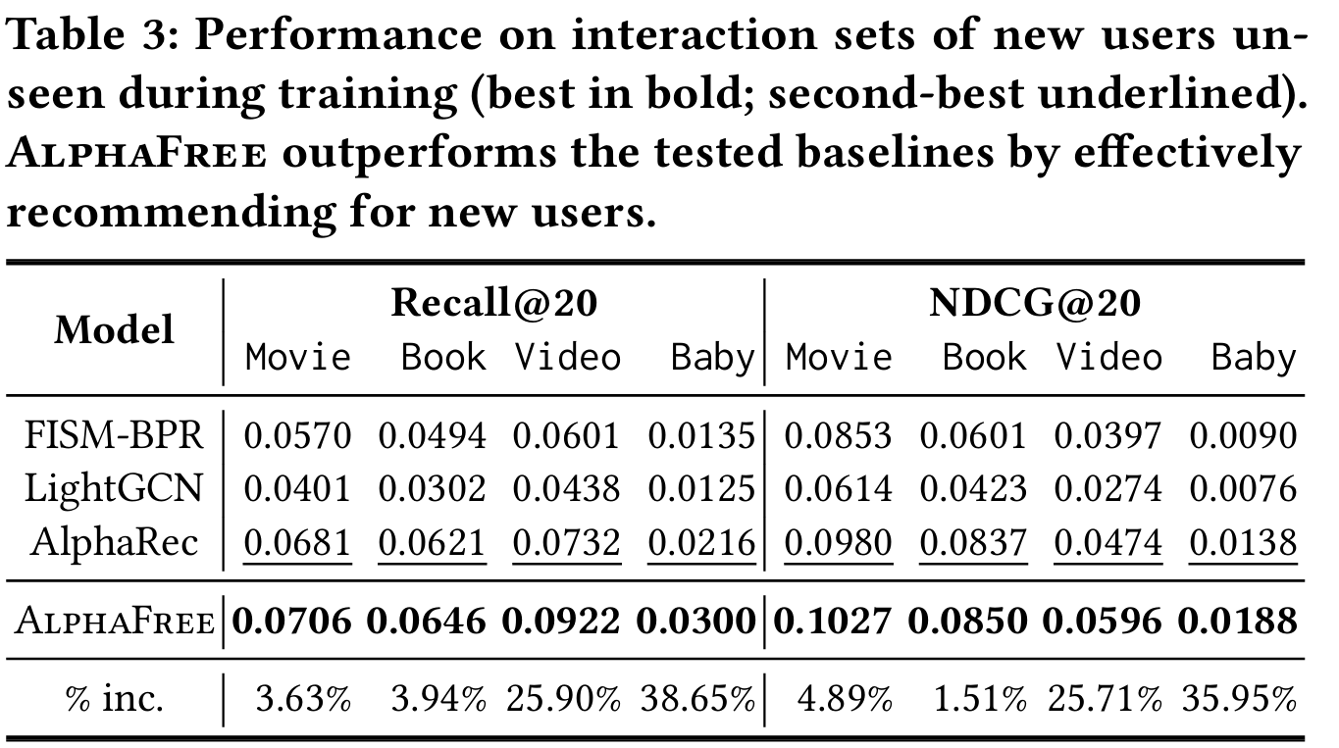
ATAI
AdvancedTechniqueof
Artificial Intelligence
ATAI
ChongqingUniversity _{AdvancedTechniqueof}
of Technology Artificial Intelligence
ChongqingUniversity of Technology
Experiments

Slide 13
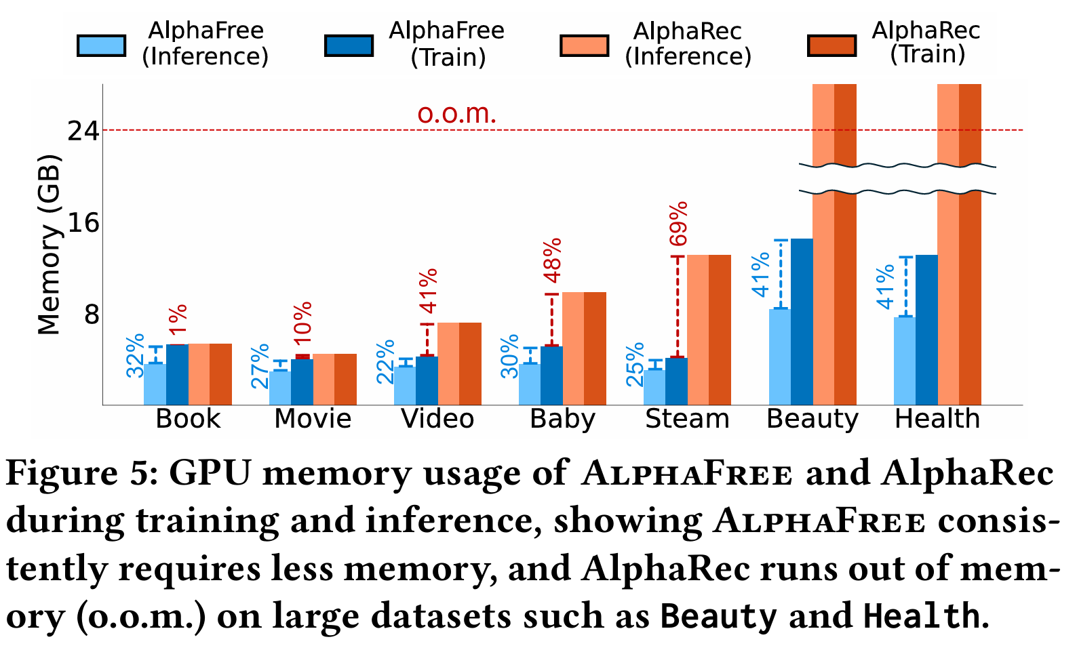
ATAI
AdvancedTechniqueof
Artificial Intelligence
ATAI
ChongqingUniversity _{AdvancedTechniqueof}
of Technology Artificial Intelligence
ChongqingUniversity of Technology
Experiments

Slide 14
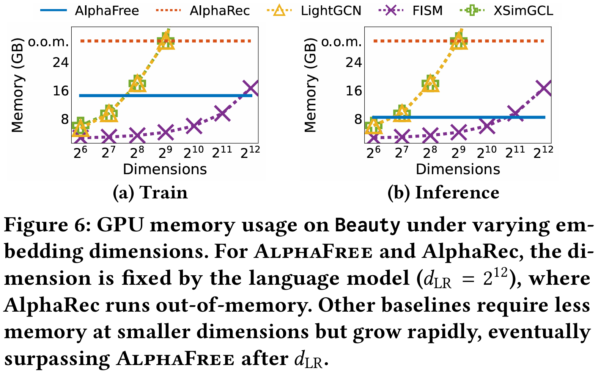
ATAI
AdvancedTechniqueof
Artificial Intelligence
ATAI
ChongqingUniversity _{AdvancedTechniqueof}
of Technology Artificial Intelligence
ChongqingUniversity of Technology
Experiments

Slide 15
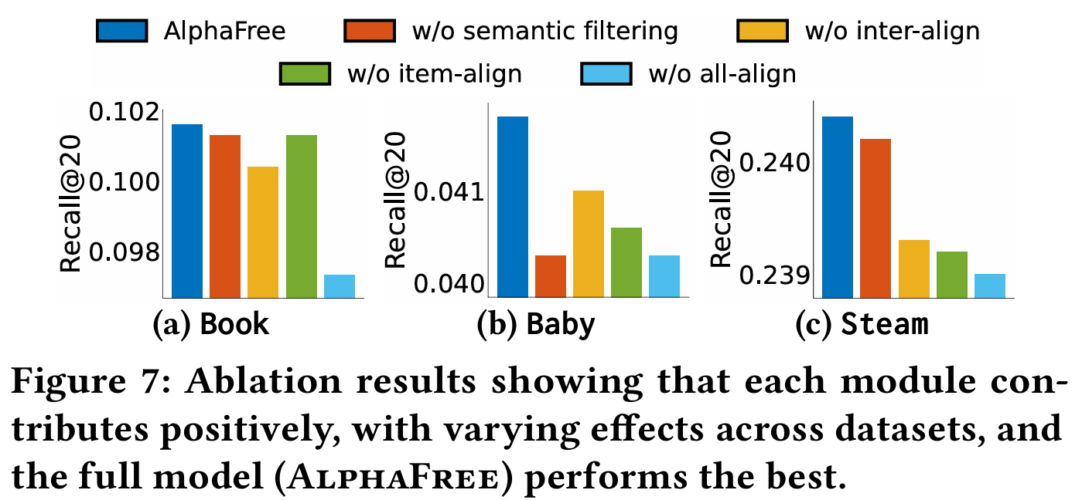
ATAI
AdvancedTechniqueof
Artificial Intelligence
ATAI
ChongqingUniversity _{AdvancedTechniqueof}
of Technology Artificial Intelligence
ChongqingUniversity of Technology
Experiments

Slide 16
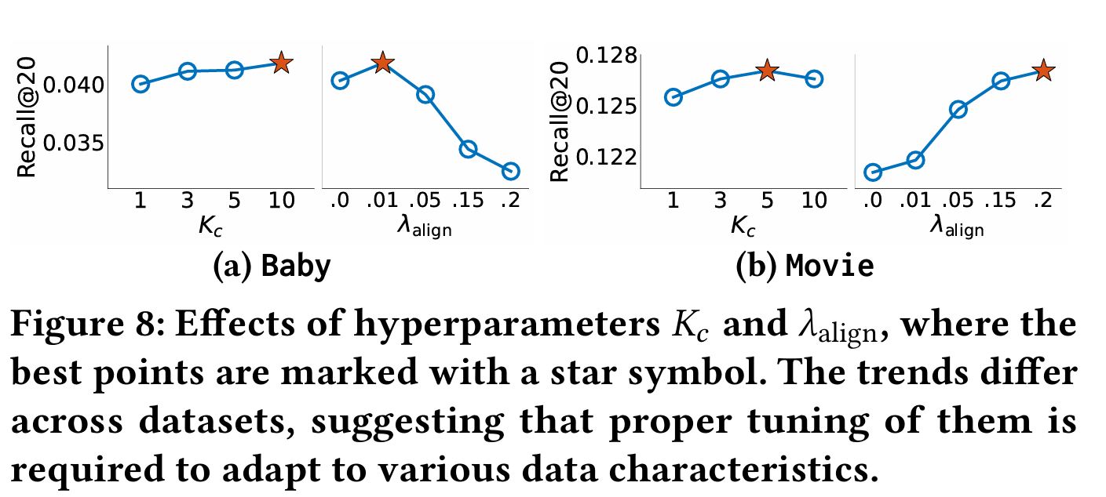
ATAI
AdvancedTechniqueof
Artificial Intelligence
ATAI
ChongqingUniversity _{AdvancedTechniqueof}
of Technology Artificial Intelligence
ChongqingUniversity of Technology
Experiments

Slide 17
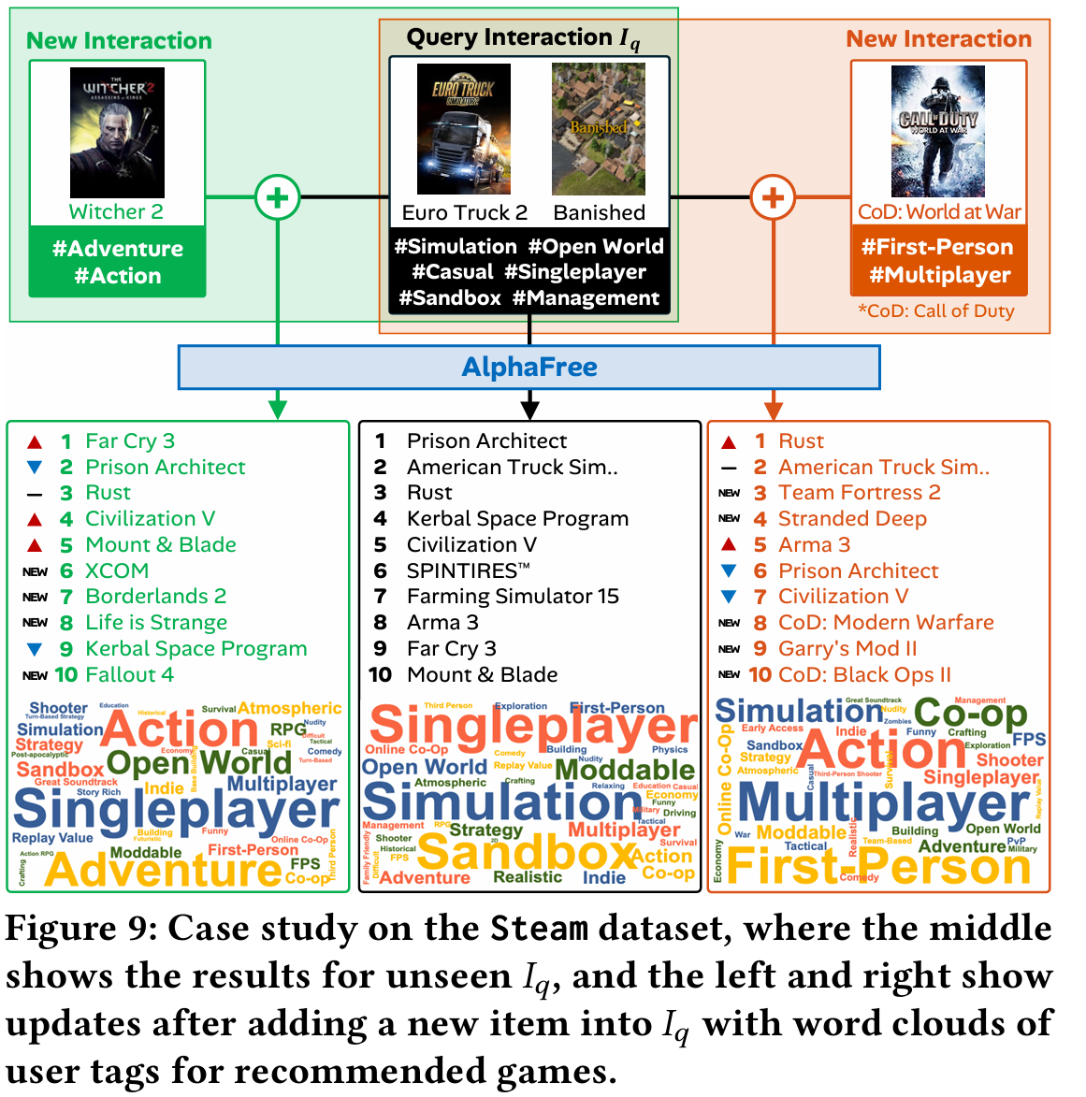
ATAI
AdvancedTechniqueof
Artificial Intelligence
ATAI
ChongqingUniversity _{AdvancedTechniqueof}
of Technology Artificial Intelligence
ChongqingUniversity of Technology
Experiments

Slide 18


ChongqingUniversity of Technology
ATAI
AdvancedTechniqueof
Artificial Intelligence
ATAI
ChongqingUniversity _{AdvancedTechniqueof}
of Technology Artificial Intelligence
Thanks!

