Slide 1
ATAI
Advanced Techniqueof Artificial Intelligence
ATAI
ChongqingUniversity _{AdvancedTechniqueof}
of Technology Artificial Intelligence
Chongqing University of
Technology
Chongqing University ^{ATAI}
_{of Technology} Advanced Techniqueof
Artificial Intelligence
Chongqing University of Technology
Chongqing University of Technology
Facet-Aware Multi-Head Mixture-of-Experts Model for Sequential
Recommendation
code: no
—— WSDM 2025
Reported by ZhenDong Huang
1

Slide 2
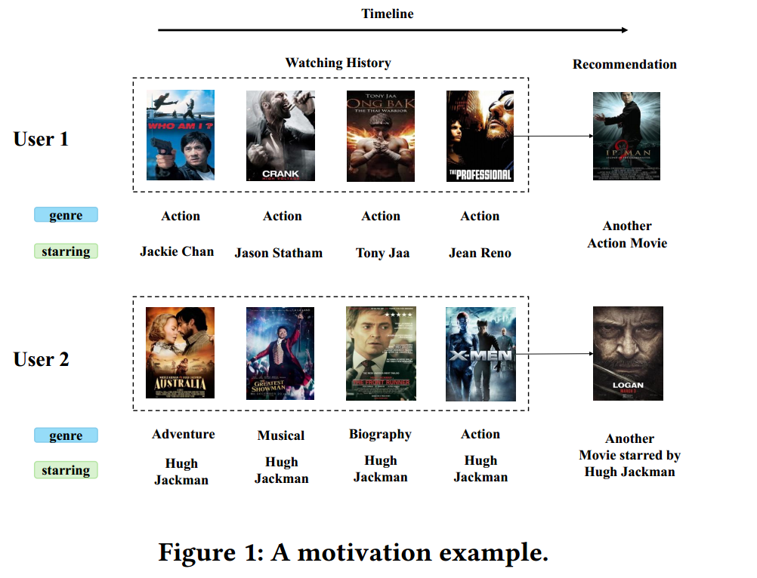
ATAI
AdvancedTechniqueof
Artificial Intelligence
ATAI
ChongqingUniversity _{AdvancedTechniqueof}
of Technology Artificial Intelligence
ChongqingUniversity of Technology
Motivation
1)a single embedding cannot well capture an item’s multifaceted nature . This is particularly problematic when different facets of an item can influence user intent.
2) in more realistic scenarios, users can have multiple preferences within a single facet.

Slide 3
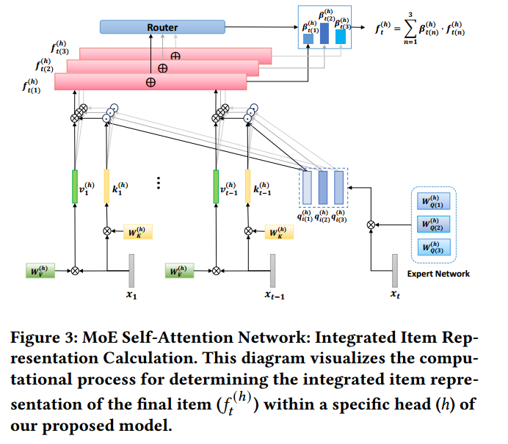
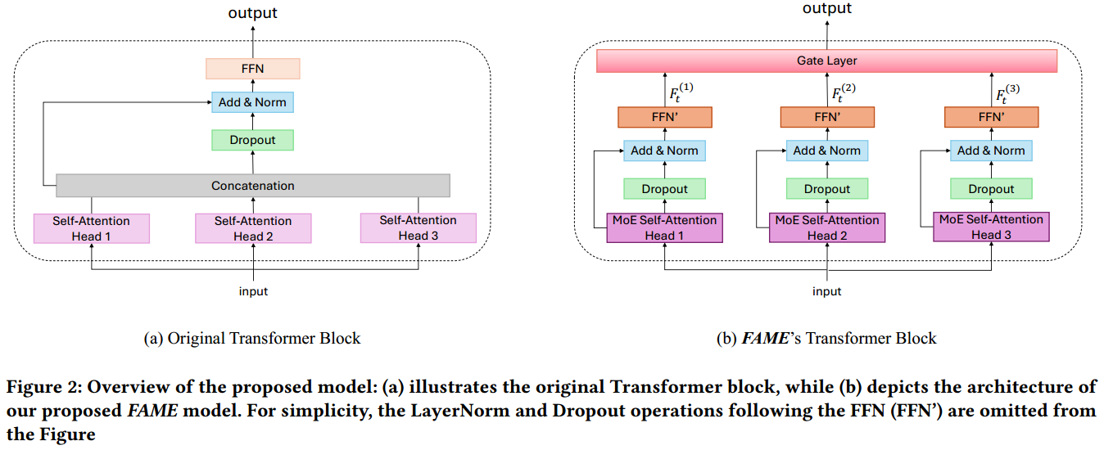
ChongqingUniversity of Technology
ATAI
AdvancedTechniqueof
Artificial Intelligence
ATAI
ChongqingUniversity _{AdvancedTechniqueof}
of Technology Artificial Intelligence
Overview

Slide 4
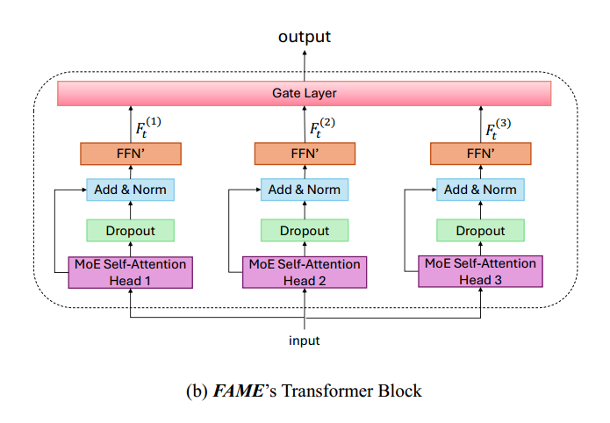
ChongqingUniversity of Technology
ATAI
AdvancedTechniqueof
Artificial Intelligence
ATAI
ChongqingUniversity _{AdvancedTechniqueof}
of Technology Artificial Intelligence
Method

Slide 5
ChongqingUniversity of Technology
ATAI
AdvancedTechniqueof
Artificial Intelligence
ATAI
ChongqingUniversity _{AdvancedTechniqueof}
of Technology Artificial Intelligence
Method

Slide 6
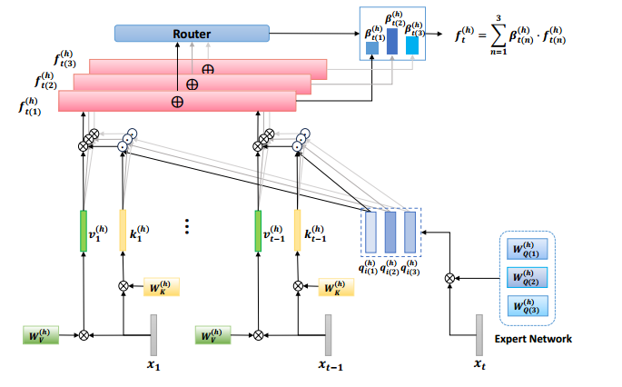
ChongqingUniversity of Technology
ATAI
AdvancedTechniqueof
Artificial Intelligence
ATAI
ChongqingUniversity _{AdvancedTechniqueof}
of Technology Artificial Intelligence
Method

Slide 7
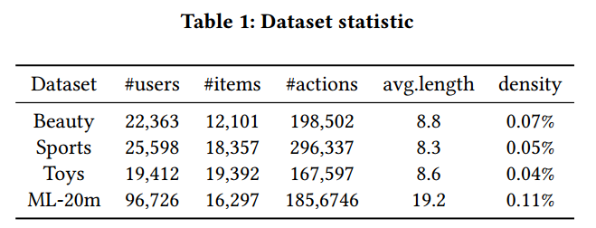
ATAI
AdvancedTechniqueof
Artificial Intelligence
ATAI
ChongqingUniversity _{AdvancedTechniqueof}
of Technology Artificial Intelligence
ChongqingUniversity of Technology
Experiments

Slide 8
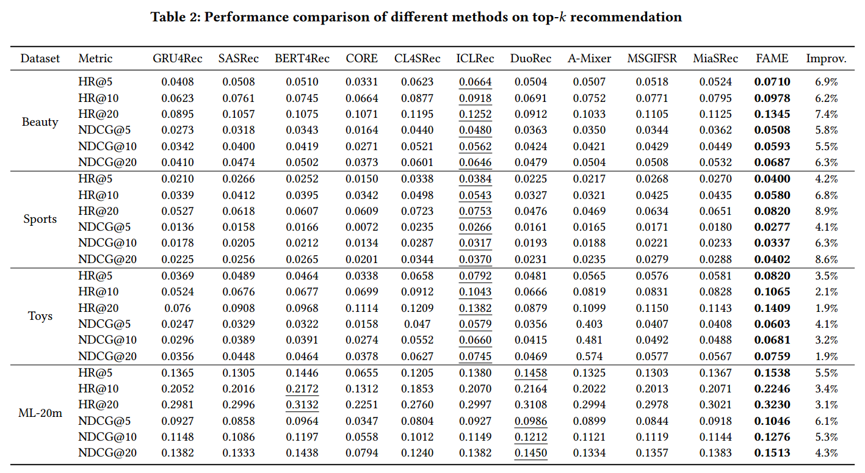
ATAI
AdvancedTechniqueof
Artificial Intelligence
ATAI
ChongqingUniversity _{AdvancedTechniqueof}
of Technology Artificial Intelligence
ChongqingUniversity of Technology
Experiments

Slide 9
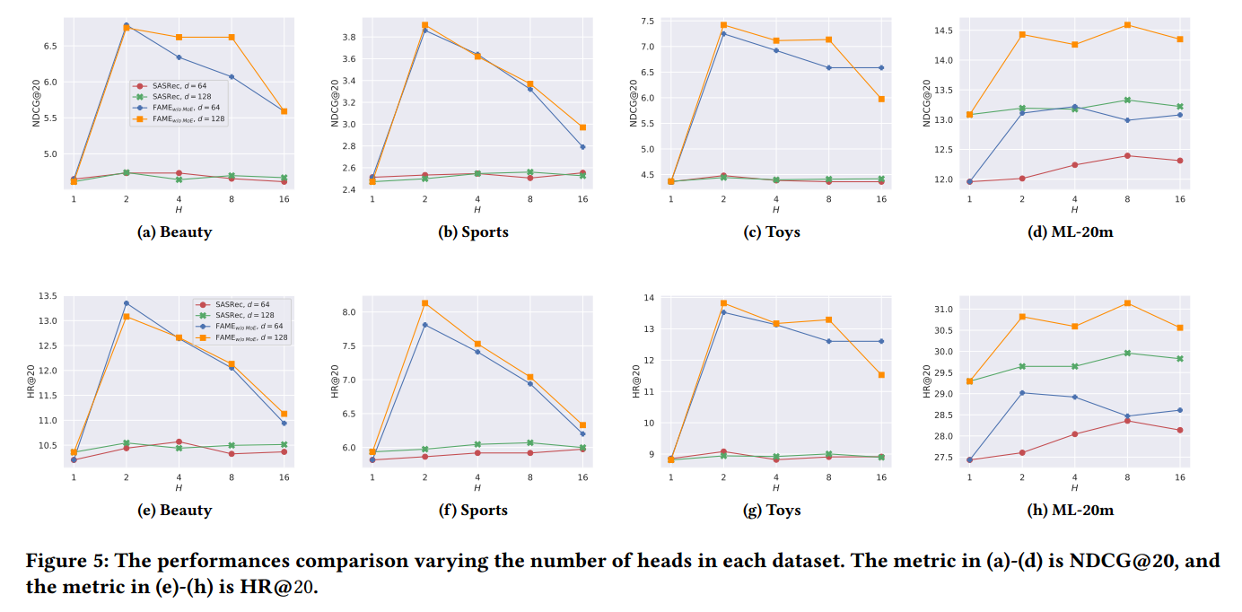
ATAI
AdvancedTechniqueof
Artificial Intelligence
ATAI
ChongqingUniversity _{AdvancedTechniqueof}
of Technology Artificial Intelligence
ChongqingUniversity of Technology
Experiments

Slide 10
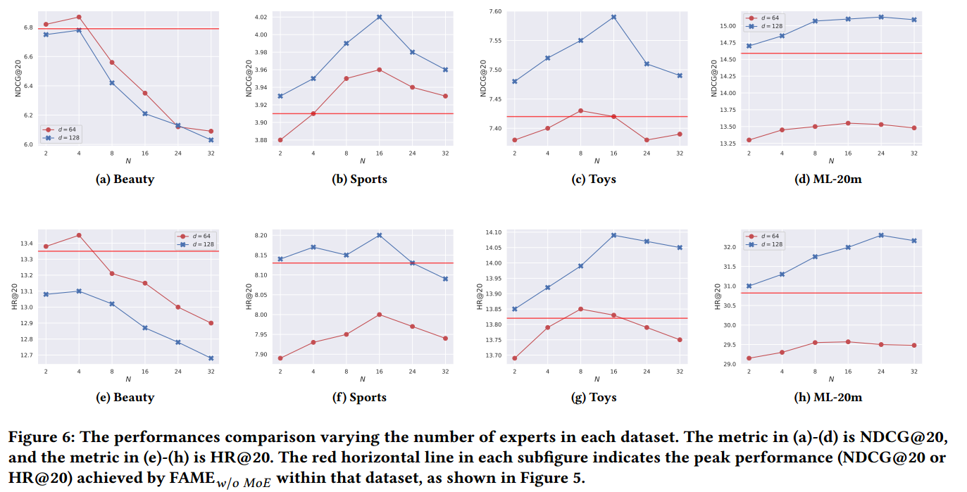
ATAI
AdvancedTechniqueof
Artificial Intelligence
ATAI
ChongqingUniversity _{AdvancedTechniqueof}
of Technology Artificial Intelligence
ChongqingUniversity of Technology
Experiments

Slide 11
ATAI
AdvancedTechniqueof
Artificial Intelligence
ATAI
ChongqingUniversity _{AdvancedTechniqueof}
of Technology Artificial Intelligence
ChongqingUniversity of Technology
Experiments

Slide 12
ChongqingUniversity of Technology
ATAI
AdvancedTechniqueof
Artificial Intelligence
ATAI
ChongqingUniversity _{AdvancedTechniqueof}
of Technology Artificial Intelligence
Thanks!

