Slide 1
ATAI
Advanced Technique of Artificial Intelligence
ATAI
ChongqingUniversity _{AdvancedTechniqueof}
of Technology Artificial Intelligence
Chongqing University of
Technology
Chongqing University ^{ATAI}
_{of Technology} Advanced Techniqueof
Artificial Intelligence
Chongqing University of Technology
Chongqing University of Technology
Diffusion Model for Interest Refinement in Multi-Interest
Recommendation
Code : None
—— SIGIR’2025
2025.2.24. • ChongQing
Reported by YaoYao Zhang
1

Slide 2
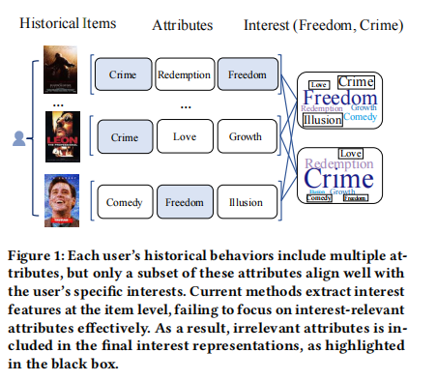
ATAI
Advanced Technique of Artificial Intelligence
ATAI
ChongqingUniversity _{AdvancedTechniqueof}
of Technology Artificial Intelligence
Chongqing University of
Technology
Chongqing University ^{ATAI}
_{of Technology} Advanced Techniqueof
Artificial Intelligence
Chongqing University of Technology
Chongqing University of Technology
Motivation
Current multi-interest recommendation methods often extract interest features at the item level, which may result in the inclusion of attributes that the user is not actually interested in, thereby affecting the recommendation performance.

Slide 3
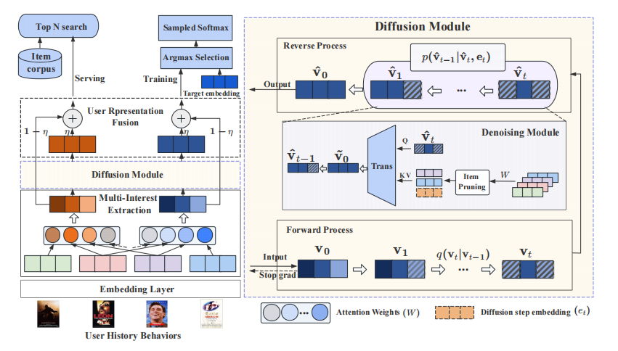
ATAI
Advanced Technique of Artificial Intelligence
ATAI
ChongqingUniversity _{AdvancedTechniqueof}
of Technology Artificial Intelligence
Chongqing University of
Technology
Chongqing University ^{ATAI}
_{of Technology} Advanced Techniqueof
Artificial Intelligence
Chongqing University of Technology
Chongqing University of Technology

Slide 4
ATAI
Advanced Technique of Artificial Intelligence
ATAI
ChongqingUniversity _{AdvancedTechniqueof}
of Technology Artificial Intelligence
Chongqing University of
Technology
Chongqing University ^{ATAI}
_{of Technology} Advanced Techniqueof
Artificial Intelligence
Chongqing University of Technology
Chongqing University of Technology
Method

Slide 5
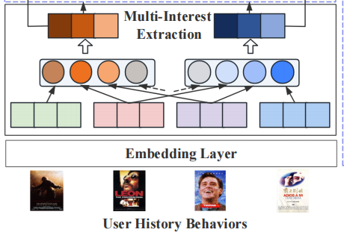
ATAI
Advanced Technique of Artificial Intelligence
ATAI
ChongqingUniversity _{AdvancedTechniqueof}
of Technology Artificial Intelligence
Chongqing University of
Technology
Chongqing University ^{ATAI}
_{of Technology} Advanced Techniqueof
Artificial Intelligence
Method
Chongqing University of Technology
Chongqing University of Technology

Slide 6
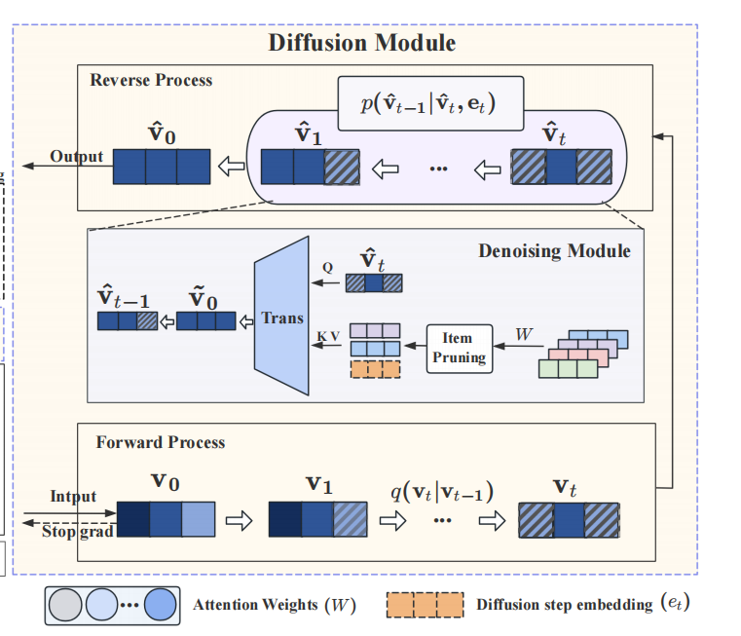
ATAI
Advanced Technique of Artificial Intelligence
ATAI
ChongqingUniversity _{AdvancedTechniqueof}
of Technology Artificial Intelligence
Chongqing University of
Technology
Chongqing University ^{ATAI}
_{of Technology} Advanced Techniqueof
Artificial Intelligence
Method
Chongqing University of Technology
Chongqing University of Technology

Slide 7
ATAI
Advanced Technique of Artificial Intelligence
ATAI
ChongqingUniversity _{AdvancedTechniqueof}
of Technology Artificial Intelligence
Chongqing University of
Technology
Chongqing University ^{ATAI}
_{of Technology} Advanced Techniqueof
Artificial Intelligence
Method
Chongqing University of Technology
Chongqing University of Technology

Slide 8
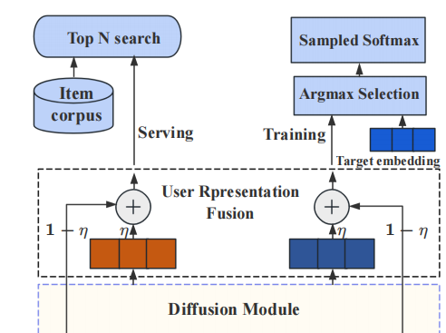
ATAI
Advanced Technique of Artificial Intelligence
ATAI
ChongqingUniversity _{AdvancedTechniqueof}
of Technology Artificial Intelligence
Chongqing University of
Technology
Chongqing University ^{ATAI}
_{of Technology} Advanced Techniqueof
Artificial Intelligence
Method
Chongqing University of Technology
Chongqing University of Technology
Notes:
(2)对一个用户所属的所有群组进行处理，让用户所属的每个群组乘以一个权重再相加得到

Slide 9
ATAI
Advanced Technique of Artificial Intelligence
ATAI
ChongqingUniversity _{AdvancedTechniqueof}
of Technology Artificial Intelligence
Chongqing University of
Technology
Chongqing University ^{ATAI}
_{of Technology} Advanced Techniqueof
Artificial Intelligence
Method
Chongqing University of Technology
Chongqing University of Technology
Notes:
(2)对一个用户所属的所有群组进行处理，让用户所属的每个群组乘以一个权重再相加得到

Slide 10
ATAI
Advanced Technique of Artificial Intelligence
ATAI
ChongqingUniversity _{AdvancedTechniqueof}
of Technology Artificial Intelligence
Chongqing University of
Technology
Chongqing University ^{ATAI}
_{of Technology} Advanced Techniqueof
Artificial Intelligence
Method
Chongqing University of Technology
Chongqing University of Technology
Notes:
(2)对一个用户所属的所有群组进行处理，让用户所属的每个群组乘以一个权重再相加得到

Slide 11
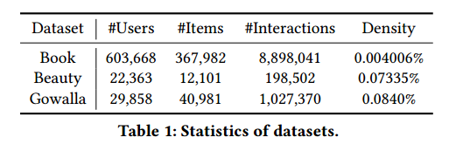
ATAI
Advanced Technique of Artificial Intelligence
ATAI
ChongqingUniversity _{AdvancedTechniqueof}
of Technology Artificial Intelligence
Chongqing University of
Technology
Chongqing University ^{ATAI}
_{of Technology} Advanced Techniqueof
Artificial Intelligence
Chongqing University of Technology
Experiments
Chongqing University of Technology

Slide 12
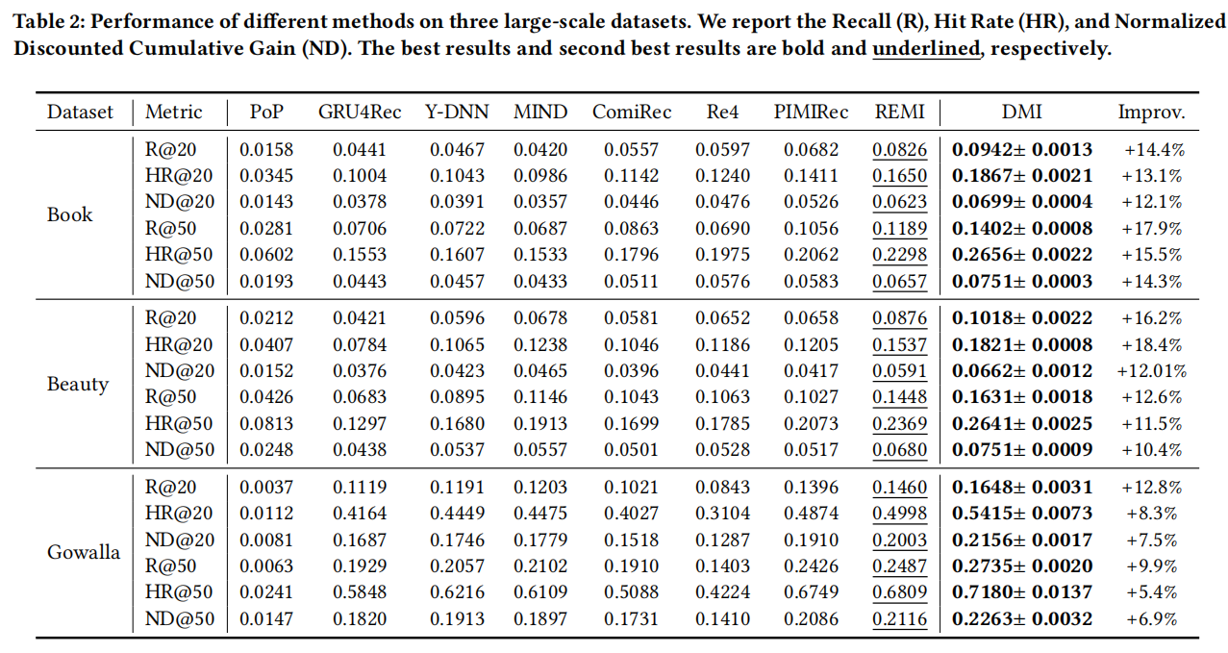
ATAI
Advanced Technique of Artificial Intelligence
ATAI
ChongqingUniversity _{AdvancedTechniqueof}
of Technology Artificial Intelligence
Chongqing University of
Technology
Chongqing University ^{ATAI}
_{of Technology} Advanced Techniqueof
Artificial Intelligence
Chongqing University of Technology
Chongqing University of Technology

Slide 13
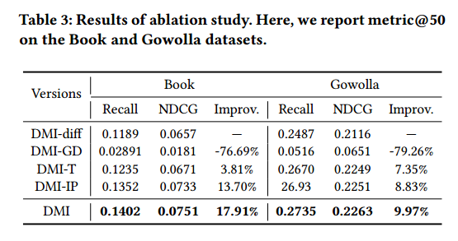
ATAI
Advanced Technique of Artificial Intelligence
ATAI
ChongqingUniversity _{AdvancedTechniqueof}
of Technology Artificial Intelligence
Chongqing University of
Technology
Chongqing University ^{ATAI}
_{of Technology} Advanced Techniqueof
Artificial Intelligence
Chongqing University of Technology
Chongqing University of Technology

Slide 14
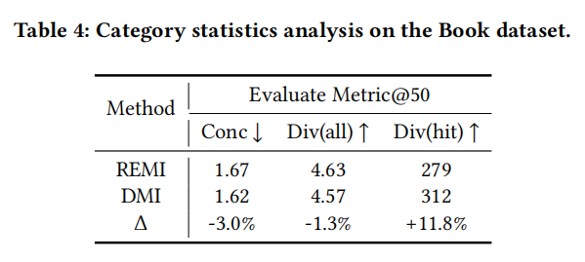
ATAI
Advanced Technique of Artificial Intelligence
ATAI
ChongqingUniversity _{AdvancedTechniqueof}
of Technology Artificial Intelligence
Chongqing University of
Technology
Chongqing University ^{ATAI}
_{of Technology} Advanced Techniqueof
Artificial Intelligence
Chongqing University of Technology
Chongqing University of Technology

Slide 15
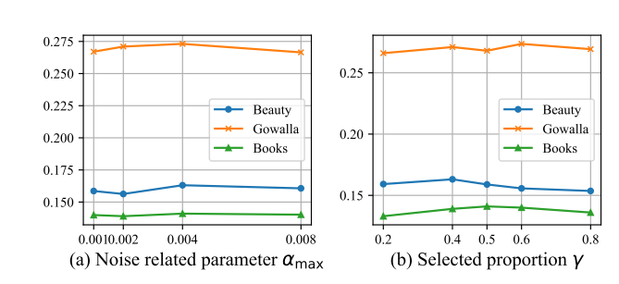
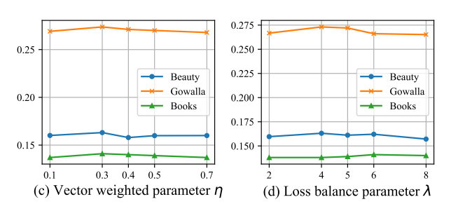
ATAI
Advanced Technique of Artificial Intelligence
ATAI
ChongqingUniversity _{AdvancedTechniqueof}
of Technology Artificial Intelligence
Chongqing University of
Technology
Chongqing University ^{ATAI}
_{of Technology} Advanced Techniqueof
Artificial Intelligence
Chongqing University of Technology
Chongqing University of Technology

Slide 16
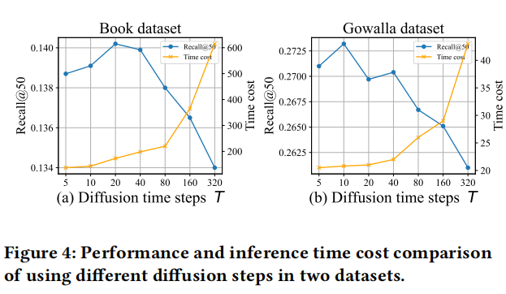
ATAI
Advanced Technique of Artificial Intelligence
ATAI
ChongqingUniversity _{AdvancedTechniqueof}
of Technology Artificial Intelligence
Chongqing University of
Technology
Chongqing University ^{ATAI}
_{of Technology} Advanced Techniqueof
Artificial Intelligence
Chongqing University of Technology
Chongqing University of Technology

Slide 17
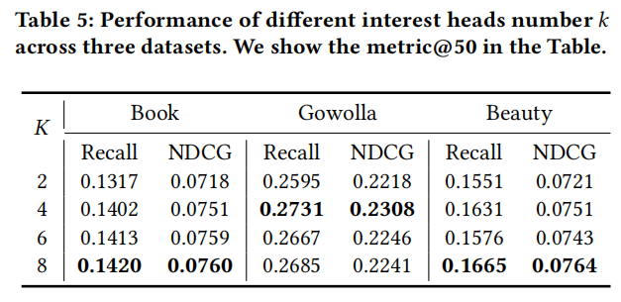
ATAI
Advanced Technique of Artificial Intelligence
ATAI
ChongqingUniversity _{AdvancedTechniqueof}
of Technology Artificial Intelligence
Chongqing University of
Technology
Chongqing University ^{ATAI}
_{of Technology} Advanced Techniqueof
Artificial Intelligence
Chongqing University of Technology
Chongqing University of Technology

Slide 18
ATAI
Advanced Technique of Artificial Intelligence
ATAI
ChongqingUniversity _{AdvancedTechniqueof}
of Technology Artificial Intelligence
Chongqing University of
Technology
Chongqing University ^{ATAI}
_{of Technology} Advanced Techniqueof
Artificial Intelligence
Chongqing University of Technology
Chongqing University of Technology

Slide 19
ATAI
Advanced Technique of Artificial Intelligence
ATAI
ChongqingUniversity _{AdvancedTechniqueof}
of Technology Artificial Intelligence
Chongqing University of
Technology
Chongqing University ^{ATAI}
_{of Technology} Advanced Techniqueof
Artificial Intelligence
Chongqing University of Technology
Chongqing University of Technology
Thanks!

