Slide 1



ChongqingUniversity of Technology
ATAI
AdvancedTechniqueof
Artificial Intelligence
ATAI
ChongqingUniversity _{AdvancedTechniqueof}
of Technology Artificial Intelligence
Overview
1.采用提示的方法，构建一个粒球化提示，来让大模型进行粒球化。
2.参考COT，多步生成粒球，进行粒球化过程。
3.关键之处在于给大模型提供一个可行的粒球质量定义。
4.把刚才几篇比较有代表性的粒球文章丢给大模型，结合上述策略，让大模型生成相关
的粒球化思路。
To do：把参考文献[37]看了，还有最后的夏老师的文章看一下。

Slide 2
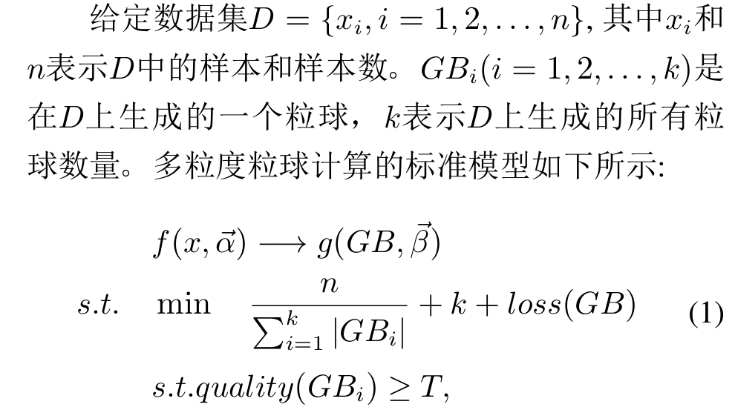
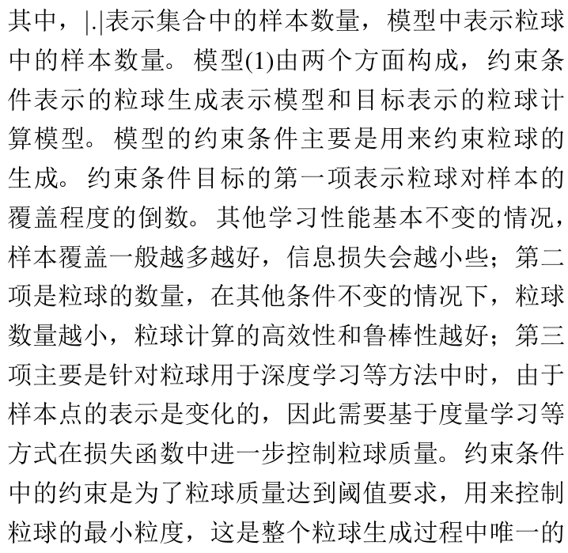
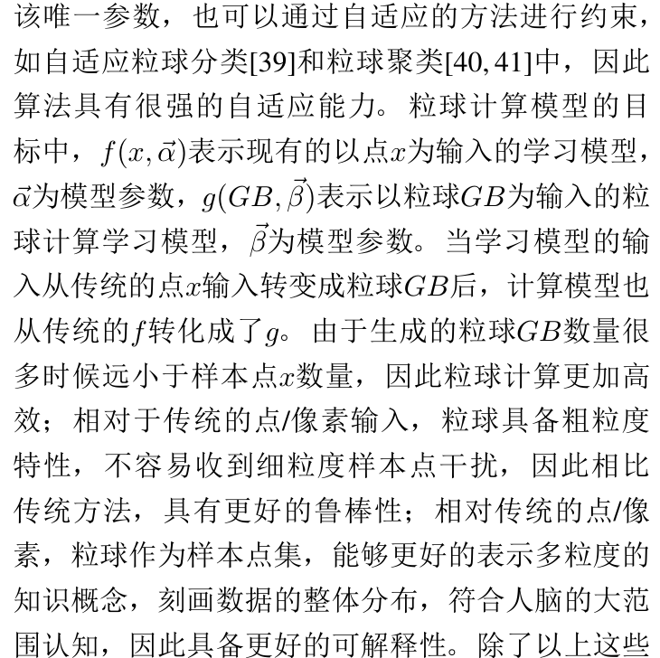
ChongqingUniversity of Technology
ATAI
AdvancedTechniqueof
Artificial Intelligence
ATAI
ChongqingUniversity _{AdvancedTechniqueof}
of Technology Artificial Intelligence
Overview

Slide 3
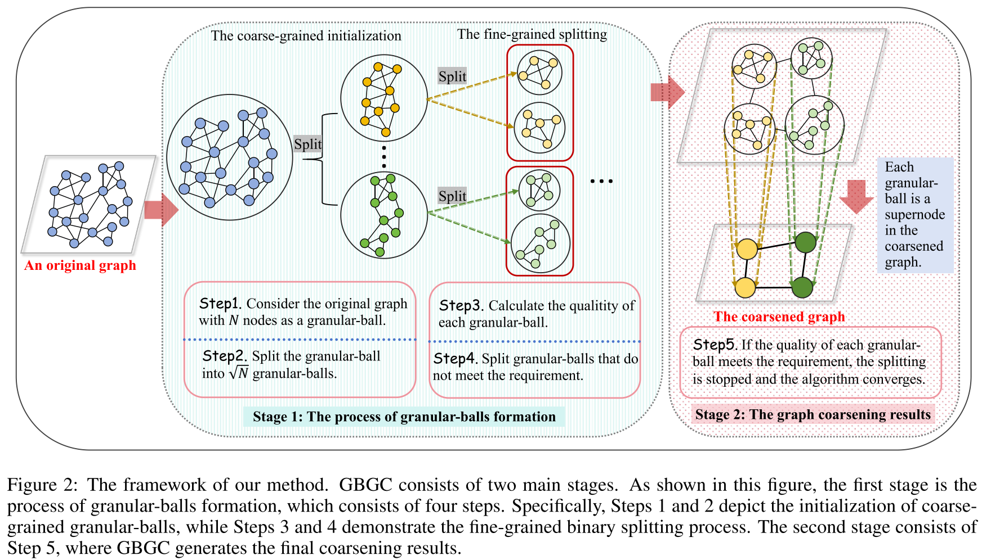


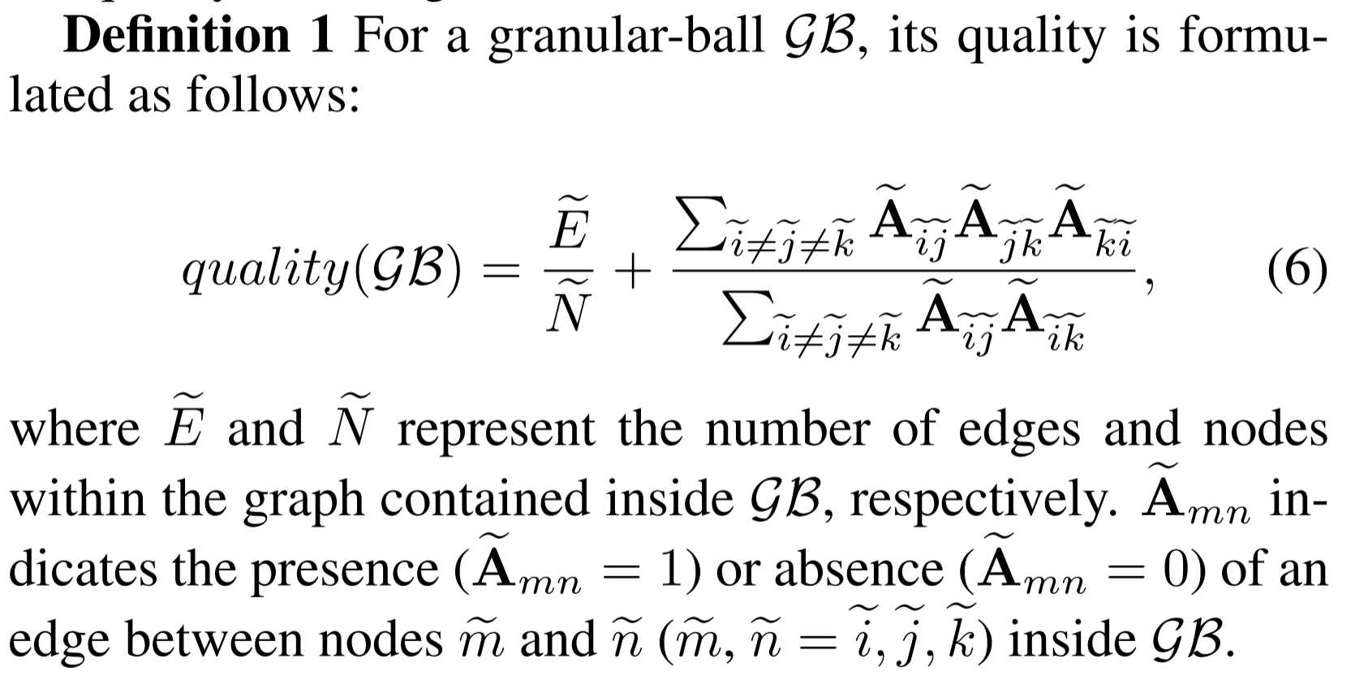
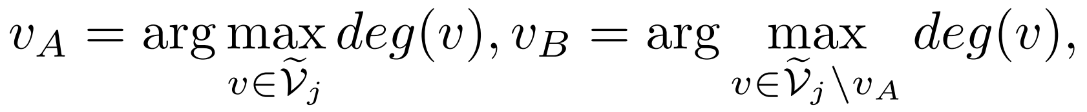
ChongqingUniversity of Technology
ATAI
AdvancedTechniqueof
Artificial Intelligence
ATAI
ChongqingUniversity _{AdvancedTechniqueof}
of Technology Artificial Intelligence
Overview
25_IJCAI_GBGC: Efficient and Adaptive Graph Coarsening via Granular-ball Computing

Slide 4
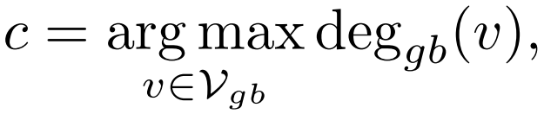
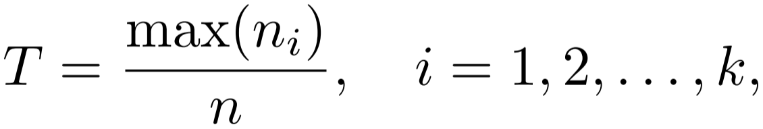
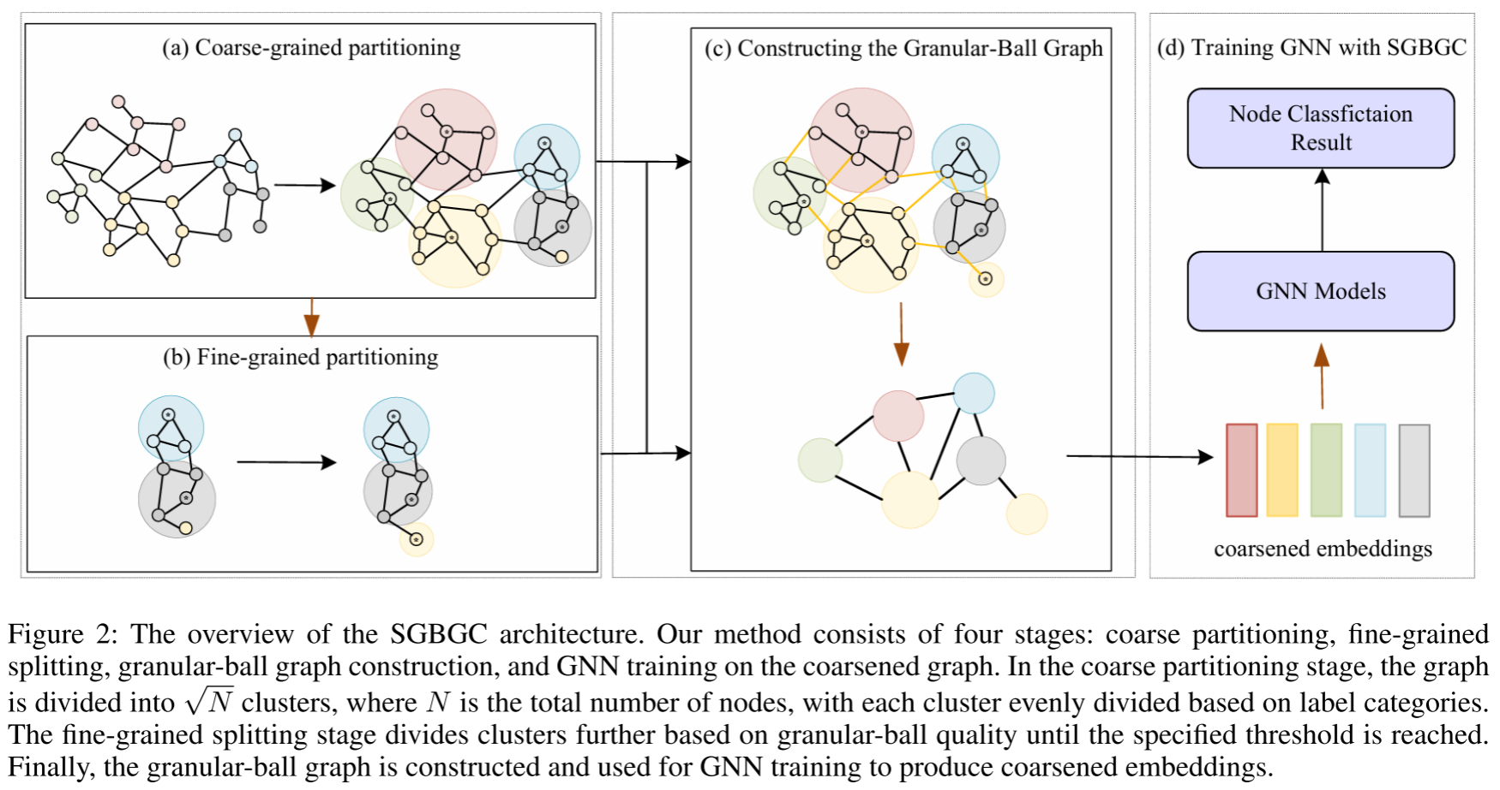
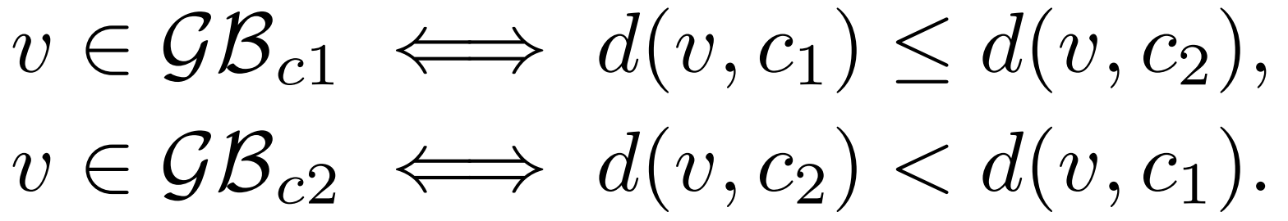
ChongqingUniversity of Technology
ATAI
AdvancedTechniqueof
Artificial Intelligence
ATAI
ChongqingUniversity _{AdvancedTechniqueof}
of Technology Artificial Intelligence
Overview
纯度做quality
25_AAAI_Graph Coarsening via Supervised Granular-Ball for Scalable Graph Neural Network Training

Slide 5
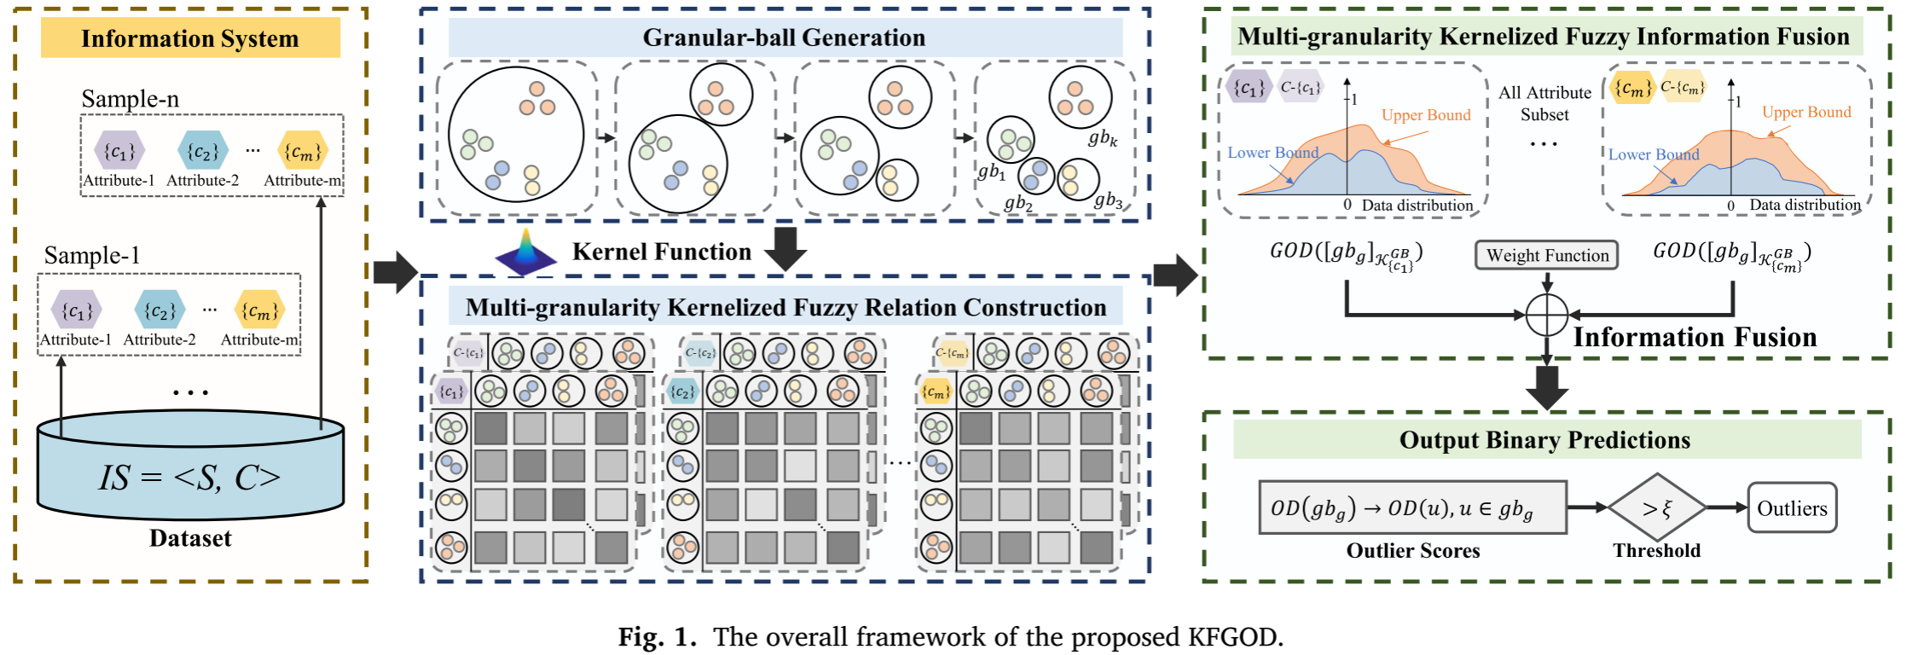
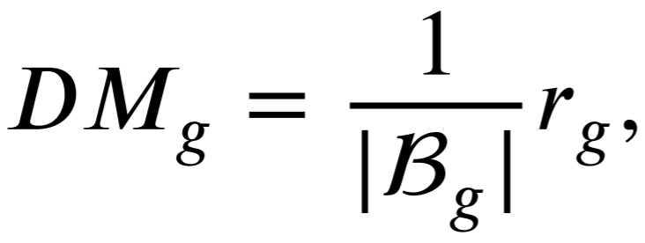
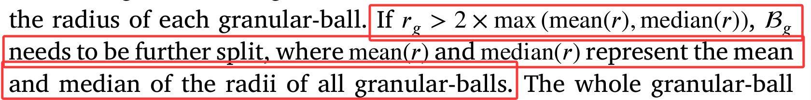
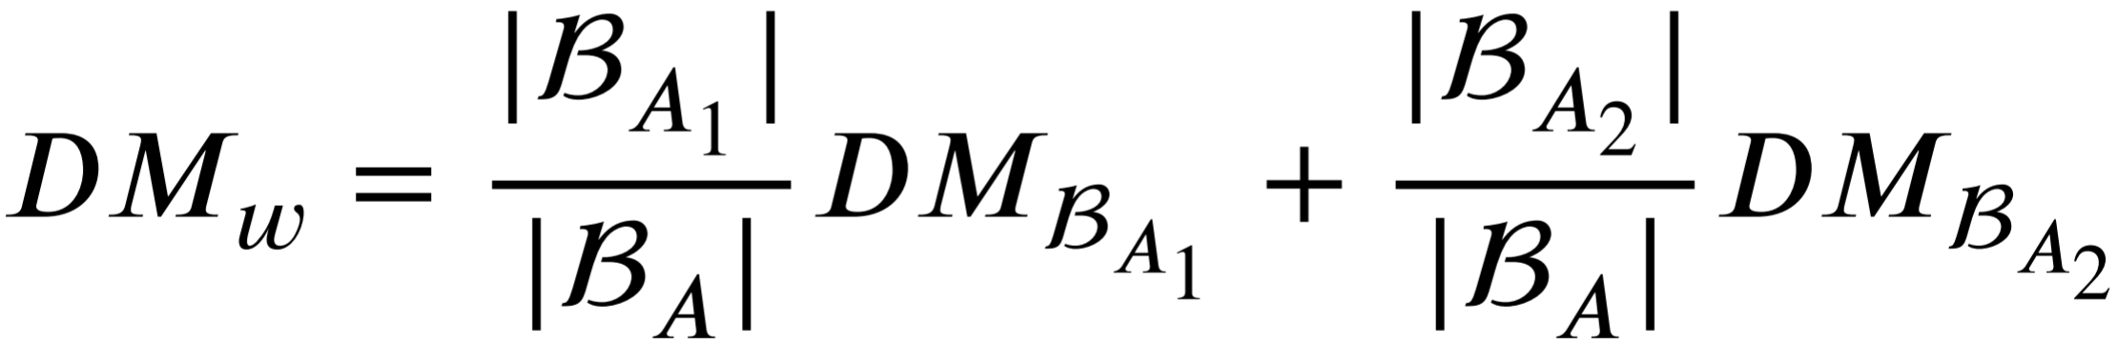
ChongqingUniversity of Technology
ATAI
AdvancedTechniqueof
Artificial Intelligence
ATAI
ChongqingUniversity _{AdvancedTechniqueof}
of Technology Artificial Intelligence
Overview
该论文粒球方法基于文献[37]：
Quality：
26_InformationFusion_A kernelized fuzzy approximation fusion model with granular-ball computing for outlier detection

Slide 6
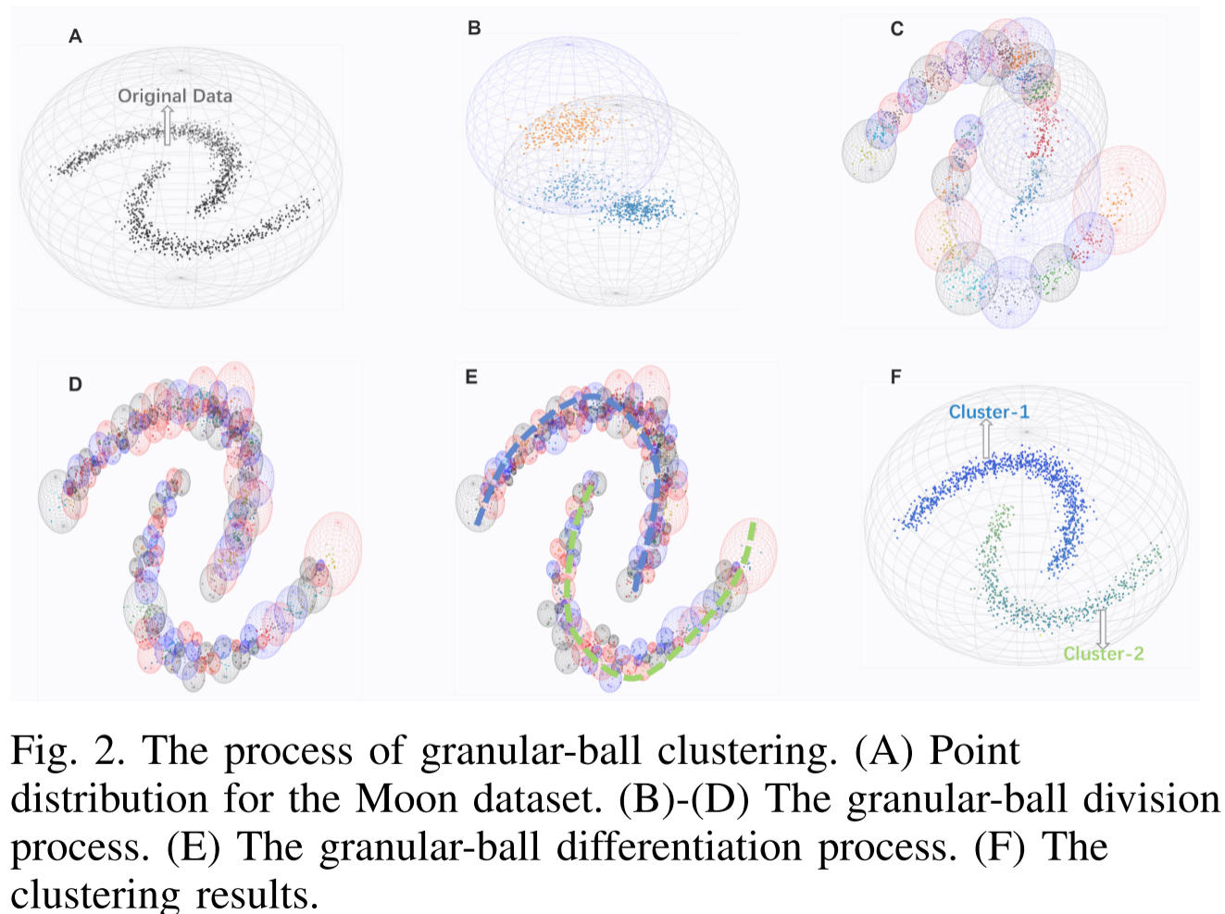
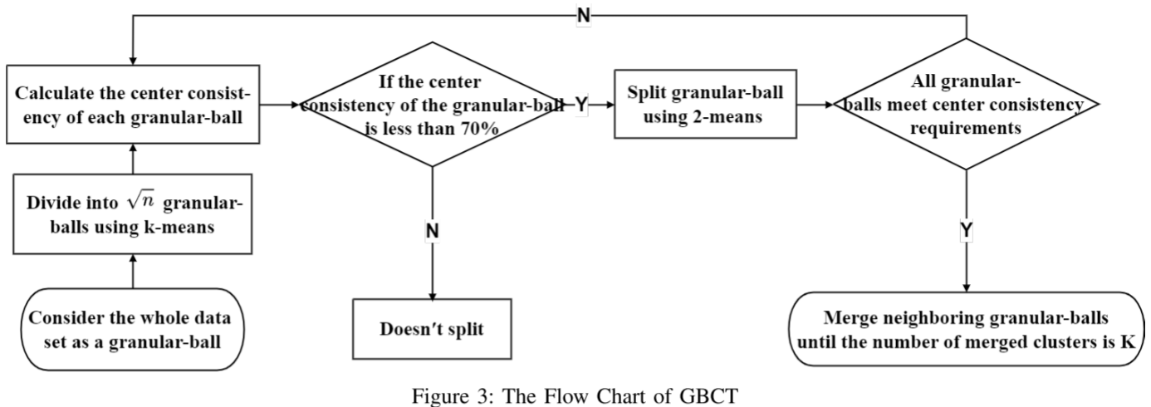
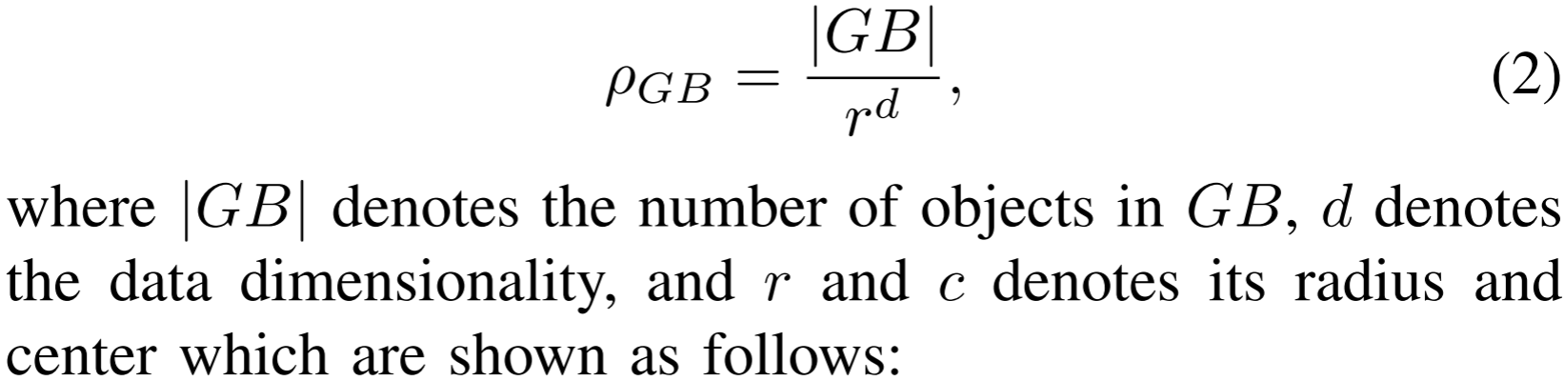
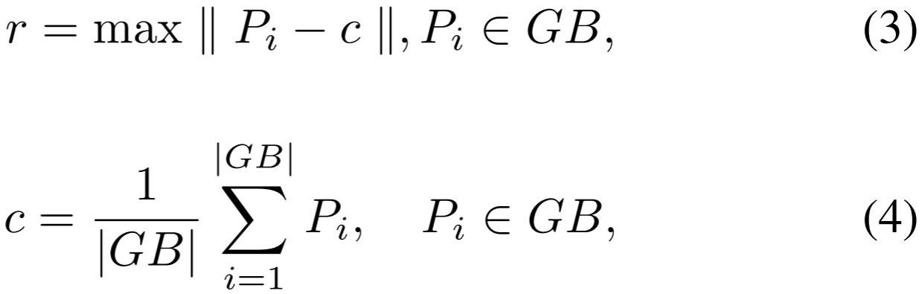
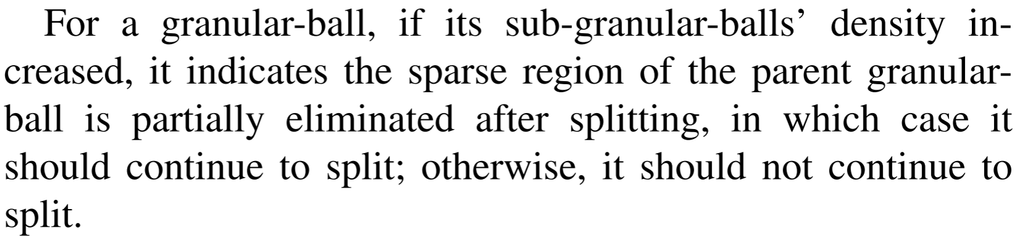
ChongqingUniversity of Technology
ATAI
AdvancedTechniqueof
Artificial Intelligence
ATAI
ChongqingUniversity _{AdvancedTechniqueof}
of Technology Artificial Intelligence
Overview
24_CoRR_GBCT: An Efficient and Adaptive Granular-Ball Clustering Algorithm for Complex Data

Slide 7
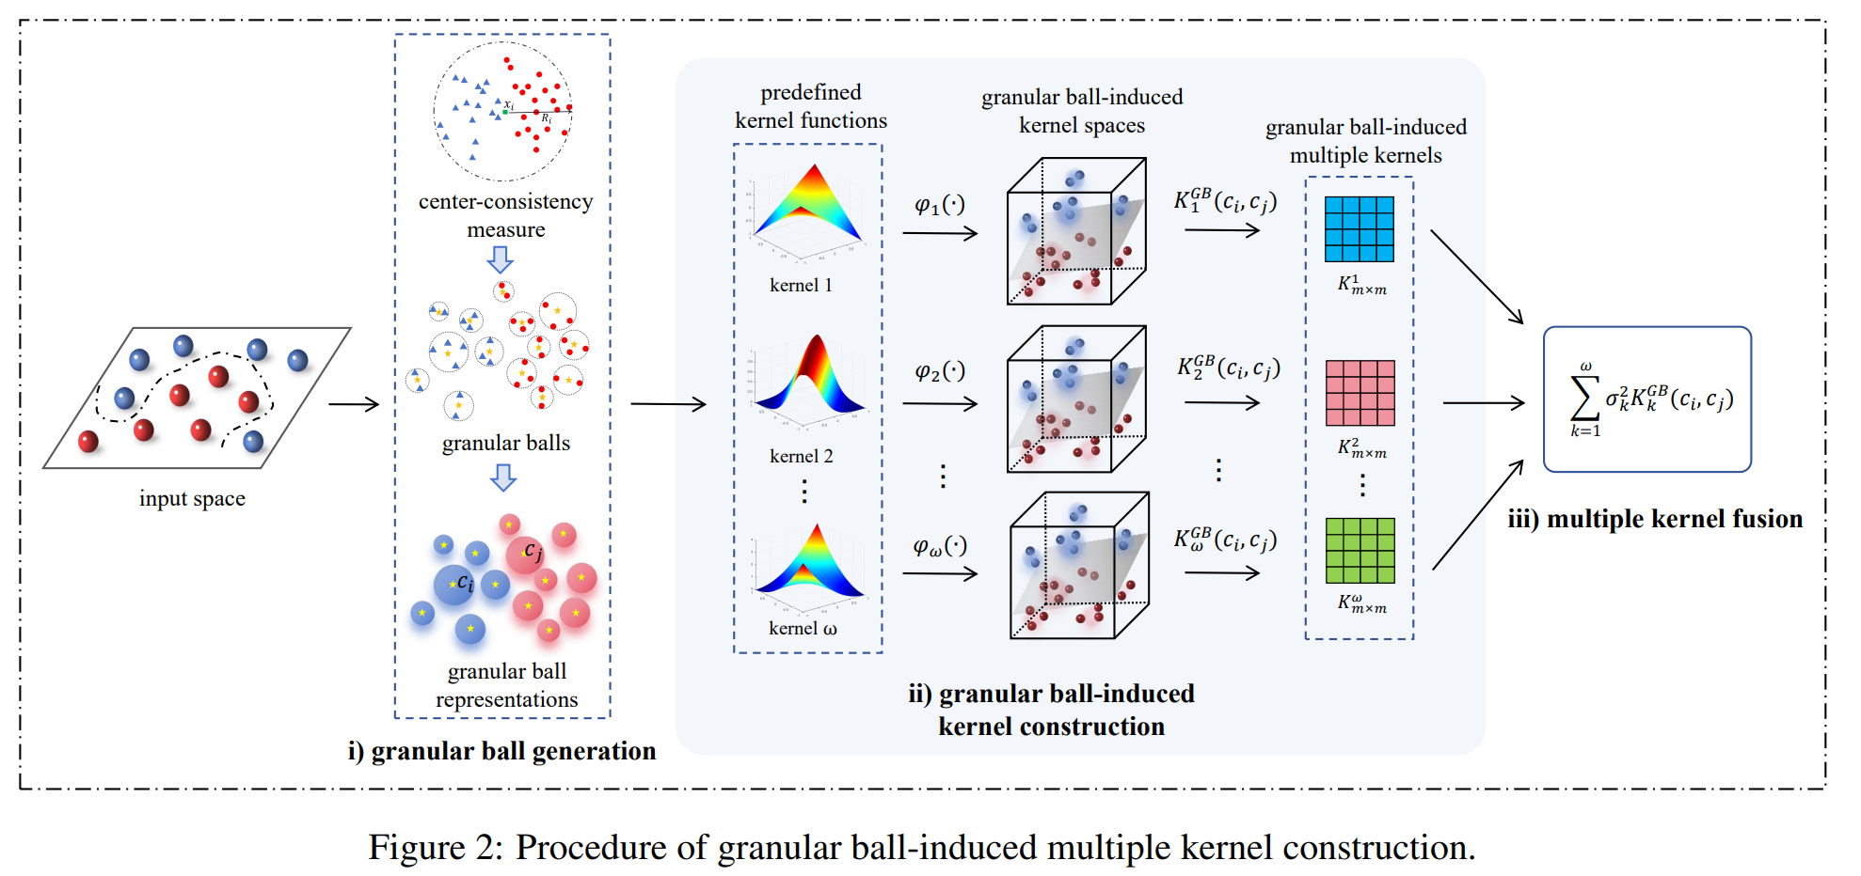
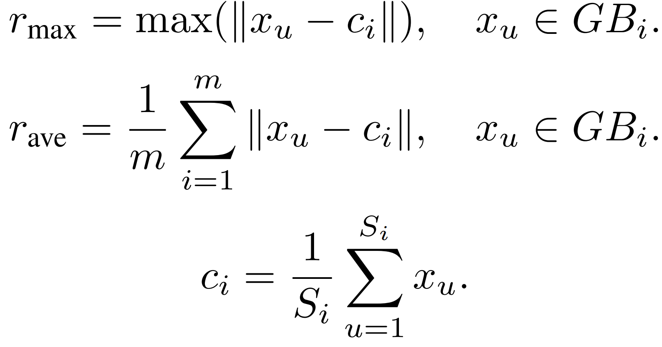
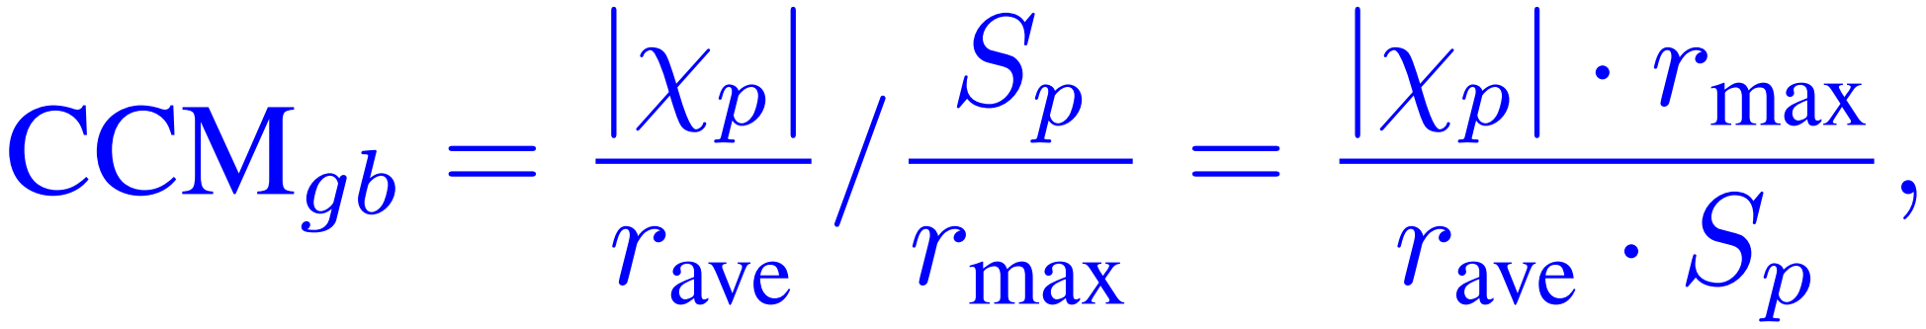
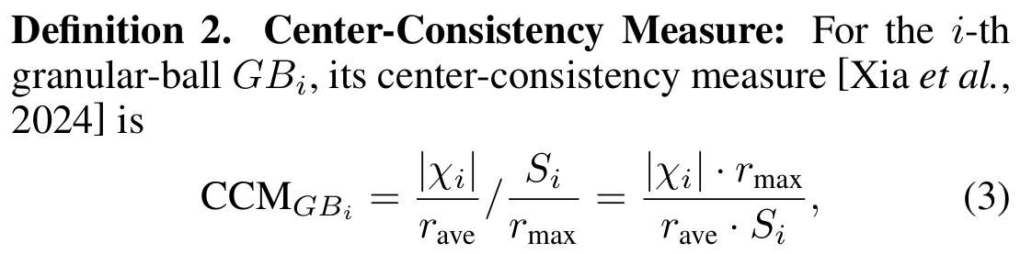
ChongqingUniversity of Technology
ATAI
AdvancedTechniqueof
Artificial Intelligence
ATAI
ChongqingUniversity _{AdvancedTechniqueof}
of Technology Artificial Intelligence
Overview
Quality：
25_IJCAI_Granular Ball-induced Multiple Kernel K-means

Slide 8
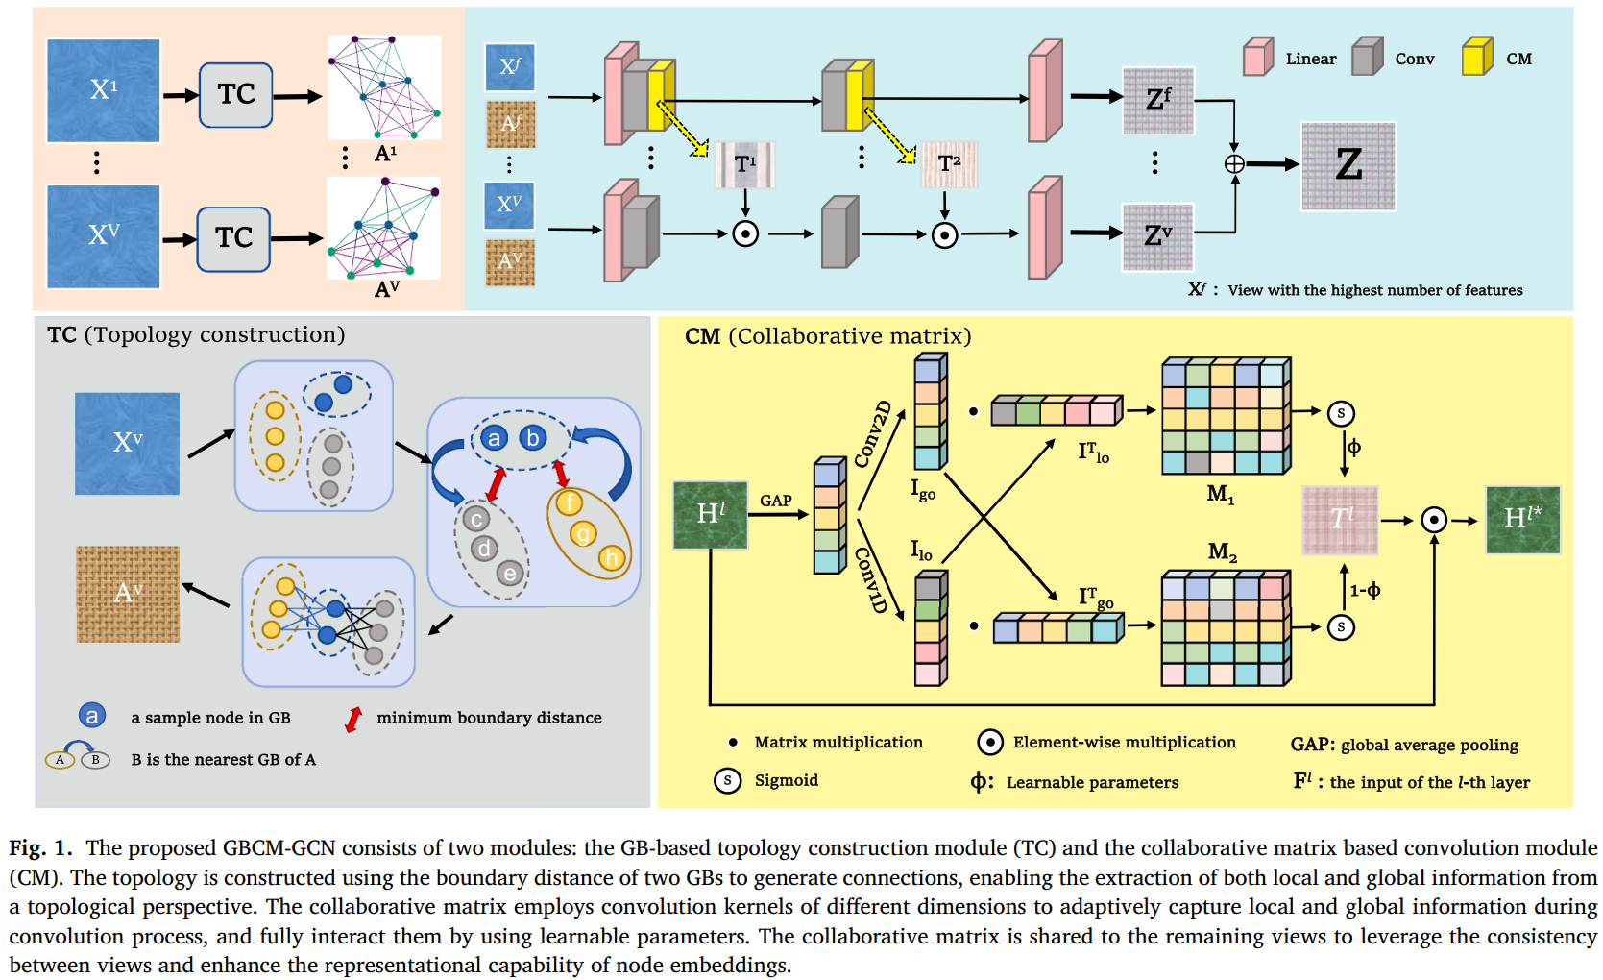
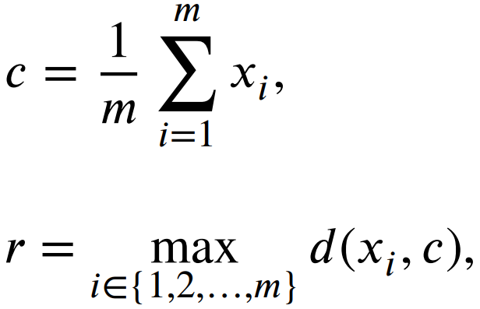
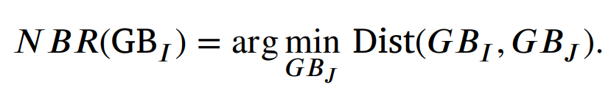
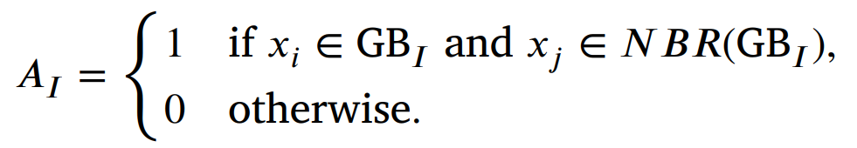
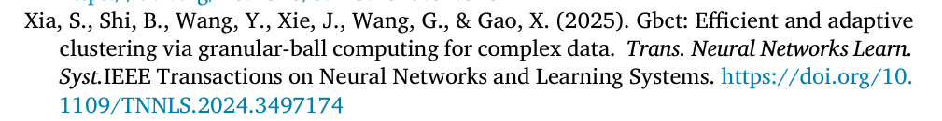
ChongqingUniversity of Technology
ATAI
AdvancedTechniqueof
Artificial Intelligence
ATAI
ChongqingUniversity _{AdvancedTechniqueof}
of Technology Artificial Intelligence
Overview
26_ESWA_Capturing local and global information:Multi-view graph convolutional network via granular-ball computing and collaborative matrix

Slide 9


ChongqingUniversity of Technology
ATAI
AdvancedTechniqueof
Artificial Intelligence
ATAI
ChongqingUniversity _{AdvancedTechniqueof}
of Technology Artificial Intelligence
Thanks!

