Slide 1
Learning Effective and Efficient Embedding via an
Adaptively-Masked Twins-based Layer
CIKM 2021
Code:None
2021.09.22 • ChongQing
Reported by Gu Tang

Slide 2
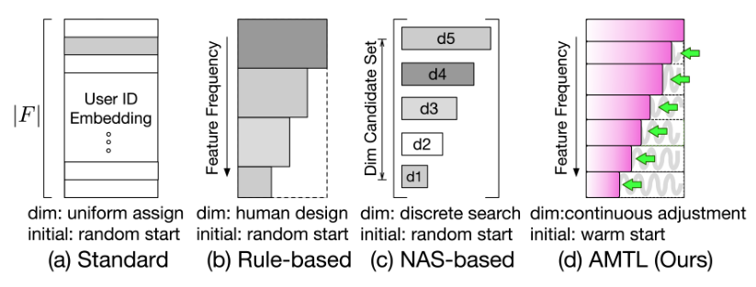
Introduction
Mixed dimension embeddings with application to memory-efficient
recommendation systems. 2019
AutoEmb: Automated Embedding Dimensionality Search in
Streaming Recommendation 2020
arXiv preprint arXiv:1909.11810 (2019) IEEE Xplore.
arXiv preprint arXiv:2002.11252 (2020).

Slide 3
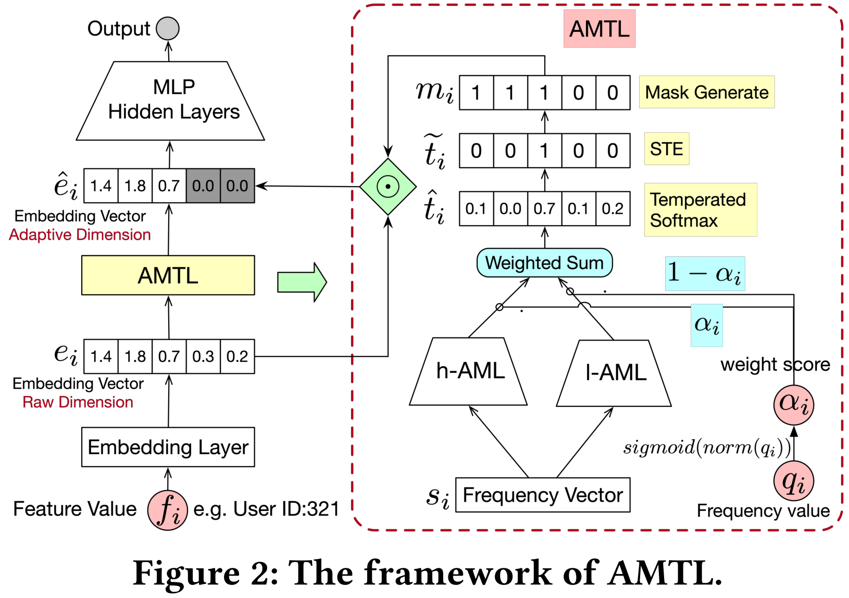
Method

Slide 4
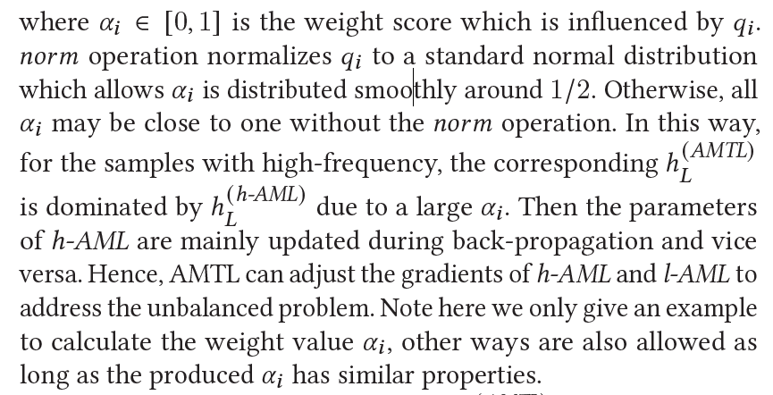
Method

Slide 5
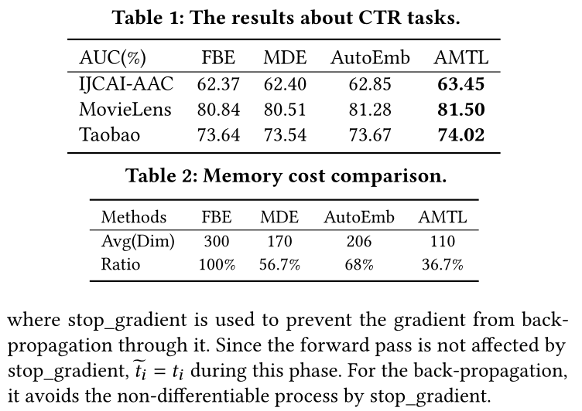
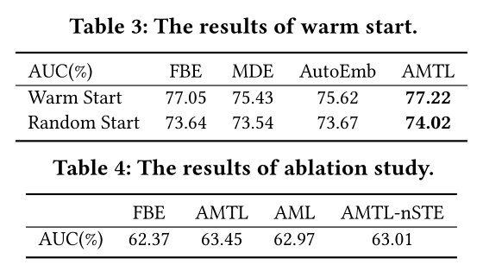
Experiment

Slide 6
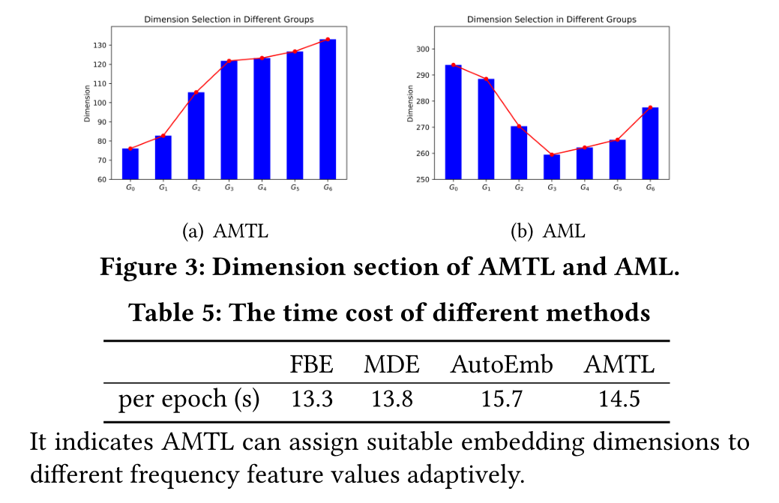
Experiments

Slide 7
Thanks

