Slide 1
Chongqing University of Technology
ATAI
Advanced Technique of Artificial Intelligence
Chongqing University of Technology
Few-Shot Text Classification with Edge-Labeling Graph Neural Network-Based Prototypical Network（COLING 2020）
Chen Lyu
Peking University
Weijie Liu
Peking University
Ping Wang
Peking University
Reported by Ting Wang
2021.07.27

Slide 2
Chongqing University of Technology
ATAI
Advanced Technique of Artificial Intelligence
Chongqing University of Technology
1. Innovation
2. Method
3. Experiments
4. Conclusion

Slide 3
Background
1.All the methods mentioned above adopt a GloVe word embedding combined with CNN or RNN structure for text embedding.
2.These methods focus more on the semantic features of the texts itself, ignoring the potential relationships between texts.

Slide 4
Innovation
1.We propose Edge-Labeling Graph Neural Network-Based Prototypical Network (EGNN-Proto) for few-shot text classification,our model is the first to combine a graph neural network with a prototypical network.
2.Our model is the first to utilize an edge-labeling graph neural network to solve the few-shot text classification problem.
3.Our method outperforms the current state-of-the-art models on two few-shot text classification datasets.

Slide 5
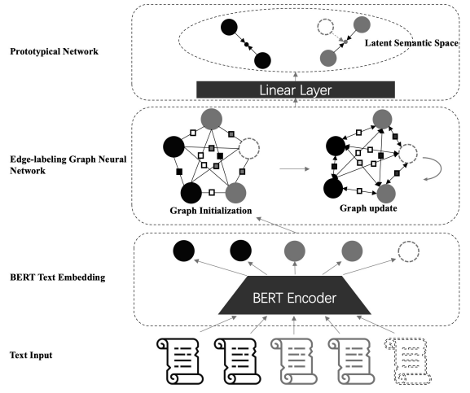
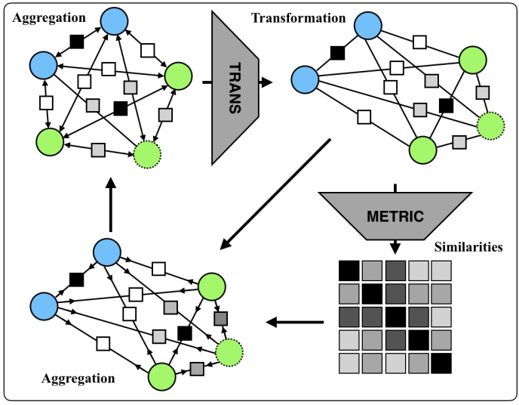
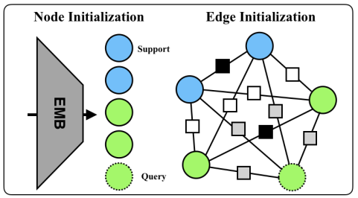
Approach
1.Text Embedding
(x:text θ:parameter v:embedding)
2.Edge-labeling Graph Neural Network
EGNN model

Slide 6
Approach
edge feature:
(1)
ground-truth node labels:
(2)
(3)
(4)
(5)
(6)
Paper: Edge-Labeling Graph Neural Network for Few-shot Learning(CVPR 2019)
Code: https://github.com/khy0809/fewshot-egnn

Slide 7
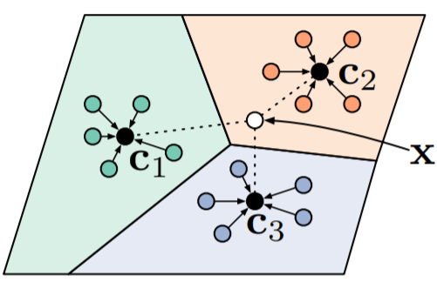
Approach
3.Prototypical Network

Slide 8
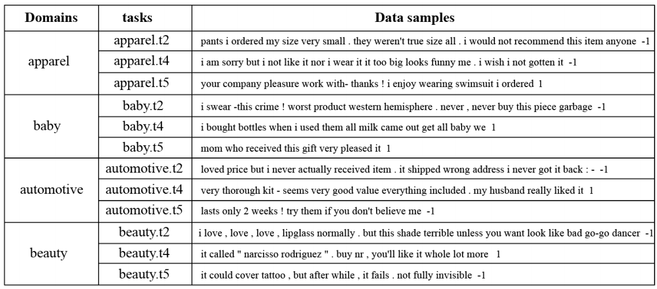
Experiments
ARSC: Consists of English reviews of 23 types of products on Amazon.Following the experiment setting of Yu (2018), we creat a 12-way 5-shot text classification task on this dataset.
Dataset：
https://github.com/zxlzr/FewShotNLP/tree/master/data

Slide 9
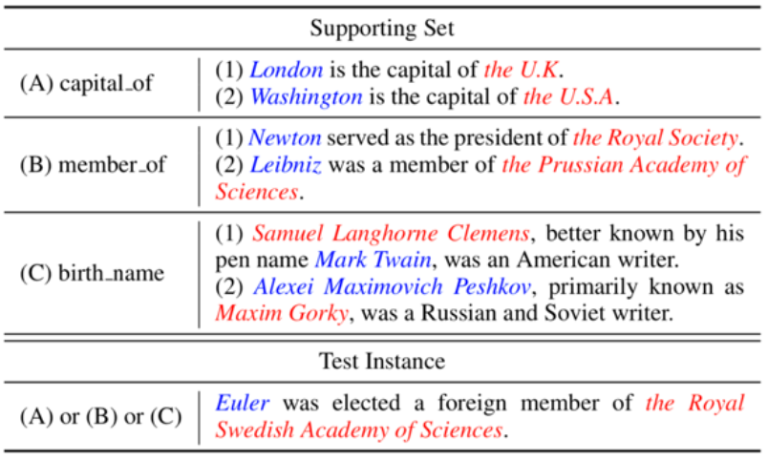
Experiments
FewRel: Few-Shot relation classification dataset, consisting of 70000 instances on 100 relations derived from Wikipedia. In our experiment, we follow the settings of Sun (2019) and evaluate our method on 5-way 5-shot and 10-way 5-shot settings.
Dataset：
https://github.com/thunlp/FewRel

Slide 10
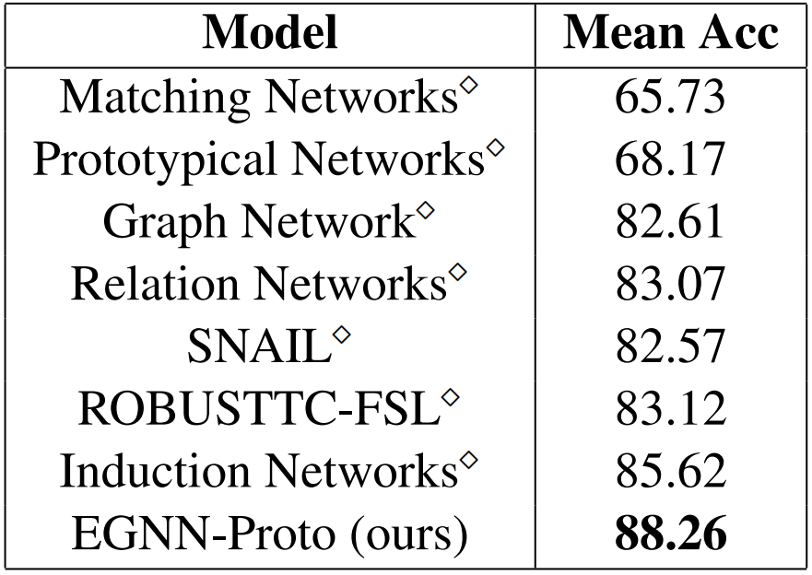
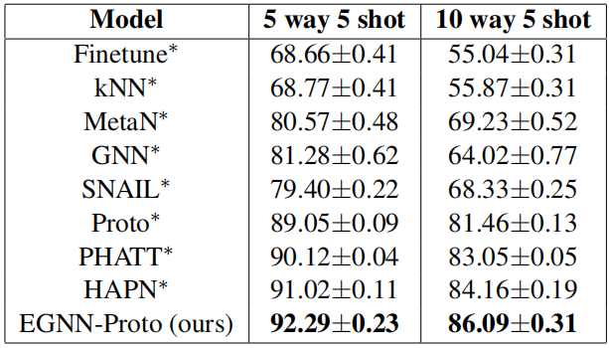
Experiments
Table 1: Classification Accuracy (%) on ARSC (on the left) and FewRel Dataset (on the right). The results of methods are reported by Geng (2019) while ∗reported by Sun (2019)

Slide 11
Thanks!

