Slide 1
Chongqing University of Technology
ATAI
Advanced Technique of Artificial Intelligence
Chongqing University of Technology
Graph Enhanced Representation Learning
for News Recommendation
(International World Wide Web Conferences-2020)
Reported by Ting Wang
2020.04.28 • AnHui

Slide 2
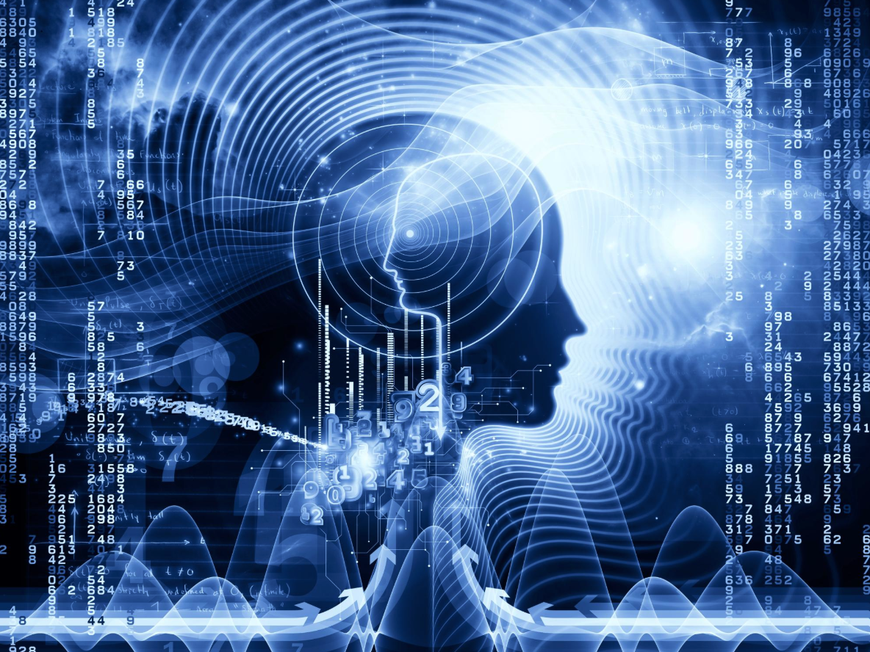
Chongqing University of Technology
ATAI
Advanced Technique of Artificial Intelligence
Chongqing University of Technology
1. Innovation
2. Method
3. Experiments
4. Conclusion

Slide 3
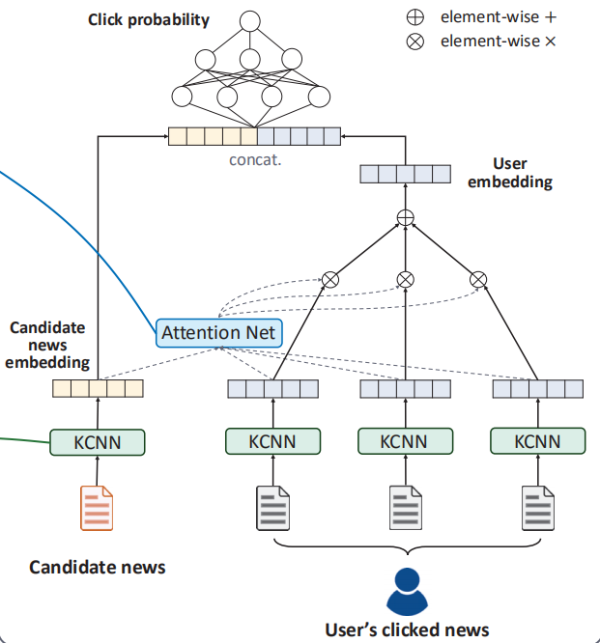
Innovation
Problems with the current method:
When the news content such as titles are short and vague, and the historical behaviors of user are sparse, it is difficult for them to learn accurate news and user representations.

Slide 4
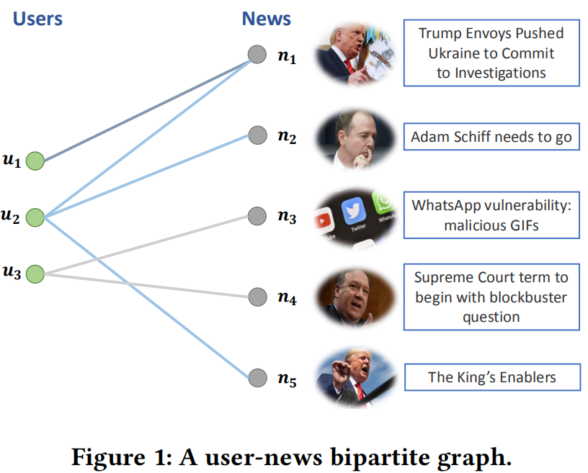
Innovation
1. From user news interactions, a bipartite graph can be established.
node:
user,news
edge:
interactions between them
neighbor news: some news are viewed by the same user.
neighbor users.: some users are clicked the same news.
eg. [n₁,n₂,n₅]∈neighbor news [u₁,u₂]∈neighbor users

Slide 5
Innovation
2.News representation:
(1) utilize the transformer to build news semantic representations
(2) add topic embeddings of news
(3) aggregating neighbor news via a graph attention network
3.Users representation:
(1) ID embeddings and historically clicked news
(2) aggregate the ID embeddings of neighbor users

Slide 6
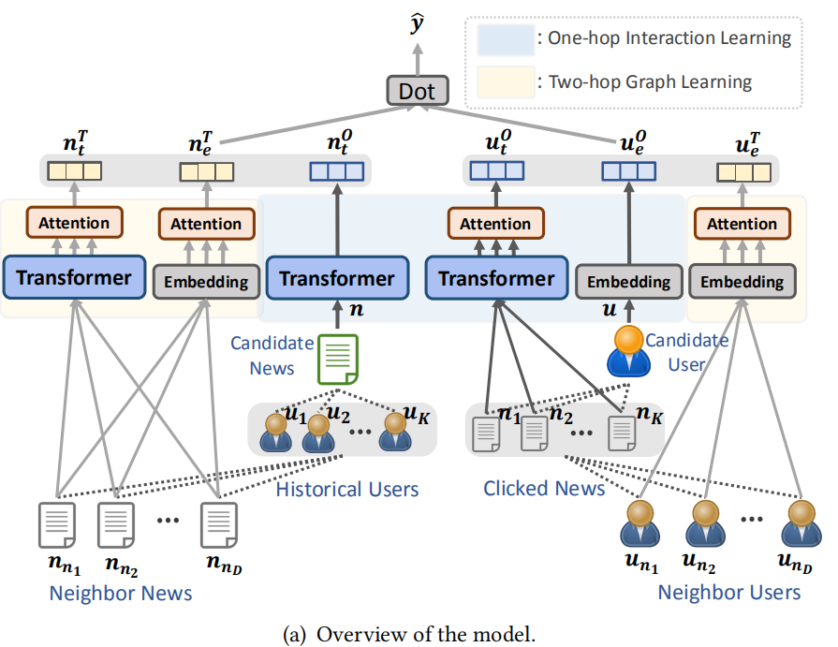
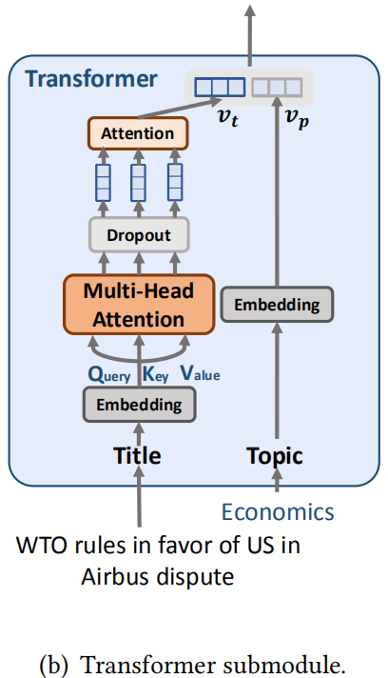
Approach
eg.Sparks gives Penny Toler a fire from the organization
title:
title embedding:
h_{i} =

Slide 7
Approach
One-hop:
(1) Candidate news semantic representations
(2) Target user semantic representations
(3) Target user ID representations
a target user u clicked news:
clicked news through transformer:
attention weight β^{n}_{i} of the ith clicked news:

Slide 8
Approach
Two-hop:
(1) Neighbor user ID representations
(2) Neighbor news ID representations
(3) Neighbor news semantic representations
neighbor users:
neighbor users ID embedding:
attention weight β^{u}_{i} of the ith neighbor user:

Slide 9
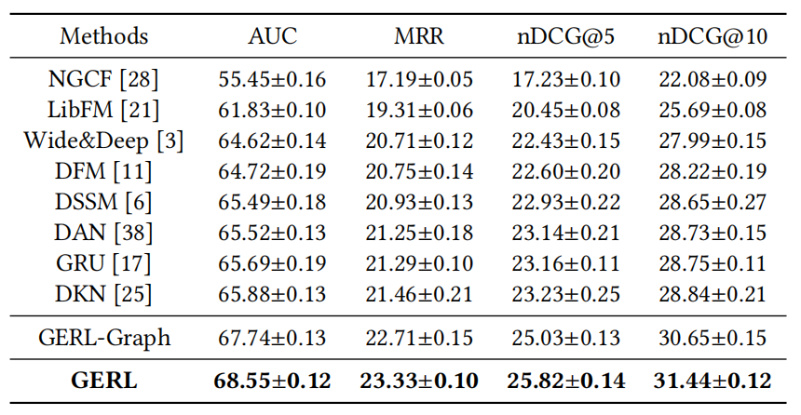
Experiments
data: Dec. 13rd, 2018 to Jan. 12nd,2019
maximum length of news title: 30
max number of user clicked news: 50
dataset: MSN News [https://www.msn.com/en-us/news.]

Slide 10
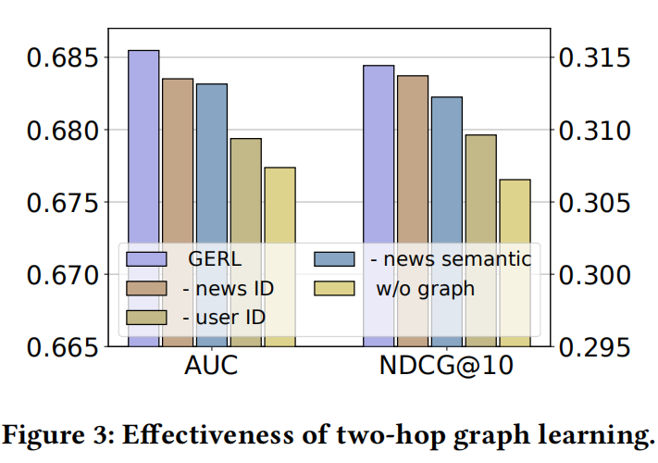
Experiments
1.Adding the neighbor user information improves performances more significantly than adding neighbor news information.
2.The improvement brought by neighbor news semantic representations outweighs that brought by neighbour news ID.
3. Combining each part in the graph learning leads to the best model performance.

Slide 11
Conclusion
Our approach consists of a one-hop interaction learning module and a two-hop graph learning module. The one-hop interaction learning module forms news representations via the transformer architecture. It also learns user representations by attentively aggregating their clicked news. The two-hop graph learning module enhances the representations of users and news by aggregating their neighbor embeddings via a graph attention network. Both IDs and textual contents of news are utilized to enrich the neighbor embeddings.

Slide 12
Thanks!

