Slide 1
Chongqing University of Technology
ATAI
Advanced Technique of Artificial Intelligence
Chongqing University of Technology
Global Context Enhanced Graph Neural Networks for Session-based Recommendation
(SIGIR-2020)
Reported by Ting Wang
2020.09.24 • ChongQing

Slide 2
Chongqing University of Technology
ATAI
Advanced Technique of Artificial Intelligence
Chongqing University of Technology
1. Introduction
2. Method
3. Experiments
4. Conclusion

Slide 3
Introduction
Innovation：
1. Global graph
2. Session graph
3. Reversed position information

Slide 4
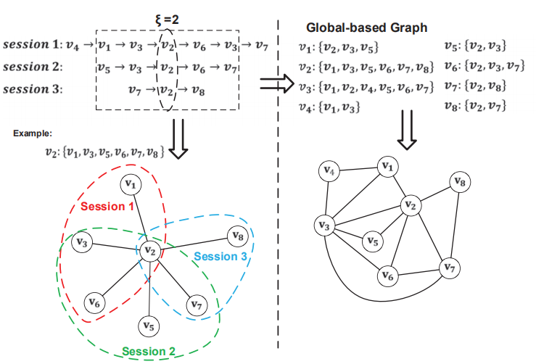
Introduction
Global graph：
v4

Slide 5
Introduction
Session graph:
Reversed position:
forward：
2
V3：
reverse：
4

Slide 6
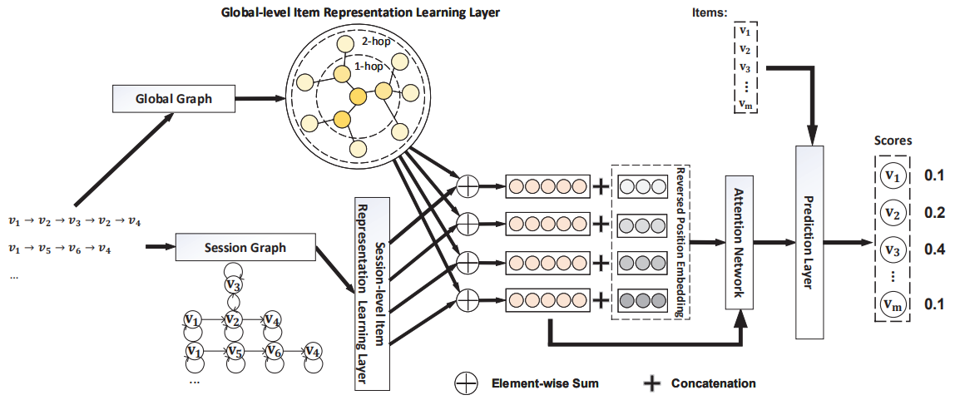
Approach
Global-level：
Information Propagation：
邻居item的最终表示
（1）
计算att score
（2）
Information Aggregation：
item的最终表示
（3）
第k层的最终表示
（4）

Slide 7
Approach
（5）
Session-level：
（6）
Short-term
（7）
Session Representation：
（8）
（9）
（10）
（11）
Long-term
（12）
（13）

Slide 8
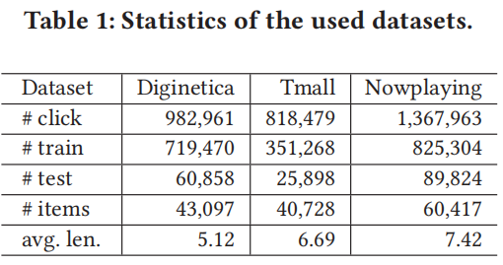
Experiments
Dataset:
Dignetica: https://competitions.codalab.org/competitions/11161
Tmall: https://tianchi.aliyun.com/dataset/dataDetail?dataId=42
Nowplaying: http://dbis-nowplaying.uibk.ac.at/#nowplaying

Slide 9
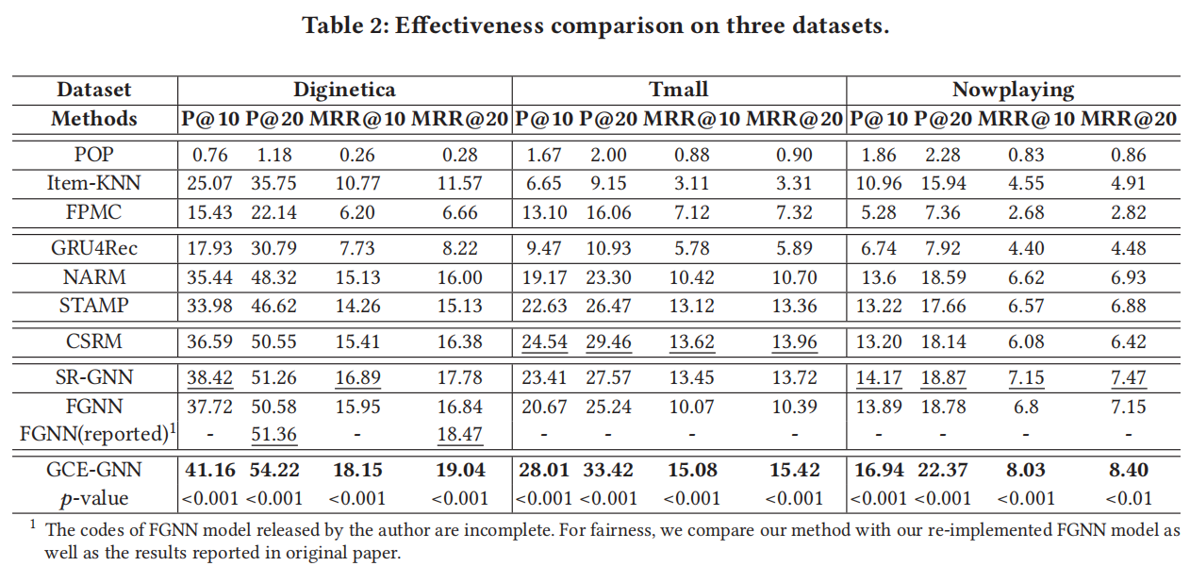
Experiments

Slide 10
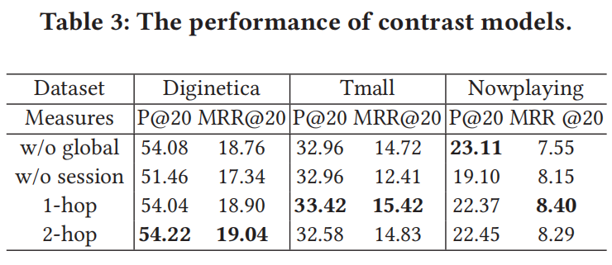
Experiments
Impact of Global Feature Encoder:
GCE-GNN w/o global: GCE-GNN without global-level feature encoder and only with local feature.
GCE-GNN w/o session: GCE-GNN without session-level feature encoder and only with global feature.
GCE-GNN-1-hop: GCE-GNN with global-level feature encoder, which sets the number of hop to 1.
GCE-GNN-2-hop: GCE-GNN with global-level feature encoder, which sets the number of hop to 2.

Slide 11
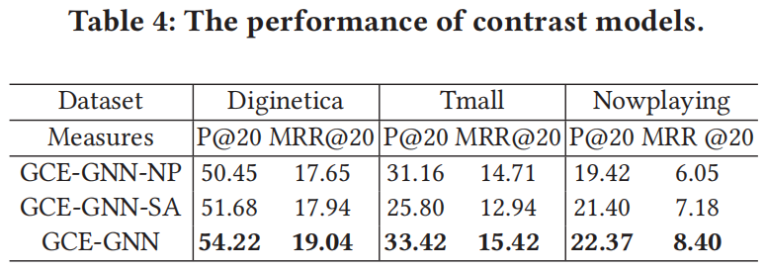
Experiments
Impact of Position Vector:
GCE-GNN-NP: GCE-GNN with forward position vector replacing the reverse order position vector.
GCE-GNN-SA: GCE-GNN with self attention function replacing the position-aware attention.

Slide 12
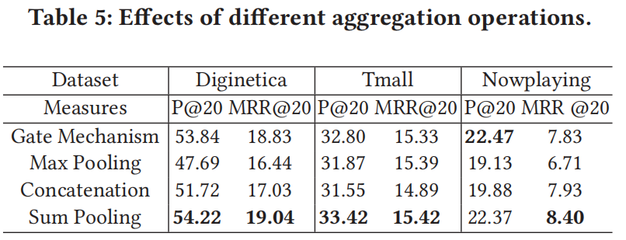
Experiments
Impact of Aggregation Operations:
Gate:
Max pooling:
Concate:

Slide 13
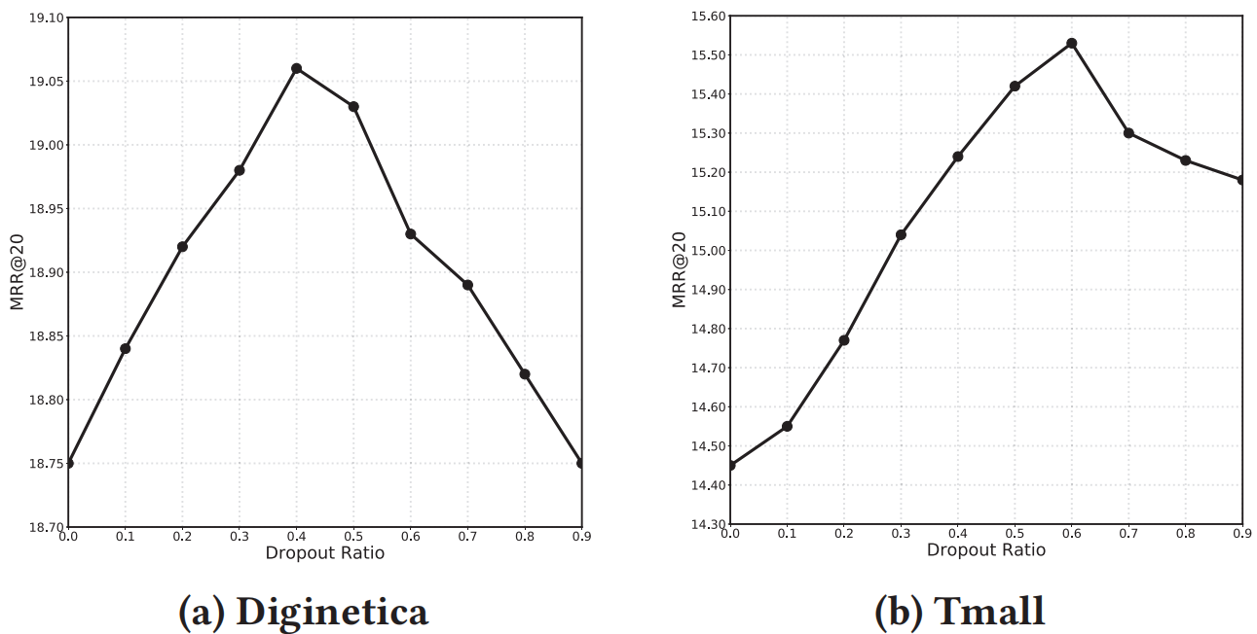
Experiments
Impact of Dropout Setting:

Slide 14
Conclusion
It first converts the session sequences into session graphs and construct a global graph. The local context information and global context information are subsequently combined to en-hance the feature presentations of items. Finally, it incorporates the reversed position vector and session information to empower the proposed model to better learn the contribution of each item. Comprehensive experiments demonstrate that the proposed method significantly
outperforms nine baselines over three benchmark datasets consistently.

Slide 15
Thanks!

