Slide 1
Chongqing University of Technology
ATAI
Advanced Technique of Artificial Intelligence
Chongqing University of Technology
LightGCN: Simplifying and Powering Graph Convolution
Network for Recommendation
Xiangnan He, et al(SIGIR 2020)
Reported by Ziteng Wu

Slide 2
Chongqing University of Technology
ATAI
Advanced Technique of Artificial Intelligence
Chongqing University of Technology
1. Introduction
2. Preliminaries
3. Method
4. Experiments

Slide 3
Introduction
GCN is originally proposed for node classification on attributed graph, where each node has rich attributes as input features; whereas in user-item interaction graph for CF, each node (user or item) is only described by a one-hot ID, which has no concrete semantics besides being an identifier. In such a case, given the ID embedding as the input, performing multiple layers of nonlinear feature transformation — which is the key to the success of modern neural networks — will bring no benefits, but negatively increases the difficulty for model training.
To validate our thoughts, we perform extensive ablation studies on NGCF( a
state-of-the-art GCN-based recommender model). With rigorous controlled experiments (on the same data splits and evaluation protocol).

Slide 4
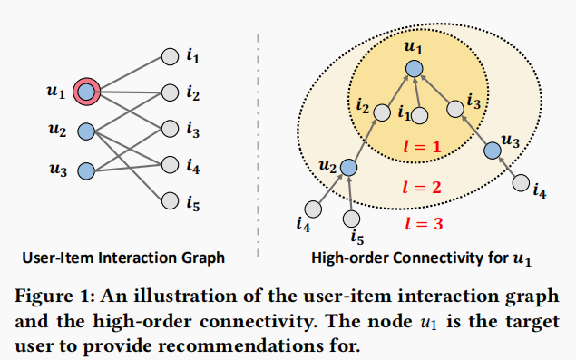
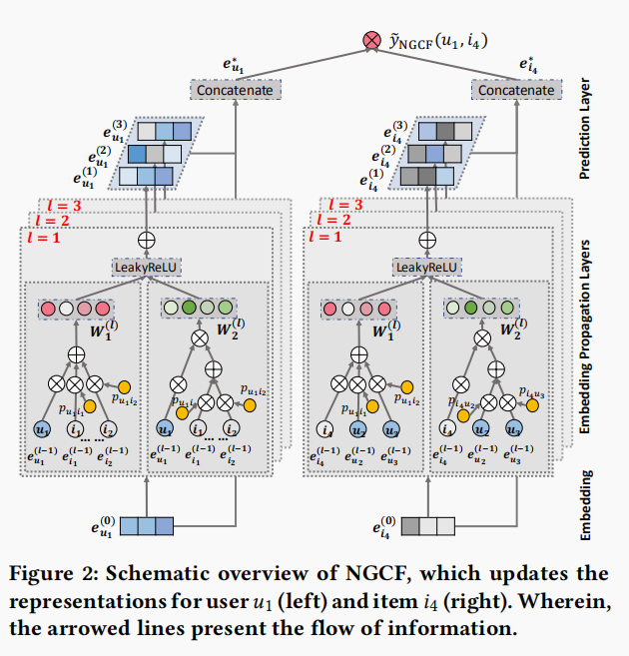
Preliminaries
NGCF
Notes:
NGCF中遵循标准GCN，里面有特征转换和非线性激活，作者猜想这两个部分对CF没有帮助，只会增加训练难度。接下来做消融实验验证猜想。

Slide 5
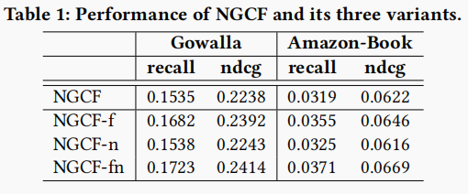
Preliminaries
Ablation
keep all hyper-parameters (e.g., learning rate, regularization coefficient, dropout ratio, etc.) same as the optimal settings of NGCF.
feature transformation and nonlinear activation impose rather negative effect on NGCF, since by removing them simultaneously, NGCF-fn demonstrates large improvements over NGCF

Slide 6
Preliminaries
Conclusion:
the two operations inherited from GCN — feature transformation and nonlinear activation — has no contribution on NGCF’s effectiveness. Even more surprising, removing them leads to significant accuracy improvements. This reflects the issues of adding operations that are useless for the target task in graph neural network, which not only brings no benefits, but rather degrades model effectiveness

Slide 7
Method
LightGCN
including the most essential component of GCN — neighborhood aggregation — for collaborative filtering.
associate each user (item) with an ID embedding
propagate the embeddings on the user-item interaction graph to refine them
combine the embeddings learned at different propagation layers with a weighted sum to obtain the final embedding for prediction

Slide 8
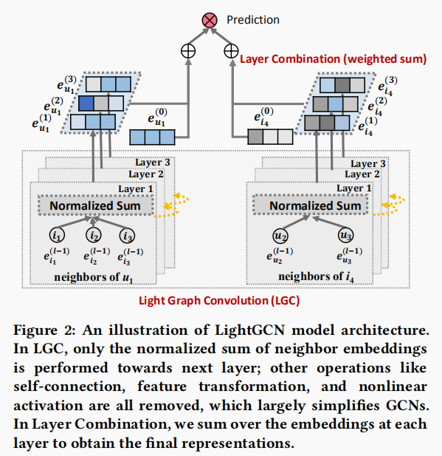
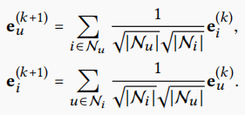
Method
initial
graph convolution operation
the final representation of a user (an item)
model prediction
BPR Loss
Matrix form:

Slide 9
Method
Model Analysis
discuss the connection with the Simplified GCN (SGCN)
this analysis shows that by doing layer combination, LightGCN subsumes the effect of self-connection thus there is no need for LightGCN to add self-connection in adjacency matrix.
discuss the relation with the Approximate Personalized Propagation of Neural Predictions (APPNP)
LightGCN enjoys the sames benefits in propagating long-range with controllable
oversmoothing

Slide 10
Experiments
experimented datasets

Slide 11
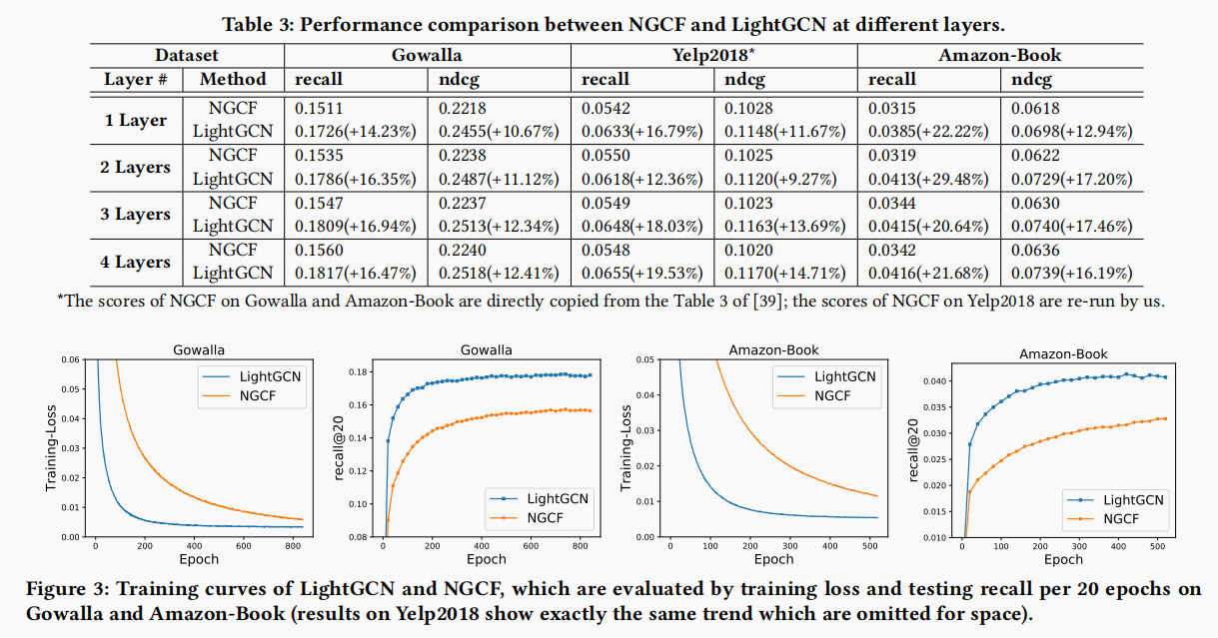
Experiments
different layers (1 to 4)

Slide 12
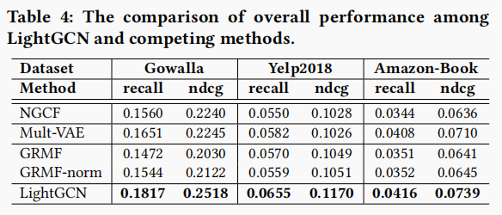
Experiments
LightGCN Performance

Slide 13
Experiments
Results of LightGCN and the variant that does not use layer combination (i.e., LightGCN-single) at different layers

Slide 14
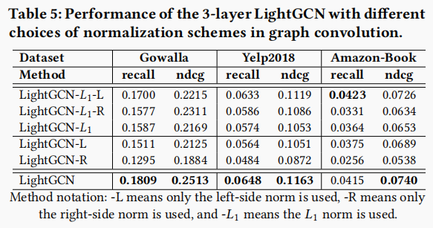
Experiments
Performance of the 3-layer LightGCN with different choices of normalization schemes

Slide 15
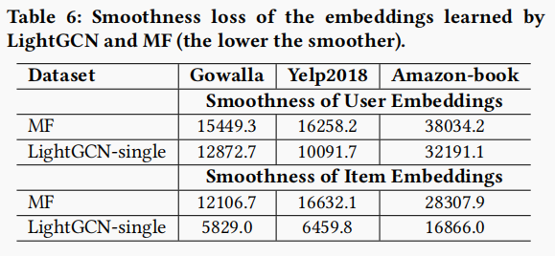
Experiments
Smoothness loss

Slide 16
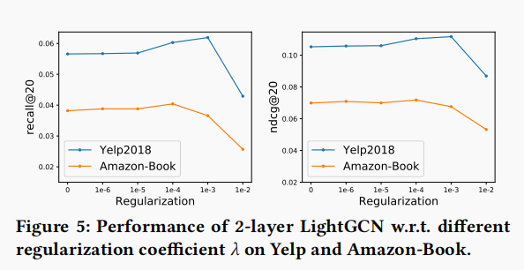
Experiments
different regularization coefficient λ

Slide 17
Thanks

