Slide 1
Chongqing University of Technology
ATAI
Advanced Technique of Artificial Intelligence
Chongqing University of Technology
K-BERT: Enabling Language Representation with Knowledge Graph
Tang Gu

Slide 2
Outline
Introduction
Approach
Experiments
Conclusion

Slide 3
Transformer

Slide 4
Positional Encoding
In the above formula, POS refers to the position of the word in the sentence, the value range is [0, \ Max \ sequence \ length], I refers to the dimension of the word vector, and the value range is [0, \ embedding \ dimension). There is a set of formulas for sin and COS, that is, a set of dimensions corresponding to the odd and even serial numbers of the embedding \ dimension, such as 0, 1, 2, 3, The above sin and COS functions are used for processing respectively, so as to produce different periodic changes. As the number of dimensions increases, the periodic changes of position embedding in embedding \ dimension dimension will become slower and slower, and a texture containing position information will be produced. As mentioned on page 6 of the original paper, the period of position embedding function changes from 2 \ pi to 10000 * 2 \ PI, In each location embedding \ dimension dimension, the value combination of sin and COS functions of different periods will be obtained, so as to generate a unique texture location information, and the model can learn the dependency between locations and the temporal characteristics of natural language

Slide 5
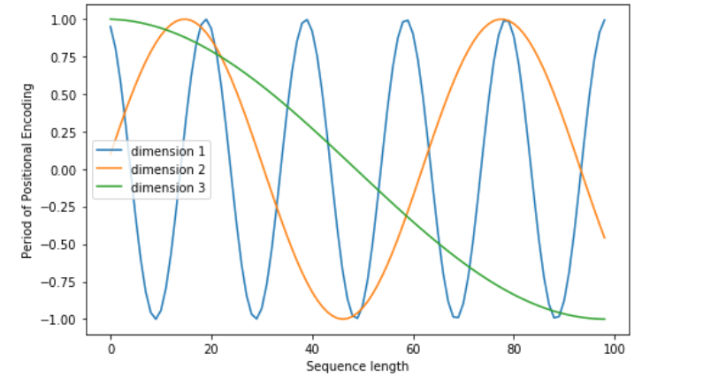
Positional Encoding

Slide 6
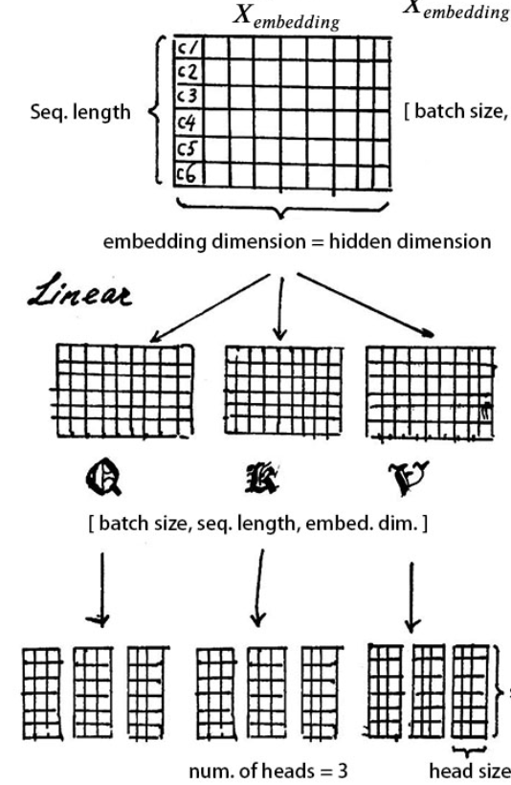
Multi-head self-attention

Slide 7
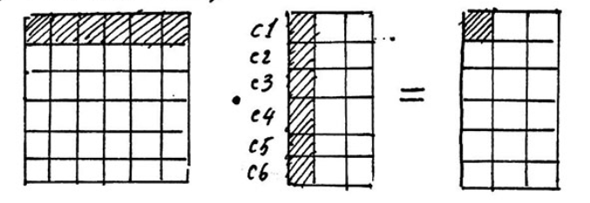
Multi-head self-attention

Slide 8
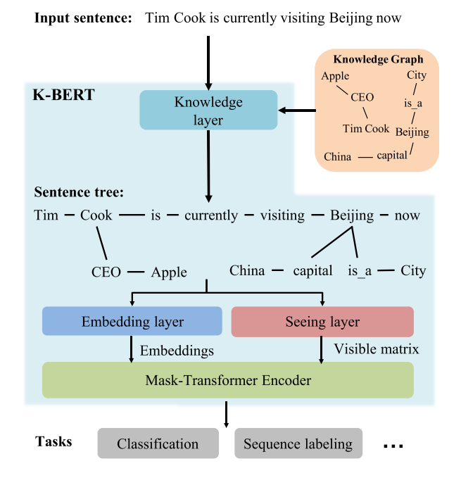
Approach

Slide 9
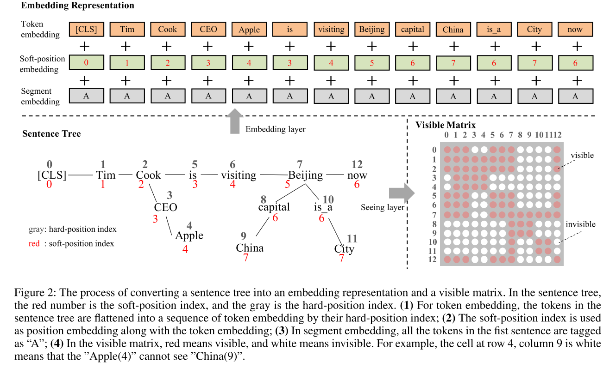
Approach
Notes:
Edges:
Topic-Document:document is belong to topic
Document-entity:entity is belong to document
Entity-entity:cosine similarity

Slide 10
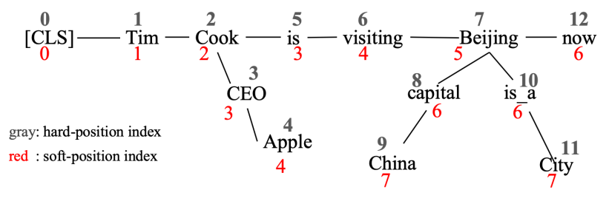
Approach
Notes:
Three types of nodes (i.e., actor, movie, director). (b) A heterogenous graph IMDB consists three types of nodes and two types of connections.
(c) Two meta-paths involved in IMDB (i.e., Moive-Actor-Moive and Movie-Director-Movie). (d) Moive m1 and its meta-path based neighbors (i.e., m1, m2 and m3).

Slide 11
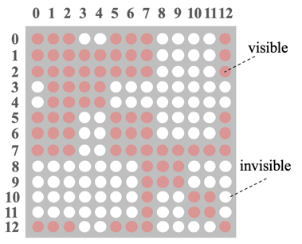
Approach

Slide 12
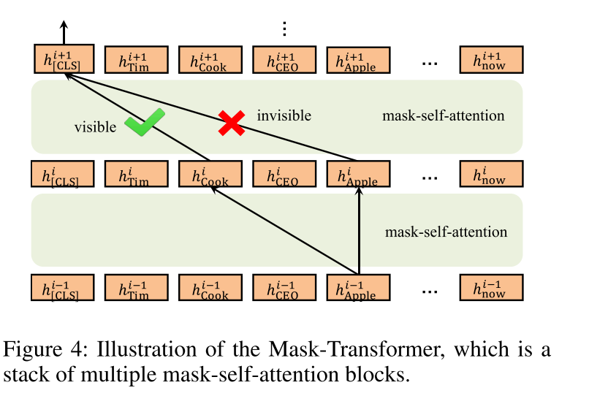
Approach

Slide 13
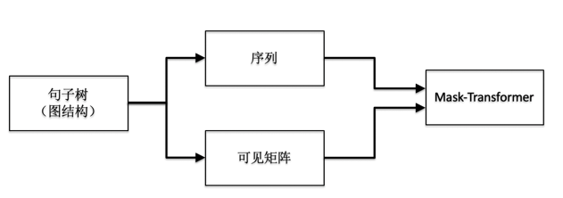
Approach

Slide 14
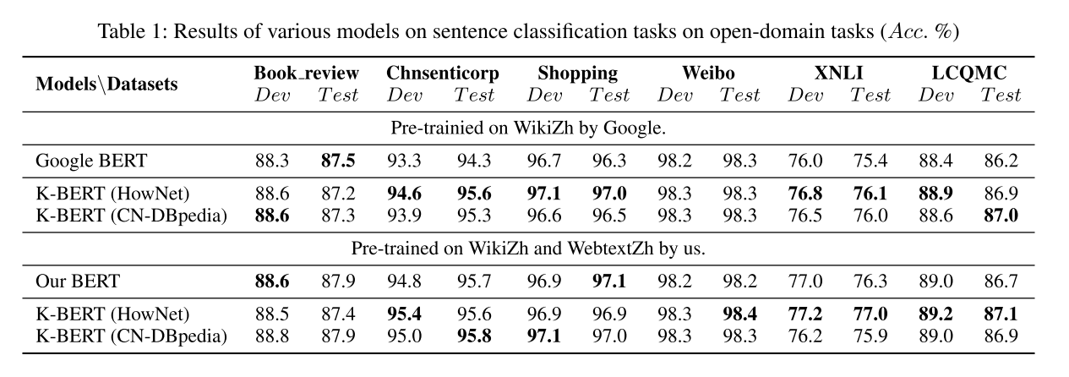
Experiments
Notes:
ASGCN-DT:在依赖树上是有方向的，ASGCN-DG在依赖树上是无方向的，它们之间唯一的区别在于邻接矩阵不同，ASGCN-DT的邻接矩阵会比较稀疏一点

Slide 15
Experiments

Slide 16
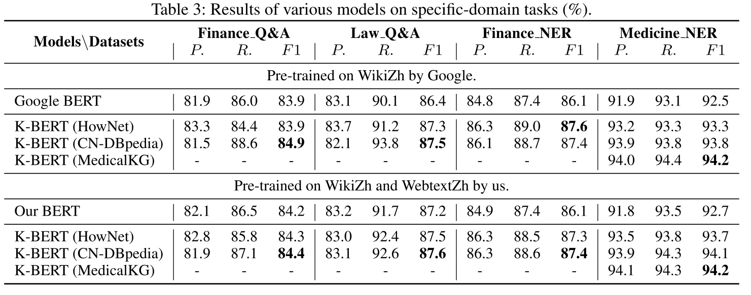
Experiments

Slide 17
Conclusion
In general, the knowledge map is suitable for improving tasks that require background knowledge, but for open domain tasks that do not require background knowledge, the effect is often not significant.
At present, K-BERT still has many problems that need to be solved, for example: how to improve the robustness of the model when the quality of the knowledge graph is too poor; how to eliminate the wrong association caused by the polysemy when the entity is associated.

Slide 18
Thanks

