Slide 1
Real-time Scene Text Detection with Differentiable Binarization
Minghui Liao1, Zhaoyi Wan2, Cong Yao2, Kai Chen3,4, Xiang Bai1
Copyright 2020, Association for the Advancement of Artificial
Intelligence (www.aaai.org). All rights reserved.
202/12/17
qiulianpeng

Slide 2
table of Contents
01
Introduction
02
Methodology
03
Experiment
04
Conclusion

Slide 3
Introduction
1

Slide 4
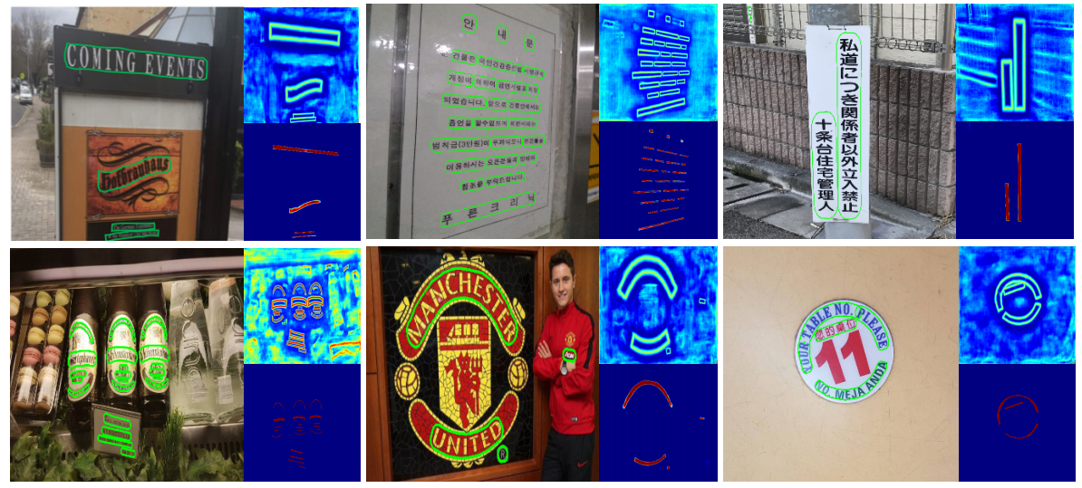
Introduction

Slide 5
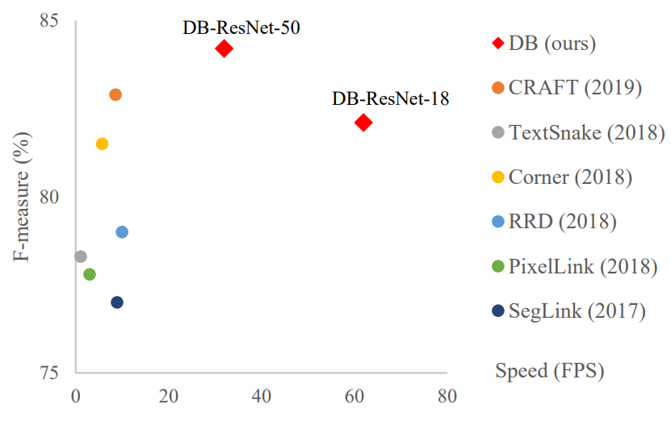
Introduction
comparisons
Differentiable Binarization module
（DB module）

Slide 6
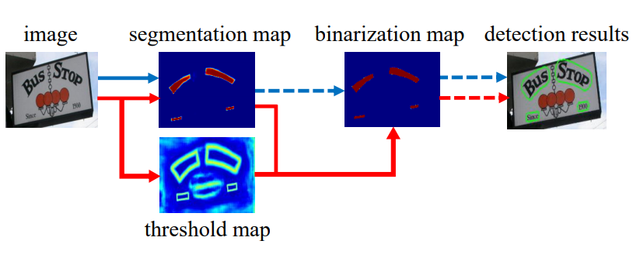
Introduction
comparisons
Traditional pipeline (blue flow) and our pipeline (red flow). Dashed arrows are the inference only operators; solid arrows indicate differentiable operators in both training and inference.

Slide 7
Methodology
2

Slide 8
Methodology
Methodology
Figure 3: Architecture of our proposed method, where “pred” consists of a3×3convolutional operator and two de-convolutional operators with stride 2.
The “1/2”, “1/4”, ... and “1/32” indicate the scale ratio compared to the input image.

Slide 9
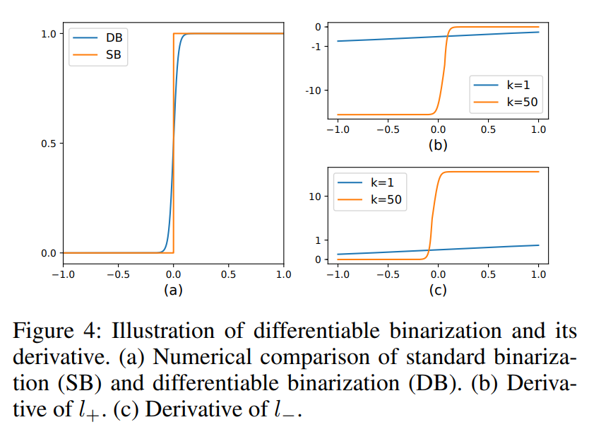
Standard binarization
Binarization
Differentiable Binarization

Slide 10
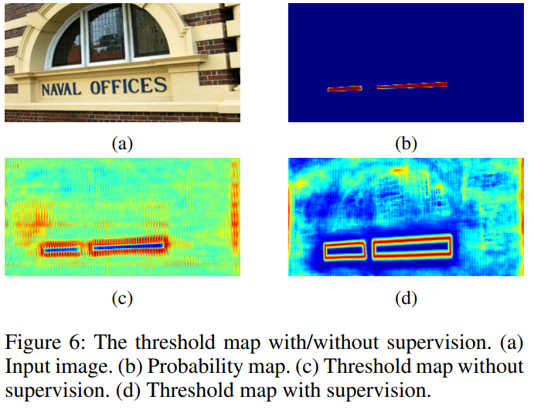
Adaptive threshold
Binarization
we apply border-like supervision on the threshold map for better guidance.
In the training period, the
supervision is applied on the probability map, the threshold map, and the approximate binary map, where the probability map and the approximate binary map share the same supervision.

Slide 11
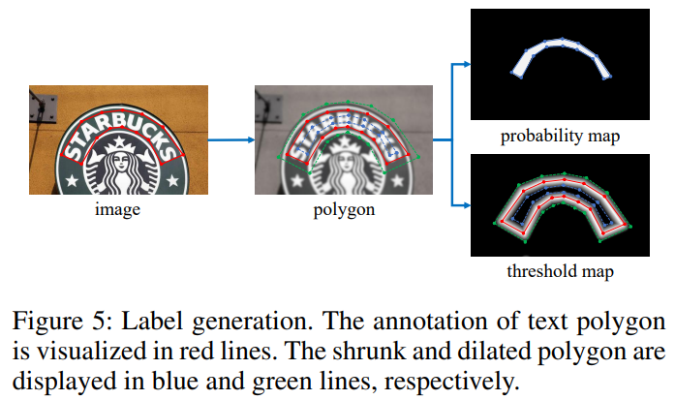
Label generation
Methodology
offset D of shrinking is computed from the perimeter L and
area A of the original polygon:
r is the shrink ratio, set to 0.4 empirically.

Slide 12
Optimization
Methodology
The loss function L:
where Ls is the loss for the probability map and Lb is the loss for the binary map. loss for the threshold map Lt. According to the numeric values of the losses, α and β are set to 1.0 and 10 respectively.
Apply a BCE loss for both Ls and Lb:
Rd is a set of indexes of the pixels inside the dilated polygon Gd; y∗ is the label for the threshold map

Slide 13
Experiment
3

Slide 14
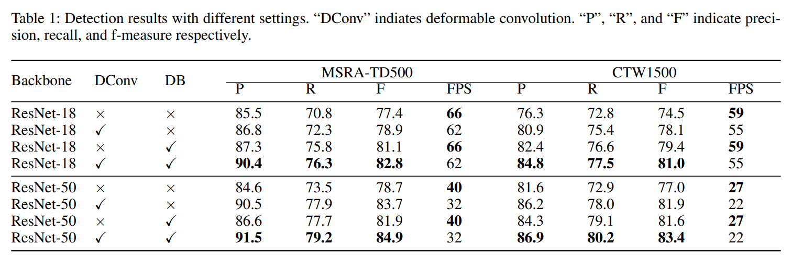
Experiment
Ablation study

Slide 15
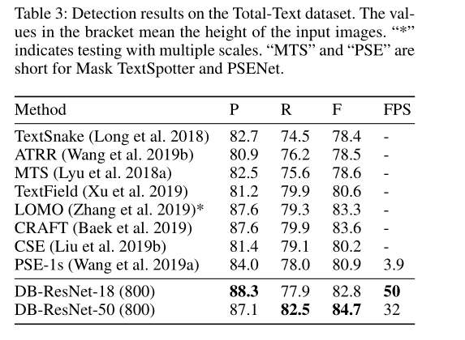
Experiment
Performance comparison
Total-Text dataset

Slide 16
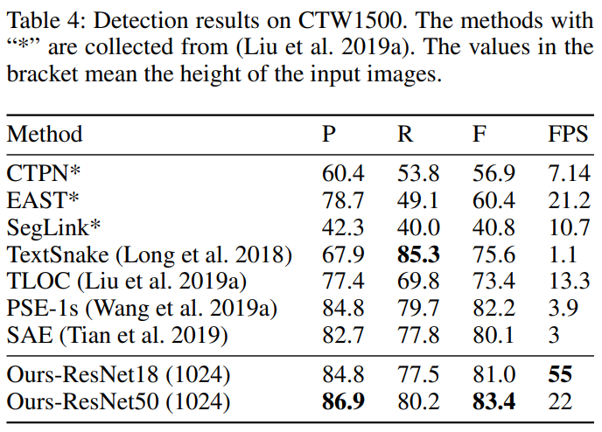
Experiment
Performance comparison
CTW1500：

Slide 17
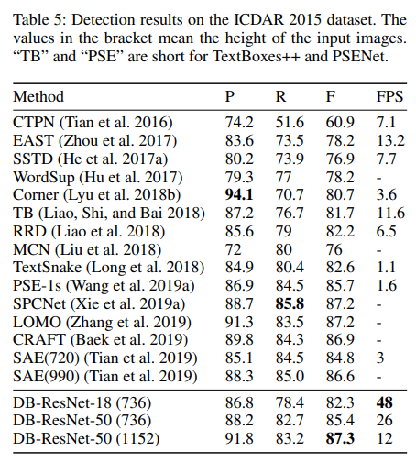
Experiment
Performance comparison
ICDAR 2015：

Slide 18
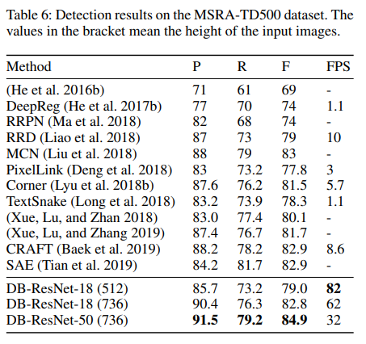
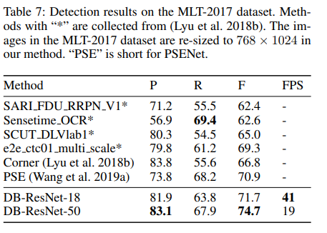
Experiment
Performance comparison
MSRA-TD500 and MLT-2017：

Slide 19
Conclusion
4

Slide 20
Conclusion
1.Achieves consistently better performances on five benchmark datasets of scene text, including horizontal, multi-oriented and curved text.
2. Performs much faster than the previous leading methods, as DB can provide a highly robust binarization map, significantly simplifying the post-processing.
3. DB works quite well when using a light-weight backbone,which significantly enhances the detection performance with the backbone of ResNet-18.
4. As DB can be removed in the inference stage without sacrificing the performance, there is no extra memory/time cost for testing.

Slide 21
Thanks！
202/12/17
qiulianpeng

