Slide 1
Fairness-Aware Explainable Recommendation over Knowledge Graphs
Zuohui Fu, Yikun Xian, Ruoyuan Gao , Jieyu Zhao , Qiaoying Huang , Yingqiang Ge, Shuyuan Xu , Shijie Geng , Chirag Shah , Yongfeng Zhang , Gerard de Melo
Rutgers University
SIGIR 2020
Speaker：刘东
51200314101

Slide 2
Outline
INTRODUCTION
DATASET
FAIRNESS OBJECTIVES
FAIRNESS-AWARE ALGORITHM
EXPERIMENTS
CONCLUSIONS

Slide 3
INTRODUCTION
Compared with traditional recommendation systems (RS), explainable recommendation is capable of not only providing high-quality recommendation results but also offering personalized and intuitive explanations [45], which are important for e-commerce and social media platforms.
Two problems:
Recommendation performance
Explanation diversity
Reason:
Data imbalance

Slide 4
INTRODUCTION
Why KG?
Since KGs preserve structured and relational knowledge, they make it easy to trace the reason for specific recommendations. KG-based approaches have thus grown substantially in popularity in explainable recommendation. Their explicit explanations take the form of reasoning paths, consisting of a sequence of relationships that start from a user and ultimately lead to a recommended item.
What’s problem?
Current RS methods tend to neglect the user–item interactions of less visible, inactive users, since they are easily overwhelmed by more visible, active users.

Slide 5
INTRODUCTION
The goals of this paper:
how to verify our concerns about the unfairness problems in explainable recommender systems and quantify such unfairness;
how to alleviate any potential algorithmic bias so as to improve the recommendation quality, while providing diverse explanations, especially for disadvantaged users
whether our fairness-aware method is able to consider both group-level fairness and individual-level fairness, and whether it possesses generalizability to multiple KG-enhanced explainable RS methods.

Slide 6
DATASET
Studying four e-commerce datasets from Amazon and conduct a data-driven observation analysis to assess their data imbalance characteristics.

Slide 7
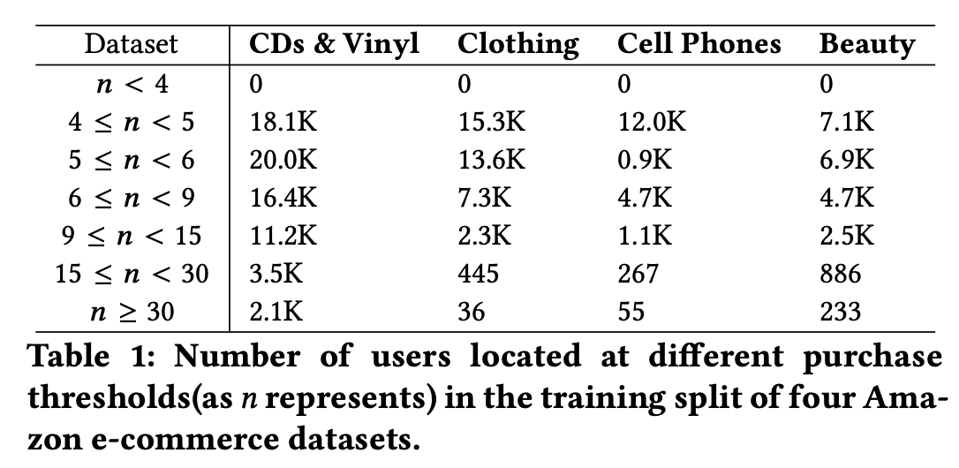
DATASET
Data Imbalance

Slide 8
DATASET
Path Distributions as a Cause of Unfairness

Slide 9
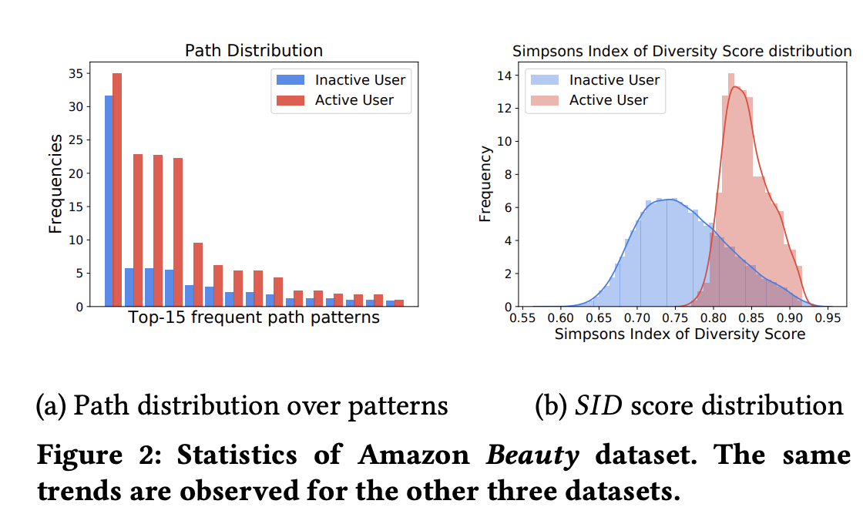
DATASET
The divergence of user–item path distributions between two groups is an essential factor leading to unfair recommendation performance and a disparity in the diversity of explanations.

Slide 10
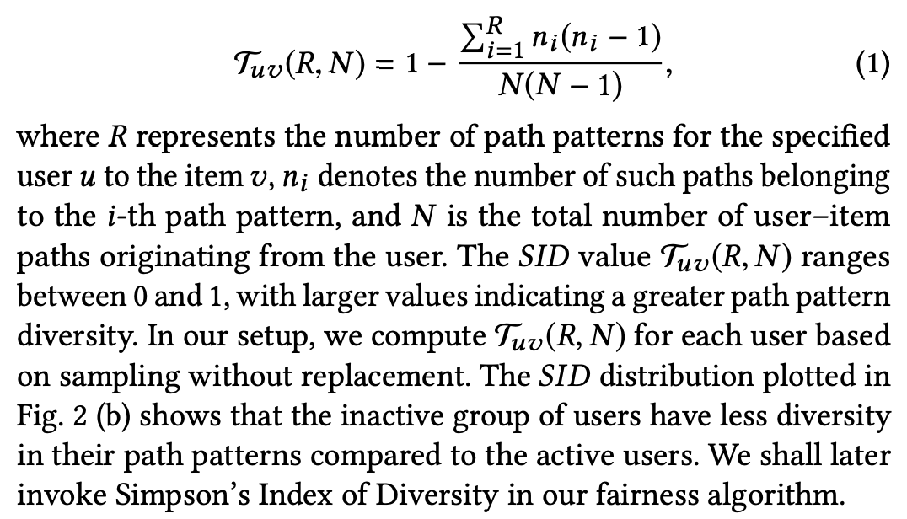
DATASET
Quantifying Diversity
Simpson’s Index of Diversity (SID)
The probability of obtaining the same pattern in two random draws is defined as :

Slide 11
FAIRNESS OBJECTIVES
We formally define the problem of fairness-aware explainable recommendation, considering both group and individual level fairness.

Slide 12
FAIRNESS OBJECTIVES
Group Unfairness Metrics:

Slide 13
FAIRNESS OBJECTIVES
Group Unfairness Metrics:

Slide 14
FAIRNESS OBJECTIVES
Individual Unfairness Metrics :

Slide 15
FAIRNESS-AWARE ALGORITHM
Question:
How could an explainable recommendation model be able to yield a fair recommendation list while maintaining explanation diversity?
Introduce two fairness scores:
the path score $S_{p}$ and the diversity score $S_{d}$

Slide 16
FAIRNESS-AWARE ALGORITHM
Path Score:
The path score weights the quality of paths.
$S(u, π)$as the coefficient expressing the preference adjustment for the user $u_{i}$.
$w_{π}$represents the weight of the path pattern π in generated explainable paths

Slide 17
FAIRNESS-AWARE ALGORITHM
Diversity Score:
Additionally, we also consider the fairness with regard to explainable path diversity h diversity
Fairness score:
By aggregating the personalization and diversity scores, we can calculate the fairness score for user ui defined as:

Slide 18
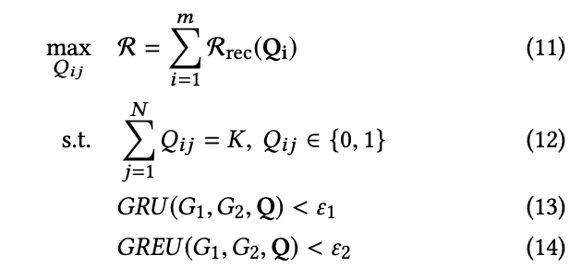
FAIRNESS-AWARE ALGORITHM
Recommendation score:
Therefore, we can formulate the optimization recommendation problem as follows:

Slide 19
FAIRNESS-AWARE ALGORITHM
Ranking Score:
Specifically, we create a top-k recommendation list with items ranked in descending order by the optimized recommendation score and the fairness score, defined as:

Slide 20
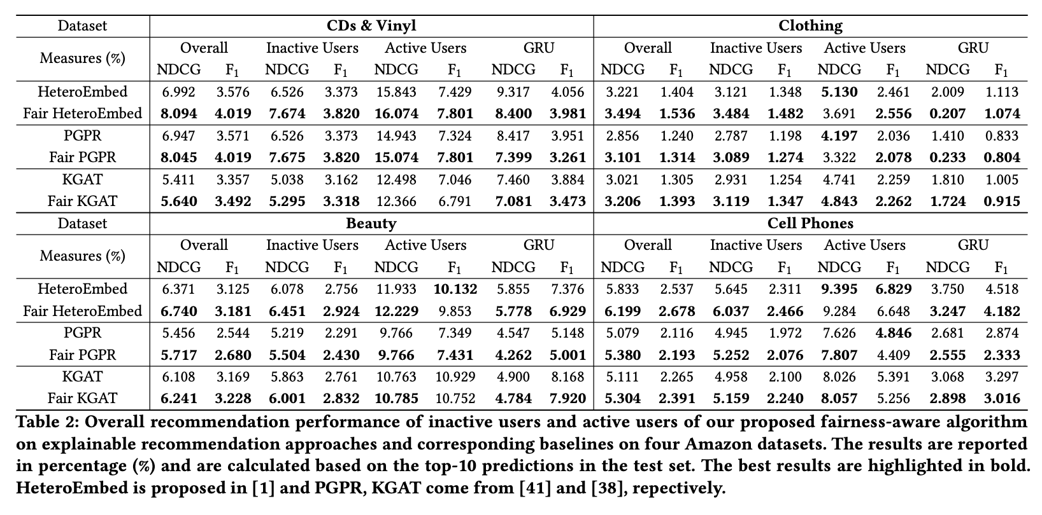
EXPERIMENTS
Main Results:

Slide 21
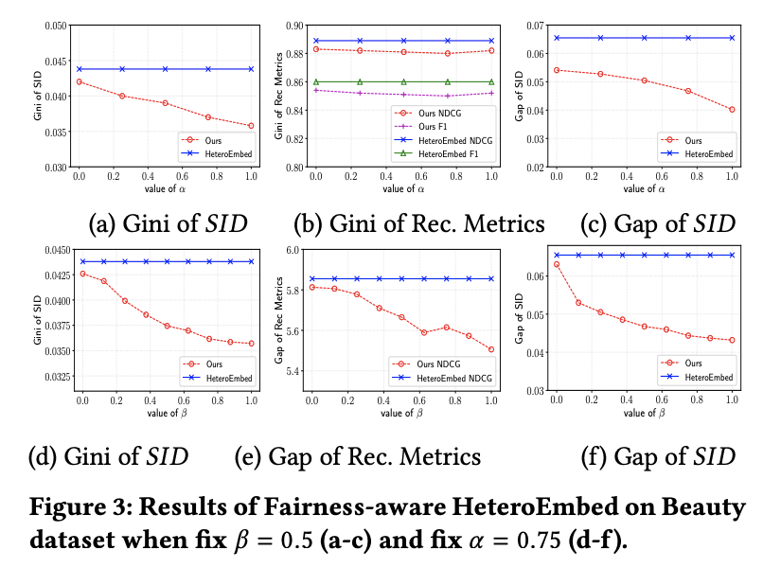
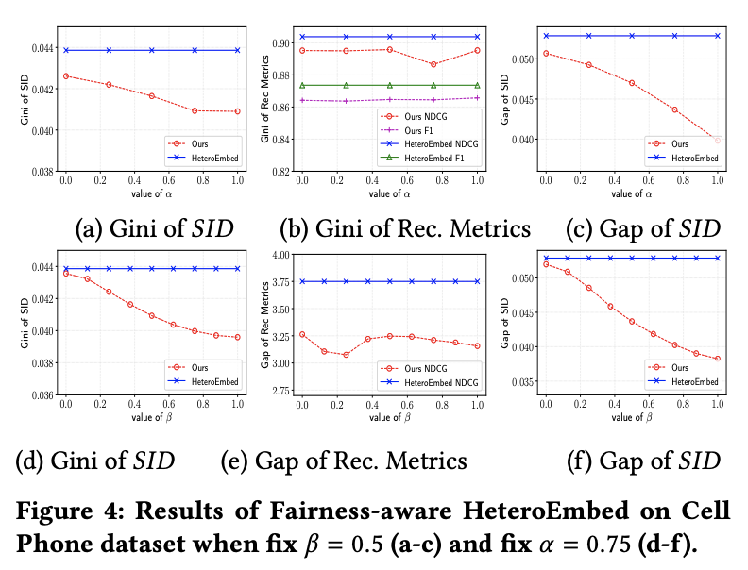
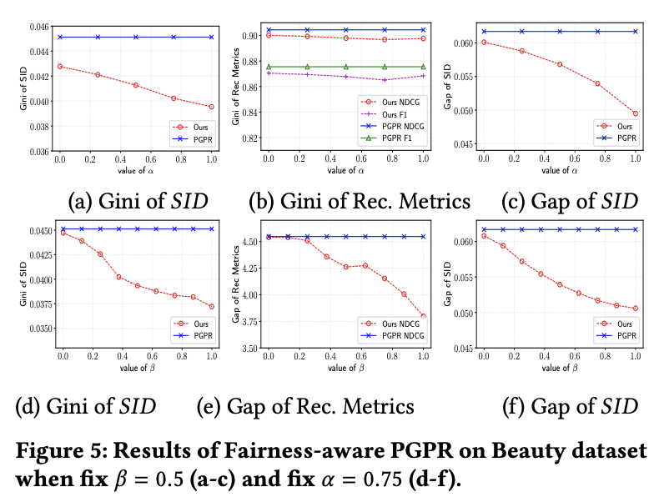
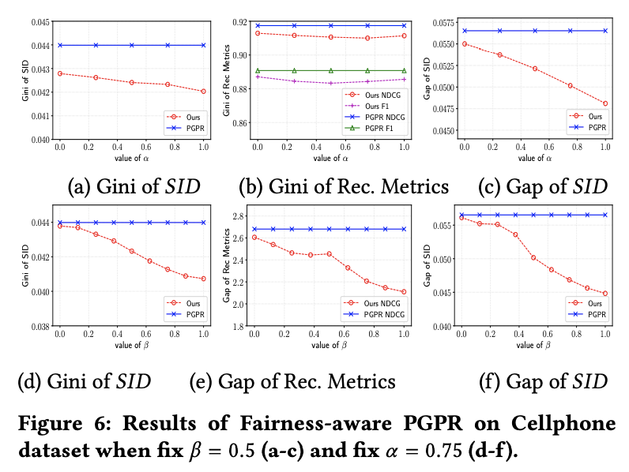
EXPERIMENTS
Ablation Study :

Slide 22
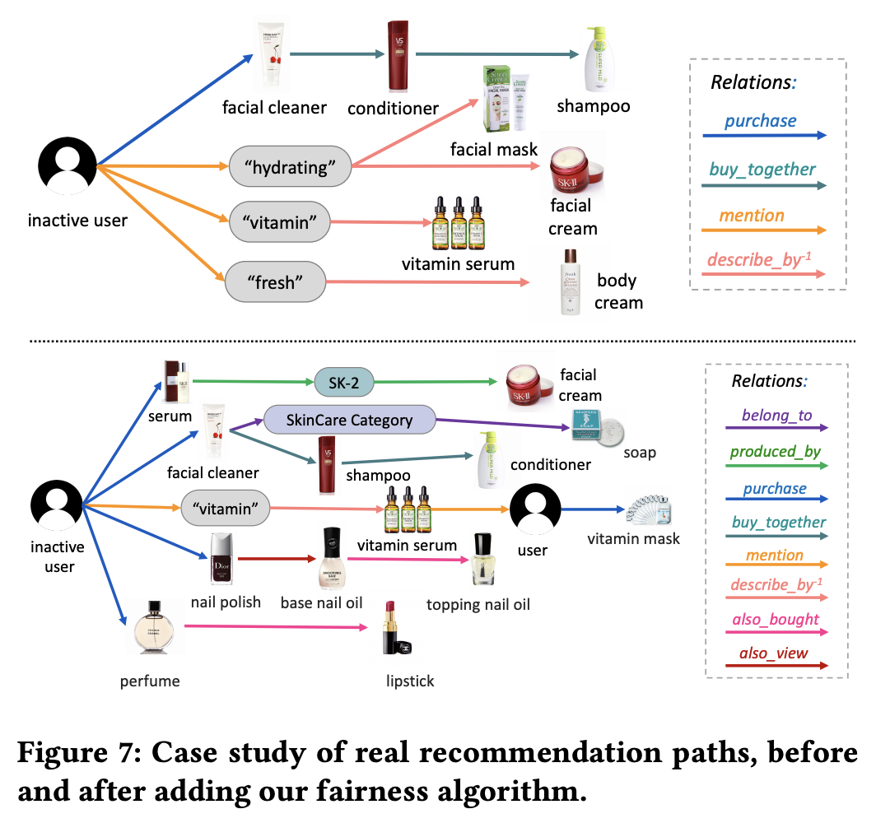
EXPERIMENTS
Case study:

Slide 23
CONCLUSIONS
Quantify unfairness at both the individual level and the group level.
Propose fairness metrics in terms of path diversity as well as the recommendation performance disparity.
Present a generalized fairnessaware algorithm that is capable not only of reducing the disparity but also of maintaining the recommendation quality

Slide 24
Thanks

