Slide 1
Chongqing University of Technology
ATAI
Advanced Technique of Artificial Intelligence
Chongqing University of Technology
Dynamic Online Conversation Recommendation(ACL-2020)
Xingshan Zeng, Jing Li, Lu Wang, Zhiming Mao, Kam-Fai Wong
2020.11.26
Reported by Jie Li
Code&dataset:https://github.com/zxshamson/dy-conv-rec

Slide 2
Chongqing University of Technology
ATAI
Advanced Technique of Artificial Intelligence
Chongqing University of Technology
2020.11.26
Reported by Jie Li
Code&dataset:https://github.com/zxshamson/dy-conv-rec

Slide 3
Chongqing University of Technology
ATAI
Advanced Technique of Artificial Intelligence
Chongqing University of Technology
1.Introduction
2.Method
3.Experiments
4.Conclusion

Slide 4
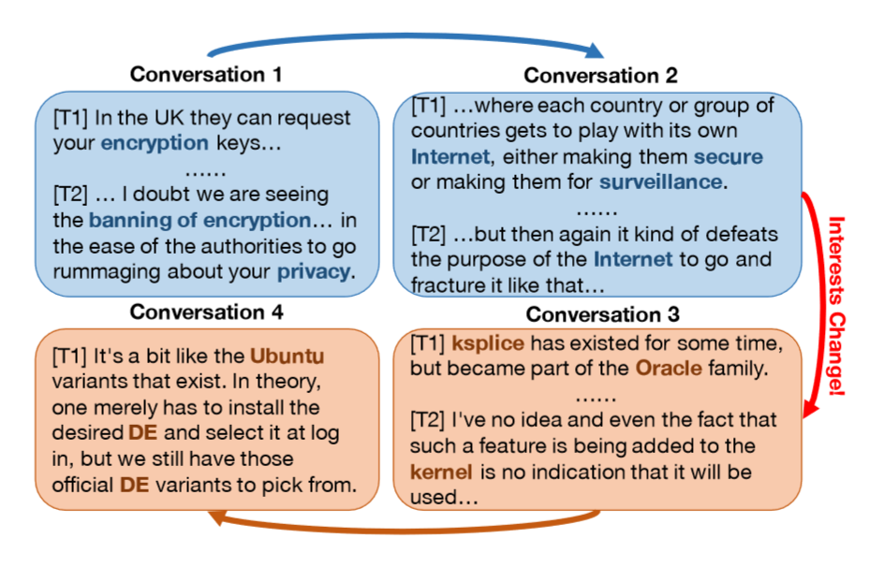
Introduction
The huge volume of online conversations produced daily hinders people’s capability of finding the information they
are interested in.
As a result, there is pressing demand for developing a conversation recommendation engine that tracks ongoing conversations and recommends suitable ones to users.

Slide 5
Introduction
Existing work do not change over time and relies on rich user interaction history for model training .
When a conversation is entirely absent from training data, the model performance is inevitably compromised. This phenomenon is referred to as conversation cold start.
To overcome this predicament, we explore dynamic conversation recommendation, which can model the change of user interests over time.

Slide 6
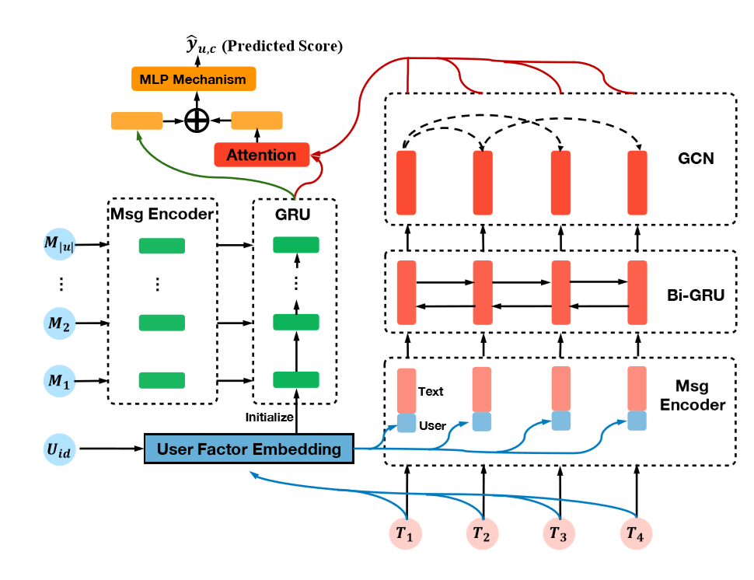
Method
Overall structure of our model.

Slide 7
Method
User Response Prediction
Capturing how user interests change over time and take advantage of the recent advancement of dynamic product recommendation
Conversation Structure Modeling
To understand conversation structure from temporal dynamics and replying structure.

Slide 8
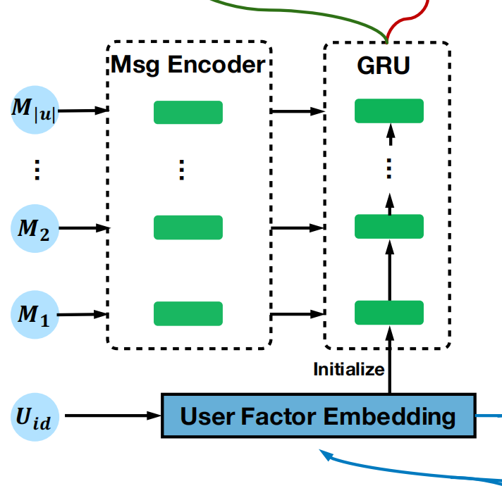
Method
Message-level Modeling.
First use a pre-trained word embedding layer to map each word into a vector space, and then employ a Convolutional Neural Network (CNN) encoder to model word occurrence with their neighbors. Afterwards, we output representation to reflect m’s content.

Slide 9
Method
User-level Modeling
Some user interests may change rapidly and some may last for a long time. For the latter,we adopt a user embedding layer to capture the time-invariant interest factor and define u’s factor as .
For the time-variant interests, we are inspired by previous work and employ a GRU encoder to capture how user interests change based on sequential chatting messages.

Slide 10
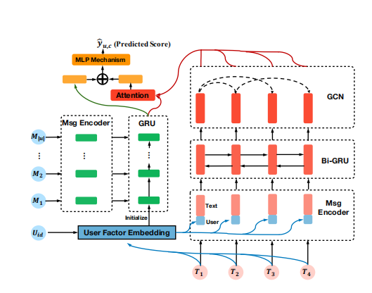
Method
Turn-level Modeling
For each turn t ∈ c, similar to message-level modeling , we use a CNN encoder over pre-trained word embeddings to capture content representation, . Further, is concatenated with author ’s user embedding to yield turn-level representation , conveying both what is said and who says that.

Slide 11
Method
Conversation-level Modeling
To explore turn interactions, we exploit turn’s chronological order and replying structure, both useful in conversation modeling

Slide 12
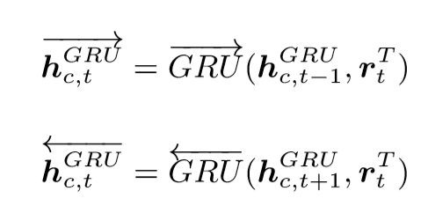
Method
Conversation-level Modeling

Slide 13
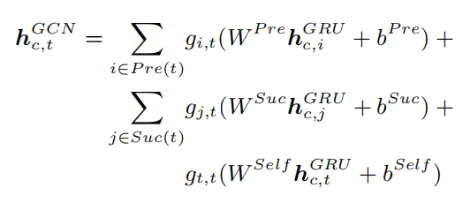
Method
Conversation-level Modeling

Slide 14
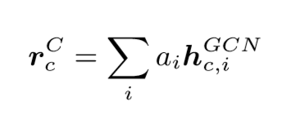
Method
Recommendation Prediction
Loss Function：weighted binary cross-entropy loss

Slide 15
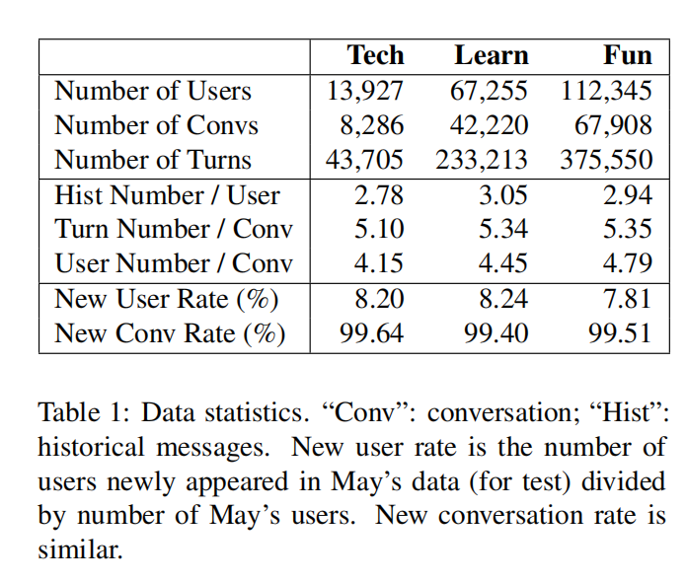
Experiment
Dataset

Slide 16
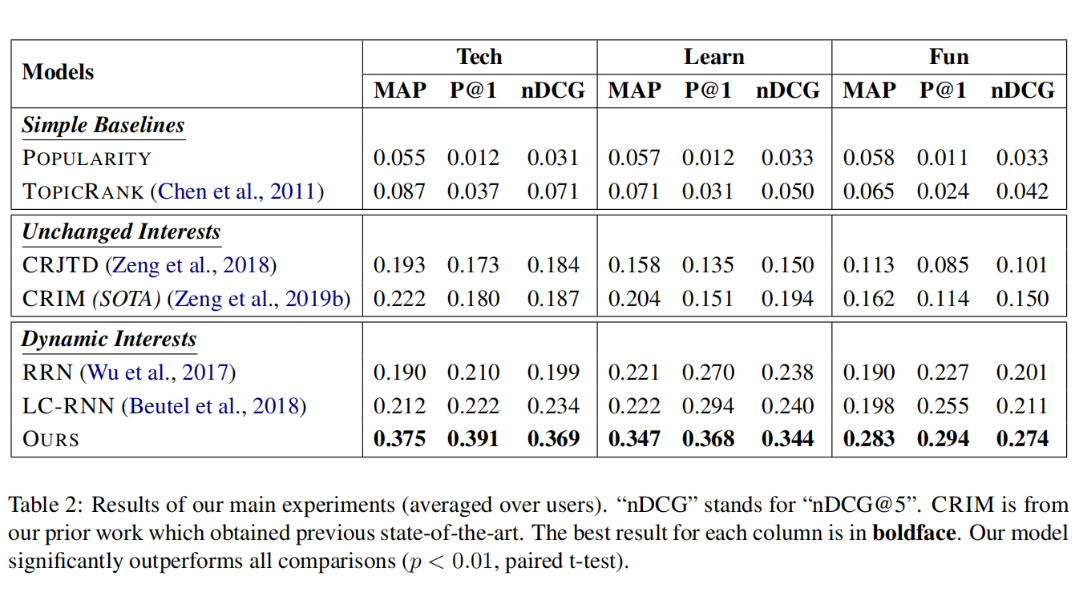
Experiment
The comparison results on all three datasets.

Slide 17
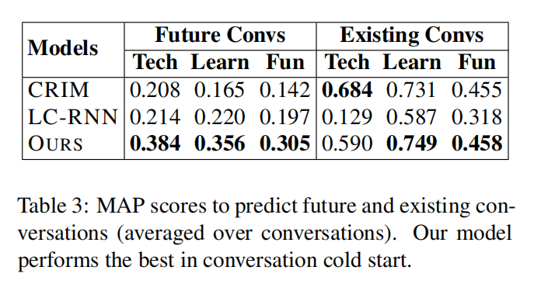
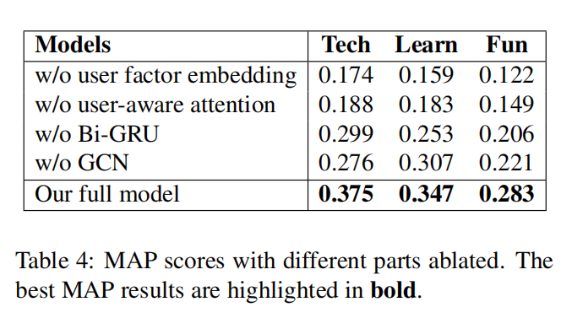
Experiment
Conversation Cold Start
Ablation Study

Slide 18
Conclusion
This paper presents a dynamic conversation recommendation model learned from the change of content and user interactions over time. Experimental results on three new datasets from Reddit show that our model significantly outperforms all comparisons, including previous state of the arts.Further discussion demonstrates the robustness of our model against history sparsity and cold start.We also analyze our model’s outputs to get more insights into user interest dynamics.

Slide 19
Chongqing University of Technology
ATAI
Advanced Technique of Artificial Intelligence
Chongqing University of Technology
Thank you!

