Slide 1
Hierarchical Matching Network for Crime Classification
SIGIR ’19, July 21–25, 2019, Paris, France
Session 3C: Fact-checking, Privacy and Legal
REPORTER：Jiangzhou Zhu

Slide 2
INTRODUCTION
APPROACH
CONTENT
EXPERIMENT
CONCLUSION
IMPROVEMENT
Hierarchical Matching Network for Crime Classification SIGIR ’19, July 21–25, 2019, Paris, France

Slide 3
1.INTRODUCTION
Hierarchical Matching Network for Crime Classification SIGIR ’19, July 21–25, 2019, Paris, France

Slide 4
Research Content
Chongqing University of Technology
Given the fact descriptions, one attempts to atomically determine the correct laws and articles violated, which can provide a handy reference for legal experts (e.g., lawyers and judges) and improve their working efficiency.
laws and articles are grouped into a two-layers’ tree hierarchy (i.e., laws as parent labels, articles as children labels) in judicial field, this task can be cast into a two layers’ hierarchical multi-label classification problem.
Hierarchical Matching Network for Crime Classification SIGIR ’19, July 21–25, 2019, Paris, France

Slide 5
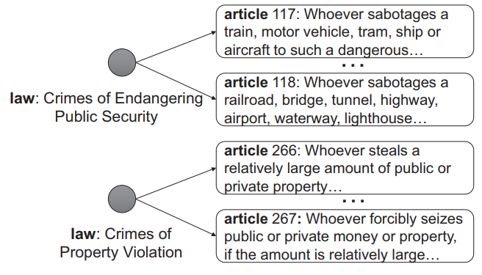
Figure 1: Hierarchical structure over laws and articles, which are extracted from Chinese Criminal Laws. Laws and articles are grouped into a tree-shaped structure, where laws are parent labels, articles are children labels. Each article only has one parent label
【Note: Figure 1 comes from this paper】
Hierarchical Matching Network for Crime Classification SIGIR ’19, July 21–25, 2019, Paris, France

Slide 6
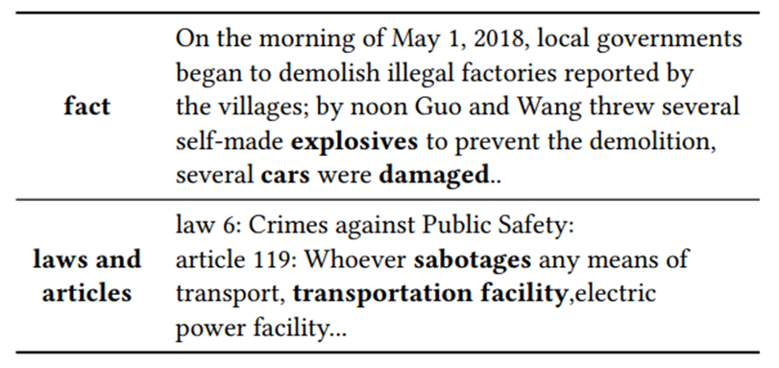
Table 1: An example of the judgment case, including a fact and labels violated. Words written in bold share similar semantics between the fact and labels.
【 Note: Table 1 comes from this paper 】
Hierarchical Matching Network for Crime Classification SIGIR ’19, July 21–25, 2019, Paris, France

Slide 7
2.APPROACH
Hierarchical Matching Network for Crime Classification SIGIR ’19, July 21–25, 2019, Paris, France

Slide 8
2.1 Formalization
Chongqing University of Technology
$X=\left\{x_{1},x_{2},…{,x}_{|X|}\right\}$
all the facts
$$P=\left\{p_{1},p_{2},…{,p}_{|P|}\right\}$$
all the parent labels (i.e, laws)
$$C=\left\{c_{1},c_{2},…{,c}_{|C|}\right\}$$
all the children labels (i.e, articles)
$C\left(p\right) →$ p’s children labels
$P\left(c\right) →$ c’s parent label
$\left\{x,Р_{x}, С_{x}\right\}→$ a instance
Where:
$x∈X$represents the fact;
$Р_{x}∈P$represents the parent label set of $x;$
$С_{x}∈C$represents the children label set of $x.$
Hierarchical Matching Network for Crime Classification SIGIR ’19, July 21–25, 2019, Paris, France

Slide 9
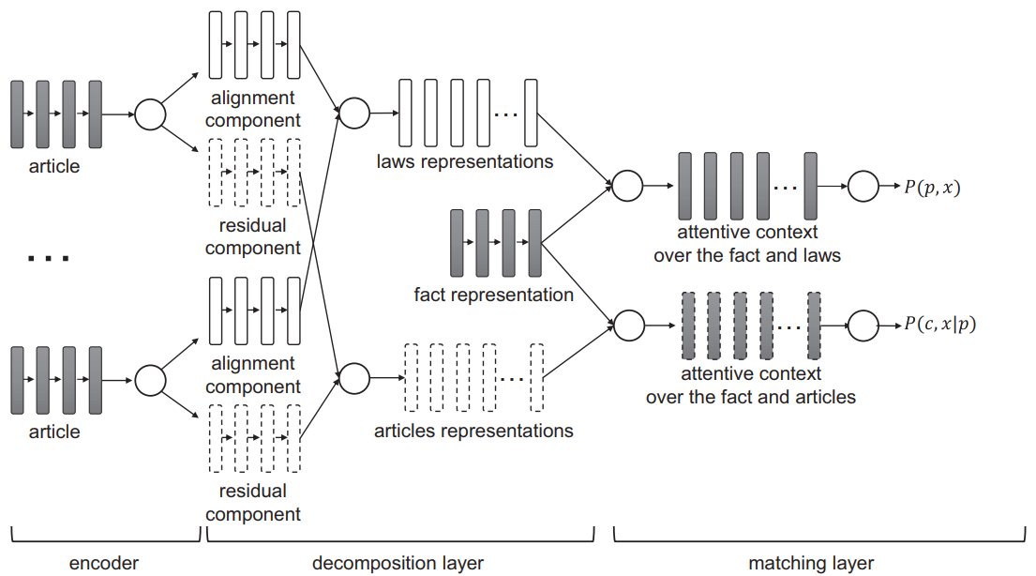
2.2 HMN Model
Chongqing University of Technology
Figure 2: Over architecture of Hierarchical Matching Network (HMN). HMN contains three layers for embedding and matching. The encoder layer obtains semantic matrices of articles and facts. In decomposition layer, alignment components of articles belonging to the same law are aggregated as the law representation, while residual components are aggregated as the article representation. The matching layer generates attentive contexts, and outputs relevance scores.
【Note: Figure 2 comes from this paper】
Hierarchical Matching Network for Crime Classification SIGIR ’19, July 21–25, 2019, Paris, France

Slide 10
2.2.1 Encoder Layer
Chongqing University of Technology
each children label $c∈C$and fact $x∈X$are described by a set of words
$V=\left\{v_{i}∈R^{D}|i=1,2,…\right\}$ denote all the word vectors in a D-dimensional continuous space
each fact $x$
$$V_{f}:[h_{f}\left(1\right),h_{f}\left(2\right),…,h_{f}\left(n\right)]$$
children label $c$
$$S_{c}:[h_{c}\left(1\right),h_{c}\left(2\right),…,h_{c}\left(m\right)]$$
where:
$h_{f}\left(t\right)=GRU\left(V_{t}:t∈x,V_{t}∈V,h_{f}\left(t−1\right)\right)$ （1）
Hierarchical Matching Network for Crime Classification SIGIR ’19, July 21–25, 2019, Paris, France

Slide 11
2.2.2 Decomposition Layer
Chongqing University of Technology
using the following cosine metric to measure the similarity between$c$and its sibling labels：
$a_{c,s}={\left(a_{c,s}\left(t\right)\right)}_{1×m}, where a_{c,s}\left(t\right)=\frac{h_{c}\left(t\right)∙h_{s}\left(m\right)}{\left\|h_{c}\left(t\right)\right\|∙\left\|h_{s}\left(m\right)\right\|}$ （2）
where：$s∈\left|SIB\left(c\right)\right|$ represents one sibling label of $c$
The alignment component of children label c ：$H_{c,a}=\left[h_{c,a}\left(1\right),h_{c,a}\left(2\right),…,h_{c,a}\left(m\right)\right]$
$h_{c,a}\left(t\right)=\frac{1}{\left|SIB\left(c\right)\right|}\sum_{s∈SIB\left(c\right)}{a_{c,s}\left(t\right)∙h_{c}\left(t\right)}$ （3）
The residual component for the children label c ：
$H_{c,r}=S_{c}−H_{c,a}$ （4）
Hierarchical Matching Network for Crime Classification SIGIR ’19, July 21–25, 2019, Paris, France

Slide 12
2.2.2 Decomposition Layer
Chongqing University of Technology
Then compress the alignment component $H_{c,a}$and residual component $H_{c,r}$ into single vectors to summarize all the information through the aggregation function $g\left(∙\right)$：
$$V_{c,a}=g\left(H_{c,a}\right)=\frac{1}{m}\sum_{t}{H_{c,a}\left(t\right)}$$
（5）
$$V_{c,r}=g\left(H_{c,r}\right)=\frac{1}{m}\sum_{t}{H_{c,r}\left(t\right)}$$
obtain all representations of parents $V_{P}$ and their children label sets $V_{C}：$
$$V_{P}=\left[V_{P_{1}},V_{P_{2}},…,V_{P_{\left|P\right|}}\right]$$
$$V_{C}=\left[V_{C\left(p_{1}\right)},V_{C\left(p_{2}\right)},…,V_{C\left(C_{\left|P\right|}\right)}\right]$$
Hierarchical Matching Network for Crime Classification SIGIR ’19, July 21–25, 2019, Paris, France

Slide 13
2.2.3 Matching Layer
Chongqing University of Technology
Purpose: select attentive semantics from both facts and labels to generate relevance scores
propose a co-attention mechanism to compute the affinity matrix:
$$M_{p,f}=V_{p}s\left({\left(V_{f}^{T}V_{P}\right)}^{T}\right)$$
$$M_{f,p}=V_{f}s\left(V_{f}^{T}V_{P}\right)$$
（6）
$$M_{c,f}=V_{C\left(p\right)}s\left({\left(V_{f}^{T}V_{C\left(p\right)}\right)}^{T}\right)$$
$$M_{f,c}=V_{f}s\left(V_{f}^{T}V_{C\left(p\right)}\right)$$
HMN outputs the relevance scores of $\left(x,p\right)$ and $\left(x,c\right)$ through the sigmoid function $σ\left(∙\right)$
$$P\left(x,p\right)= σ\left(W_{p}∙V_{f,p}\right)=σ\left(W_{p}∙\left[g\left(M_{f,p}\right);g\left(M_{p,f}\right)\right]\right)$$
（7）
$$P\left(c,x|p\right)= σ\left(W_{c}∙V_{f,c}\right)=σ\left(W_{c}∙\left[g\left(M_{f,c}\right);g\left(M_{c,f}\right)\right]\right)$$
$$L\left(\left\{x,P_{x},C_{x}\right\}\right)=\sum_{x∈X}{\left(\sum_{p∈P_{x}}{\left(lnP\left(p,x\right)−\sum_{\overline{p}∈S\left(P\right)}{lnP\left(\overline{p},x\right)}\right)}+\sum_{c∈C_{x}}{\left(ln P\left(c,x|p\right)−\sum_{\overline{c}∈SIB\left(c\right)}{ln P\left(\overline{c},x|p\right)}\right)}\right)}$$
（8）
Hierarchical Matching Network for Crime Classification SIGIR ’19, July 21–25, 2019, Paris, France

Slide 14
2.3 Learning and Prediction
Chongqing University of Technology
the best parent label set is a combination of assignments with the highest score from each parent label given the input:
$O_{P}\left(x,p\right)=\sum_{p∈P}{I\left(P\left(p,x\right)>δ_{p}\right)}$ （9）
the children label set is obtained as follows:
$O_{C}\left(x,c\right)=\sum_{p∈P_{x}^{∗}}{\sum_{c∈C\left(p\right)}{I\left(P\left(c,x|p\right)>δ_{c}\right)}}$ （10）
where：$P_{x}^{∗}=\max_{p∈P}O_{P}\left(x,p\right)$
Hierarchical Matching Network for Crime Classification SIGIR ’19, July 21–25, 2019, Paris, France

Slide 15
3.EXPERIMENT
Hierarchical Matching Network for Crime Classification SIGIR ’19, July 21–25, 2019, Paris, France

Slide 16
3.1 Dataset
Chongqing University of Technology
• Fraud and Civil Action
comprises 40,256 criminal cases related with fraud, civil action, etc. These data are crawled from China Judgment Online and span from Jan.2016 to June. 2016.
• CAIL
contains criminal cases published by the Supreme People’s Court. Each case consists of two parts, i.e., fact description and corresponding judgment result (including laws, articles, and charges).
Table 2: Statistics of the two legal datasets for experiments.
【 Note: Table 2 comes from this paper 】
Hierarchical Matching Network for Crime Classification SIGIR ’19, July 21–25, 2019, Paris, France

Slide 17
3.2 Evaluation Metric\Parameter Settings
Chongqing University of Technology
【evaluation metrics】
macro Precision (Macro-P), macro Recall (Macro-R),
macro F-measure (Macro-F) and Jaccard
【Parameter】
for each fact description, set n=500
for each children label definition, set m=30
Hierarchical Matching Network for Crime Classification SIGIR ’19, July 21–25, 2019, Paris, France

Slide 18
3.3 Analysis on the HMN
Chongqing University of Technology
Table 3: Performance comparison over HMN-I and HMN on crime classification in terms of different evaluation metrics on two datasets. The best performance in each case is written in bold. (All the values in the table are percentage numbers with % omitted)
Decomposition Strategy HMN performs obviously better than HMN-I on article and law classification
【 Note: Table 3 comes from this paper 】
Hierarchical Matching Network for Crime Classification SIGIR ’19, July 21–25, 2019, Paris, France

Slide 19
3.3 Analysis on the HMN
Chongqing University of Technology
Table 4: Performance comparison of HNM-R and HMN over two datasets (all the values in the table are percentage numbers with% omitted). Best performance is written in bold.
Label Definitions HMN outperforms HMN-R on all evaluation metrics
【 Note: Table 4 comes from this paper 】
Hierarchical Matching Network for Crime Classification SIGIR ’19, July 21–25, 2019, Paris, France

Slide 20
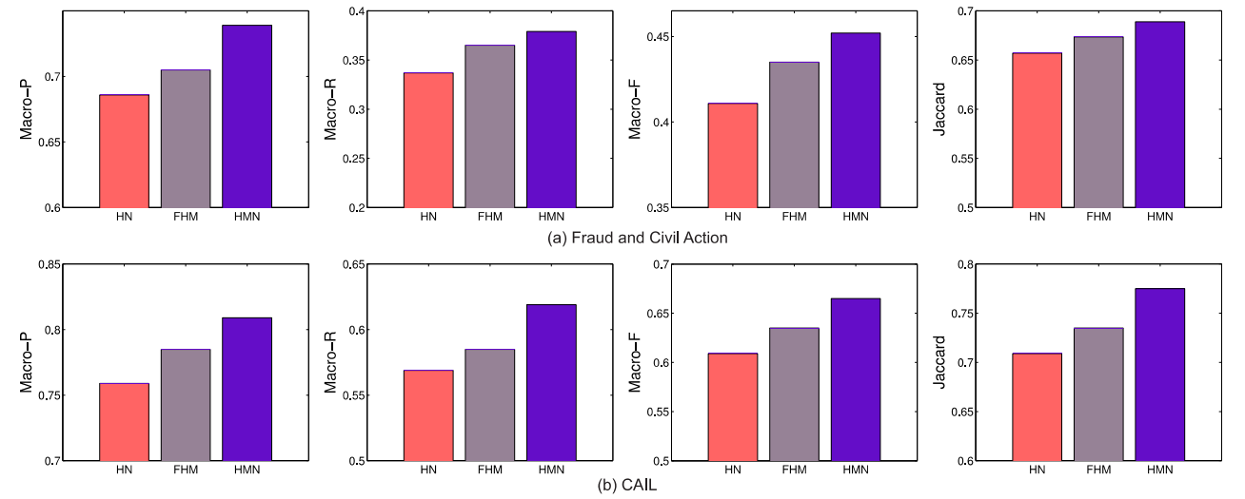
3.3 Analysis on the HMN
Chongqing University of Technology
Figure 3: Performance comparison of the final HMN model with its two sub-variant models FMN and HN on two datasets in terms of Marco-P, Macro-R, Macro-F, and Jaccard.
Semantics VS Hierarchical Structure HMN performs better than HN and FHM on both datasets
【 Note: Figure 3 comes from this paper 】
Hierarchical Matching Network for Crime Classification SIGIR ’19, July 21–25, 2019, Paris, France

Slide 21
3.4 Comparison against Baselines
Chongqing University of Technology
Table 5: Performance on crime classification between the baselines and our model (all the values in the table are percentage numbers with% omitted). The best performance in each case is written in bold. The last column shows the percentage improvement of our results against the best baseline, which are significant at p-value≤0.05.
HMN outperforms all the baseline methods in terms of all the evaluation measures on two datasets.
【 Note: Table 5 comes from this paper 】
Hierarchical Matching Network for Crime Classification SIGIR ’19, July 21–25, 2019, Paris, France

Slide 22
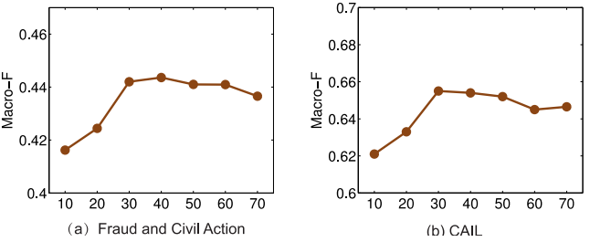
3.5 Impact of Label Definition Size
Chongqing University of Technology
Figure 4: Performance variation in terms of Macro-F against the article definition size on two datasets. X-axis represents the definition size, which is increased from 10 to 70.
【 Note: Figure 4 comes from this paper 】
Hierarchical Matching Network for Crime Classification SIGIR ’19, July 21–25, 2019, Paris, France

Slide 23
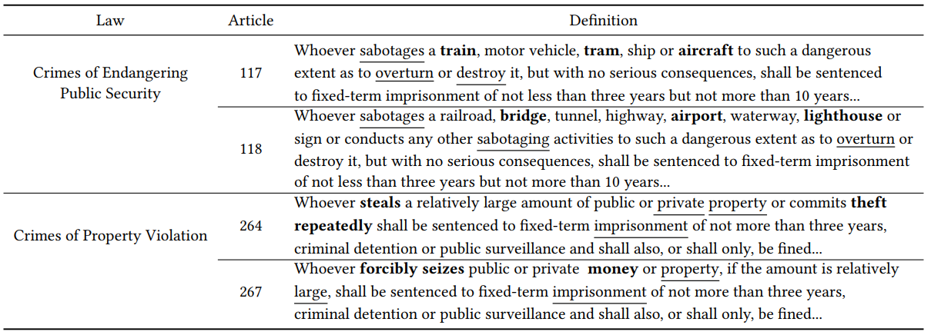
3.6 Case Study
Chongqing University of Technology
Table 6: Semantics analysis among article definitions. According to the attention weight learned in decomposition layer, words written in bold represent Top-3 significant words representing semantics of articles, while words underline are Top-3 significant words representing laws.
【 Note: Table 6 comes from this paper 】
Hierarchical Matching Network for Crime Classification SIGIR ’19, July 21–25, 2019, Paris, France

Slide 24
4.CONCLUSION
Hierarchical Matching Network for Crime Classification SIGIR ’19, July 21–25, 2019, Paris, France

Slide 25
Conclusion
Chongqing University of Technology
By designing a decomposition strategy, HMN decomposes article definitions into the residual and alignment components.
The residual components capture unique characteristics of articles, while alignment components are aggregated to form law representations. A co-attention mechanism is finally applied to generate relevance scores for matching.
HMN model has better effect on crime classification than other models.
Hierarchical Matching Network for Crime Classification SIGIR ’19, July 21–25, 2019, Paris, France

Slide 26
5.IMPROVEMENT
Hierarchical Matching Network for Crime Classification SIGIR ’19, July 21–25, 2019, Paris, France

Slide 27
Improvement
Chongqing University of Technology
HMN concerns a shallow hierarchical structure, only dependencies between laws and articles are concerned. In the future, we will introduce more subtasks (i.e. such as charges, fines, and the term of penalty) in legal judgment, and analyze the impact of their dependencies for crime classification.
Hierarchical Matching Network for Crime Classification SIGIR ’19, July 21–25, 2019, Paris, France

Slide 28
THANKS
Hierarchical Matching Network for Crime Classification SIGIR ’19, July 21–25, 2019, Paris, France

