Slide 1
Chongqing University of Technology
ATAI
Advanced Technique of Artificial Intelligence
Chongqing University of Technology
Graph Convolutional Networks for Text Classification
The Thirty-Third AAAI Conference on Artificial Intelligence (AAAI-19)
Reported by Haoming Wu

Slide 2
Chongqing University of Technology
ATAI
Advanced Technique of Artificial Intelligence
Chongqing University of Technology
1.Introduction
2.Method
3.Result
4.Advantage and Disadvantage

Slide 3
Introduction
Text classification is a fundamental problem in natural language processing (NLP).
opinion mining
news filtering
spam detection
A lot of research has been done before this.
hand-crafted features
deep learning models
graph neural networks
Recently,graph neural networks or graph embeddings has attracted wide attention.

Slide 4
Method
图片来源于网络

Slide 5
Method
图片来源于网络

Slide 6
Method
图片来源于网络

Slide 7
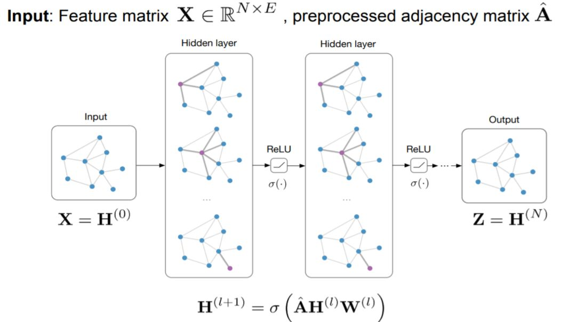
Method
Convert to formula
$H^{0}$=$X$
$H^{1}$=$σ(\hat{A}XW_{0})$
$H^{(L+1)}$=$σ(\hat{A}H^{L}W_{L})$
$\hat{A}$=$D^{−\frac{1}{2}}AD^{−\frac{1}{2}}$
$D_{ii}$=$\sum_{j}{A_{ij}}$
Z=softmax($\hat{A}$ReLU($\hat{A}XW_{0}$)$W_{1}$)
$ℒ$=$\sum_{d∈y_{D}}{\sum_{f=1}^{F}{Y_{df}lnZ_{df}}}$
图片来源于网络

Slide 8
Method

Slide 9
Result

Slide 10
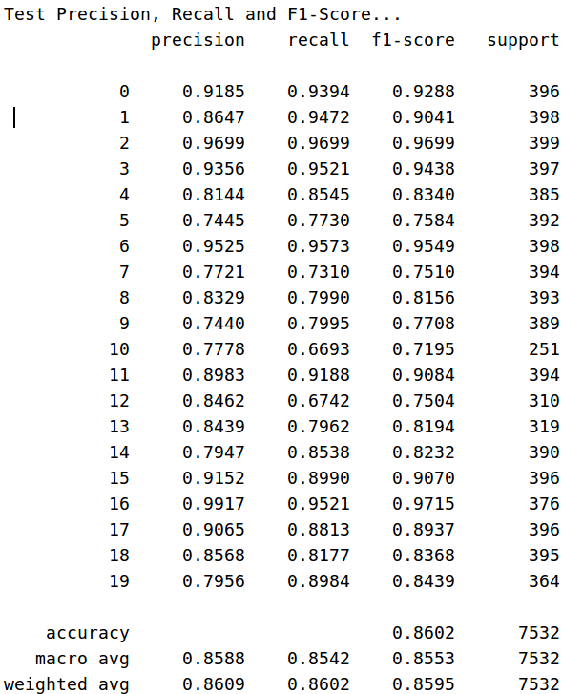
Result
Classification effect on 20ng

Slide 11
Result

Slide 12
Advantage and Disadvantage
Advantage
This is the first study to model a whole corpus as a heterogeneous graph and learn word and document embeddings with graph neural networks jointly.
Our method also learns predictive word and document embeddings automatically.
Disadvantage
Ignore the order factor between words and words.
Cannot deepen the number of network layers.

