Slide 1
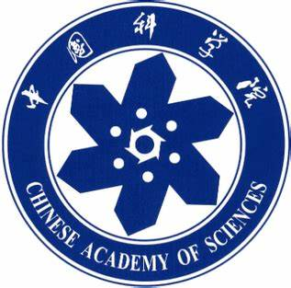
Chongqing University of Technology
ATAI
Advanced Technique of Artificial Intelligence
Chongqing University of Technology
Multi-Task Feature Learning for Knowledge Graph Enhanced Recommendation
World-Wide Web Conference (WWW-2019)
Reported by Ting Wang

Slide 2
Chongqing University of Technology
ATAI
Advanced Technique of Artificial Intelligence
Chongqing University of Technology
1.Introduction
2.Method
3.Experiments
4.Conclusion

Slide 3
Introduction
Background:
The most popular recommendation techniques in RS is collaborative filtering (CF) .However,CF-based methods usually suffer from the sparsity of user-item interactions and the cold start problem.

Slide 4
Introduction
Contribution:
Exactly modeling the problem as multi-task learning: finding that the inter-task similarity is helpful to not only recommender systems but also knowledge graph embe-dding.

Slide 5
Introduction-Related Work
Multi-Task Learning:
1.Feature learning approach
2.Low-rank approach
3.Task clustering approach
4.Task relation learning approach
5.Decomposition approach

Slide 6
Introduction-Related Work
Knowledge Graph Embedding:
1.Distance-based scoring functions,such as TransX.
2.Semantic matching models,such as RESCAL,ANALOGY.

Slide 7
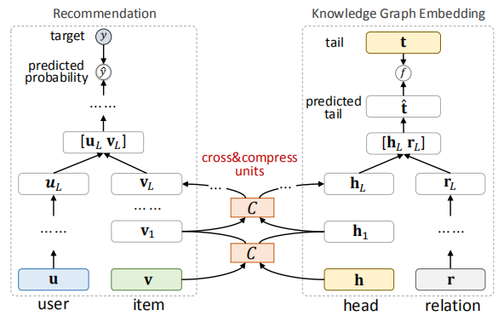
Method

Slide 8
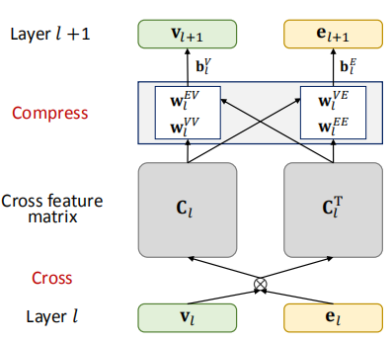
Method-Cross&compress Unit

Slide 9
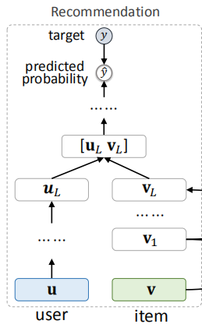
Method-Recommendation Module

Slide 10
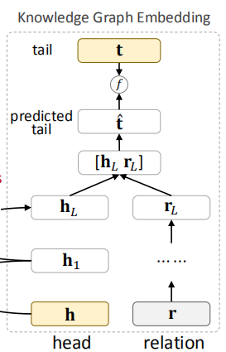
Method-KGE

Slide 11
Experiments

Slide 12
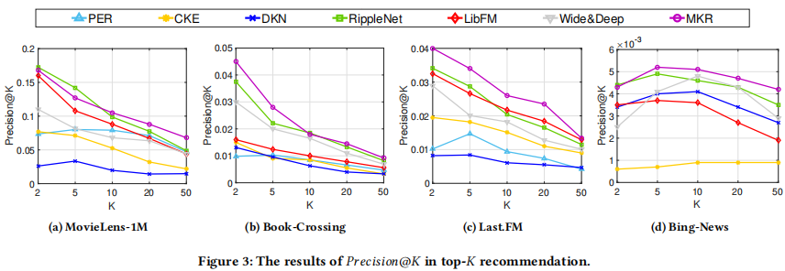
Experiments

Slide 13
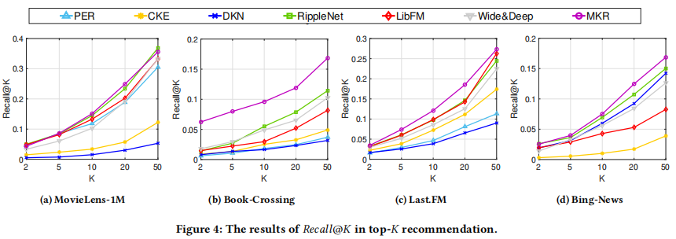
Experiments

Slide 14
Thank you!

