Slide 1
Chongqing University of Technology
Chongqing University of Technology
Investigating Passage-level Relevance and Its Role in Document-level Relevance Judgment
SIGIR ’19, July 21–25, 2019, Paris, France
Reporter: Li Tong

Slide 2
·INTRODUCTION
·DATASET
·WORK
·CONCLUSION

Slide 3
INTRODUCTION
FORMER WORK:
based on document-level signals
OTHER WORK:
·the highest passage-level relevance score
·AR principle and DRD/CRD principle
·the generalized mean aggregation operator
·discourse units
·neural models
·… …

Slide 4
INTRODUCTION
• RQ1: What is the relationship between document-level relevance and the relevance of passages composed of the document?
• RQ2: Can we promote the performance of document ranking with the help of this relationship?

Slide 5
DATASET
1.CONSTRUCT DATASET
DOCUMENT: THUCNews a Chinese news datasets
·split less than 4 and more than 20
·calculate BM25 scores
·randomly sample 15 from top 20
QUERY: 10-day query logs of commercial search engine
(set background、domain、query type)
·70 intermediate-frequency
·intellectual and factual

Slide 6
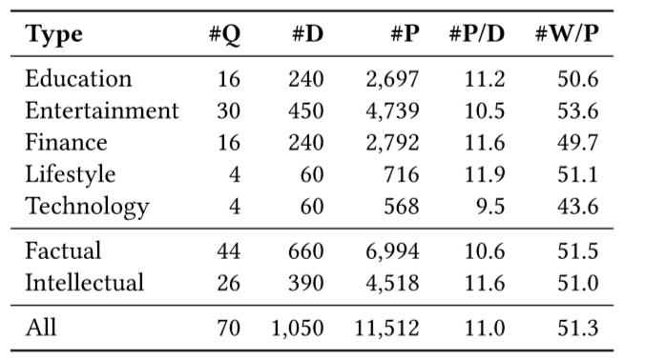
DATASET

Slide 7
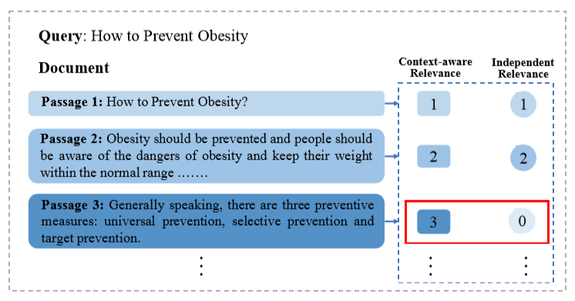
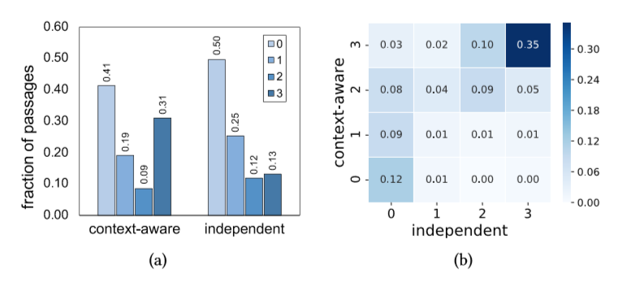
DATASET
2.RELEVANCE ANNOTATION
examine the query background type
(0)Irrelevant (1)Marginally relevant (2) Fairly relevant (3)Highly relevant
Whether the context information should be provided?

Slide 8
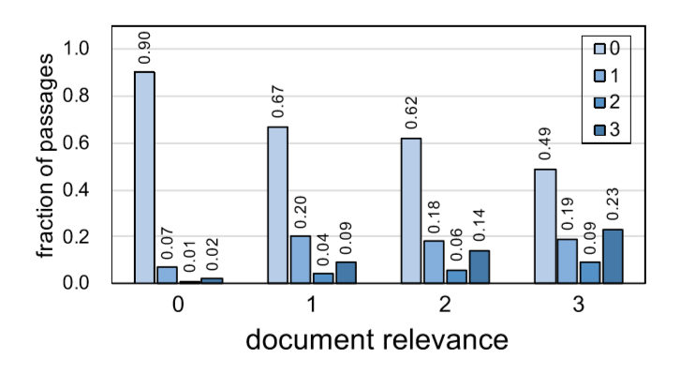
WORK
1.Passage-level Relevance Distribution

Slide 9
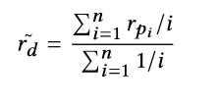
WORK
2.Passage-level Relevance Aggregation
method: minimum maximum median mean
Document-Level Relevance:
Position decay:
Passage length

Slide 10
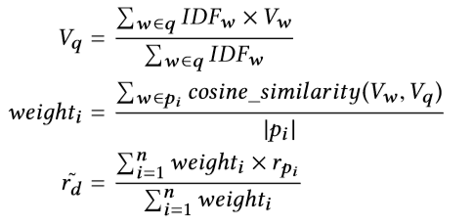
WORK
2.Passage-level Relevance Aggregation
Exact match:
Query similarity:

Slide 11
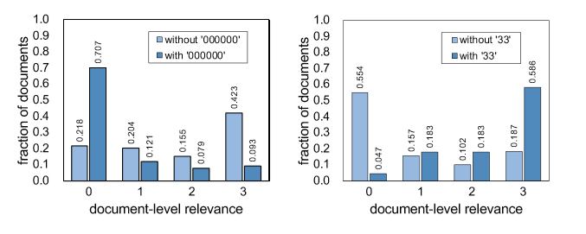
WORK
3.Passage-level Relevance Sequence

Slide 12
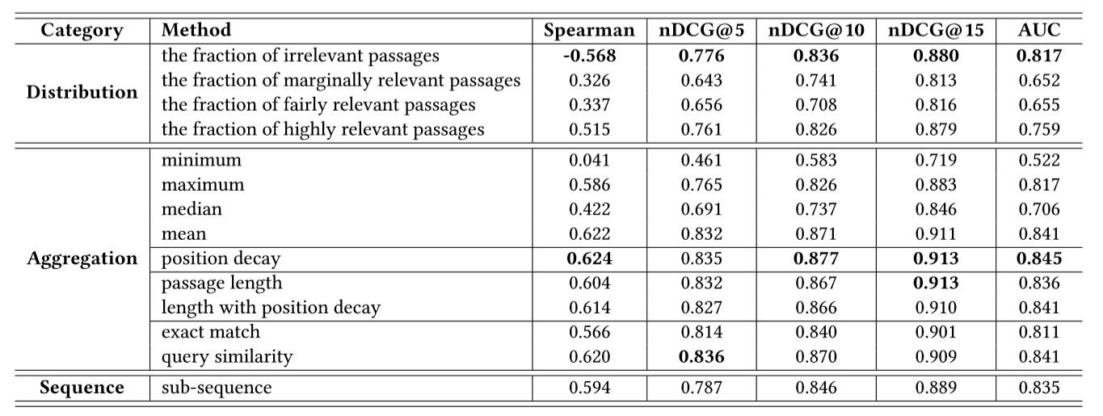
WORK
4.Analysis on Query Types

Slide 13
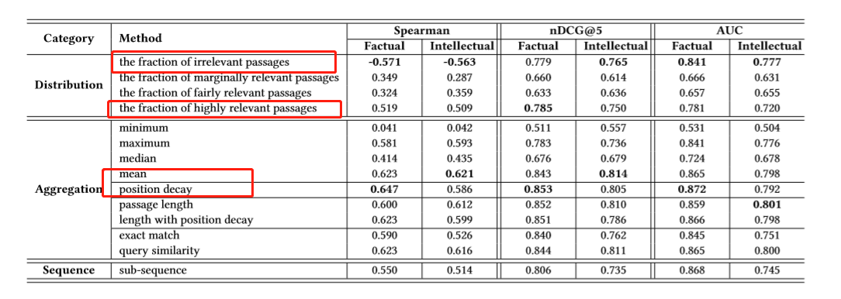
WORK
4.Analysis on Query Types

Slide 14
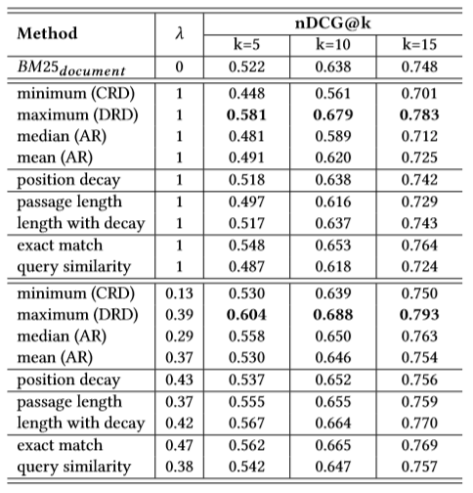
PERFORMANCE

Slide 15
Conclusion
Shortage:
·Chinese news data
·some features of passage
·time-consuming and expensive to annotate
Future work:
·more features eg: context information
·behavior patterns eg:eye movement

Slide 16
Thanks
18

